Slide 1
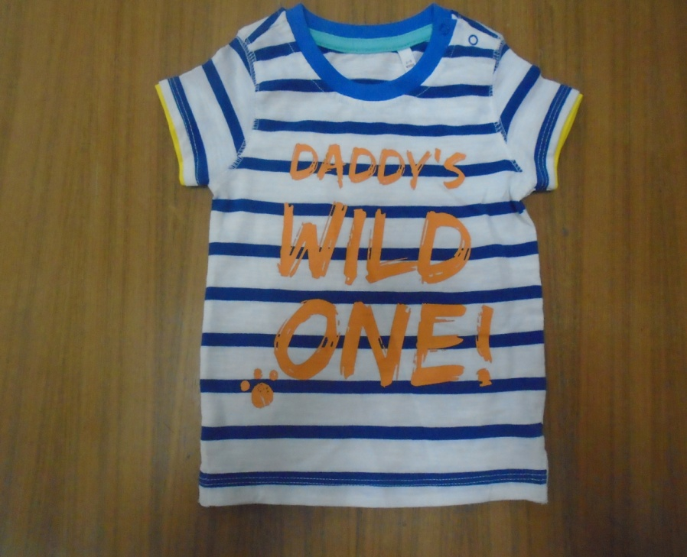
Hatem Fashion Ltd.
STYLE: BHS-01
FABRIC: 100% SLUB COTTON S/JERSEY 180 GSM
REMARKS:

Slide 2
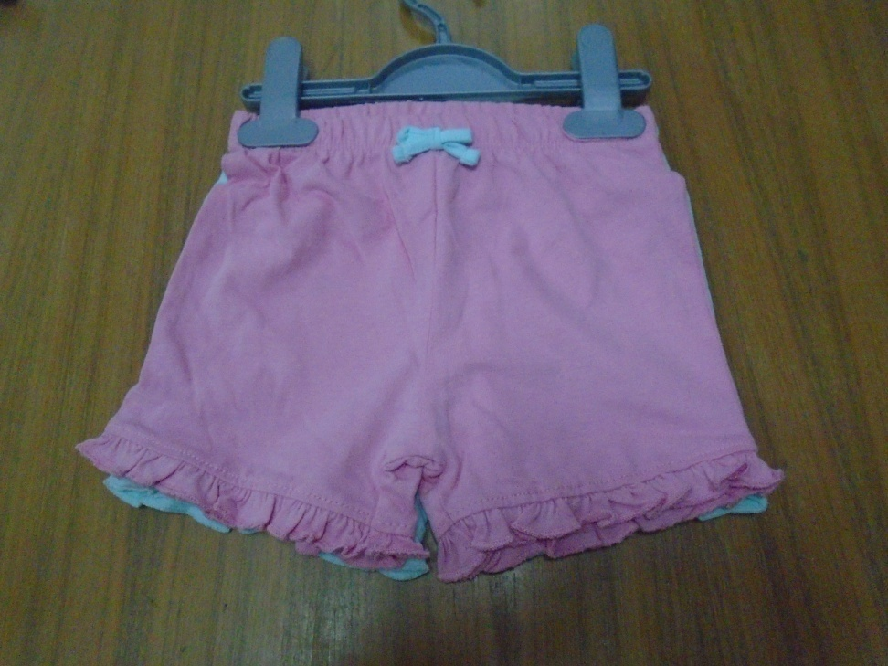
Hatem Fashion Ltd.
STYLE:BHS-02
FABRIC:100% COTTON S/JERSEY PEACHED 180 GSM
REMARKS: TWO PCS PACK WITH HANGER

Slide 3
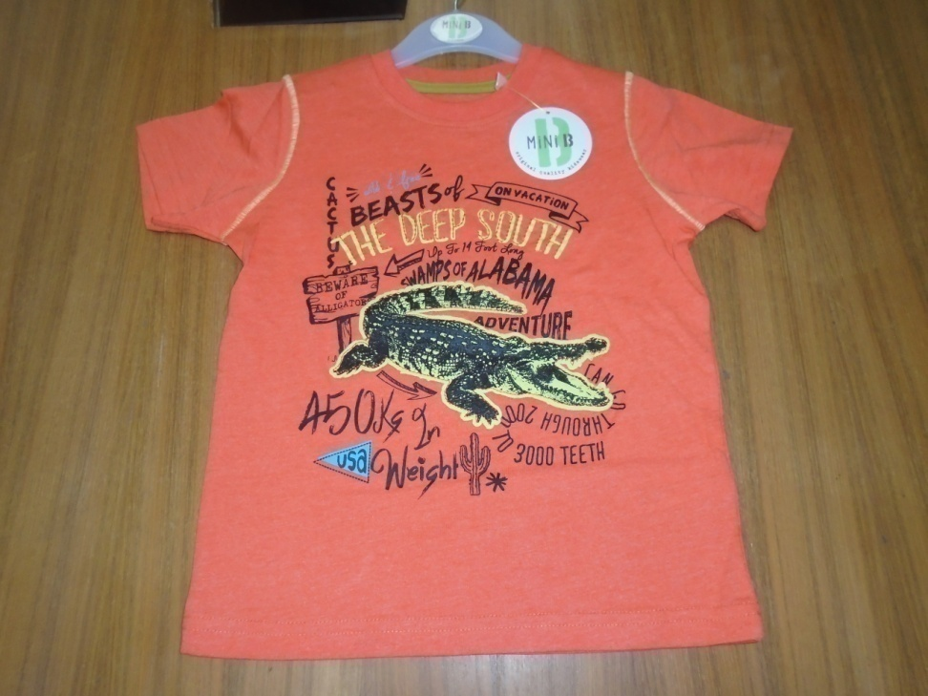
Hatem Fashion Ltd.
STYLE: BHS-3
FABRIC:60% COTTON 40% POLYESTER S/JERSEY 160 GSM
REMARKS:

Slide 4
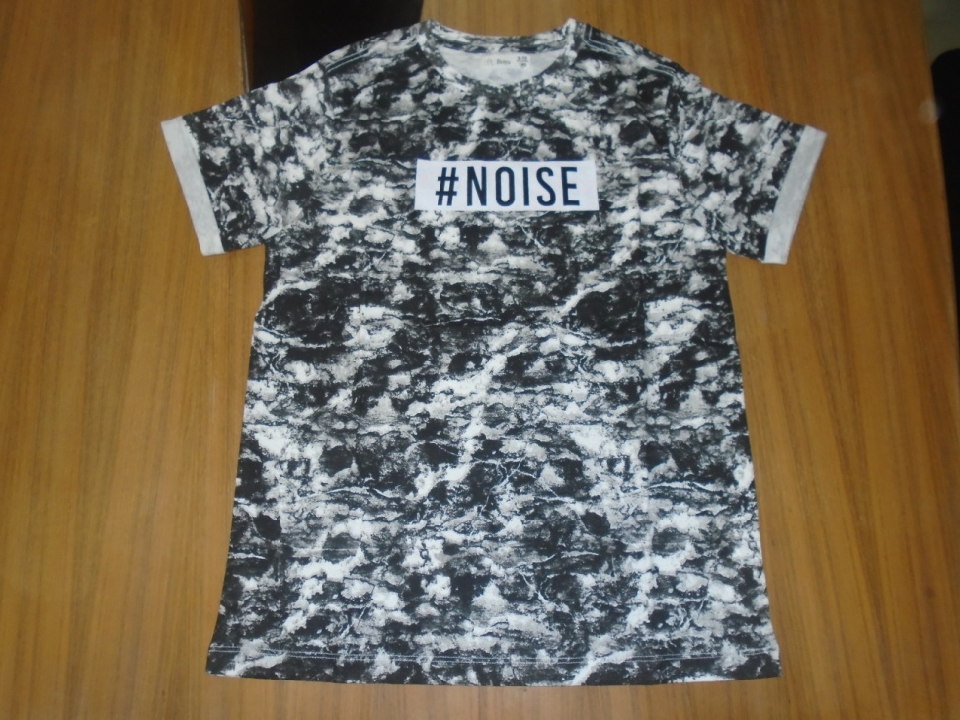
Hatem Fashion Ltd.
STYLE: 66069-K
FABRIC:100% cotton S/J with AOP 140 gsm.
REMARKS:

Slide 5
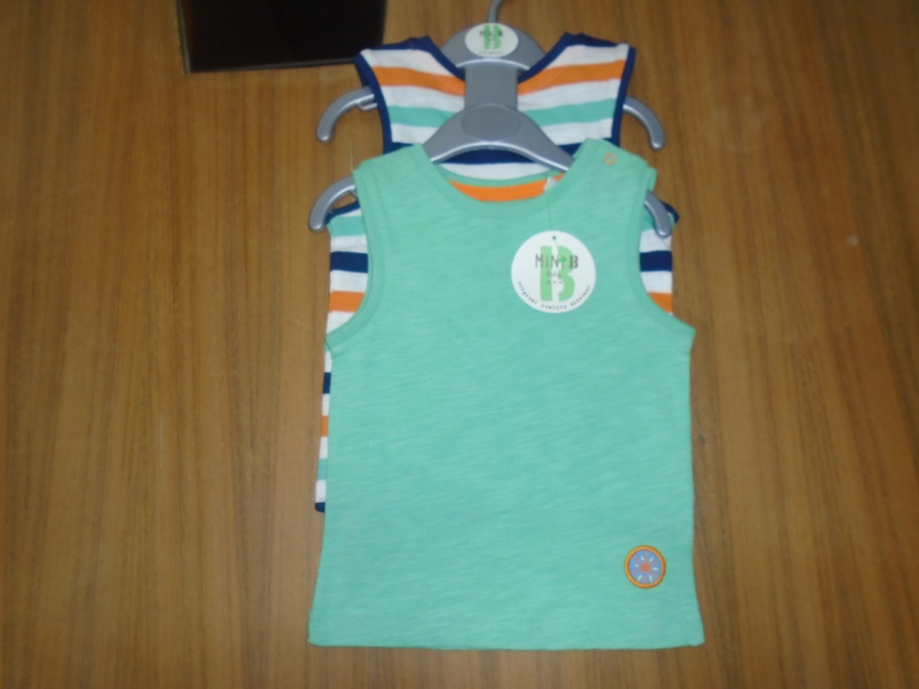
Hatem Fashion Ltd.
STYLE: BHS-04
FABRIC:100% COTTON SLUB S/JERSEY 180 GSM
REMARKS: TWO PCS PACK

Slide 6
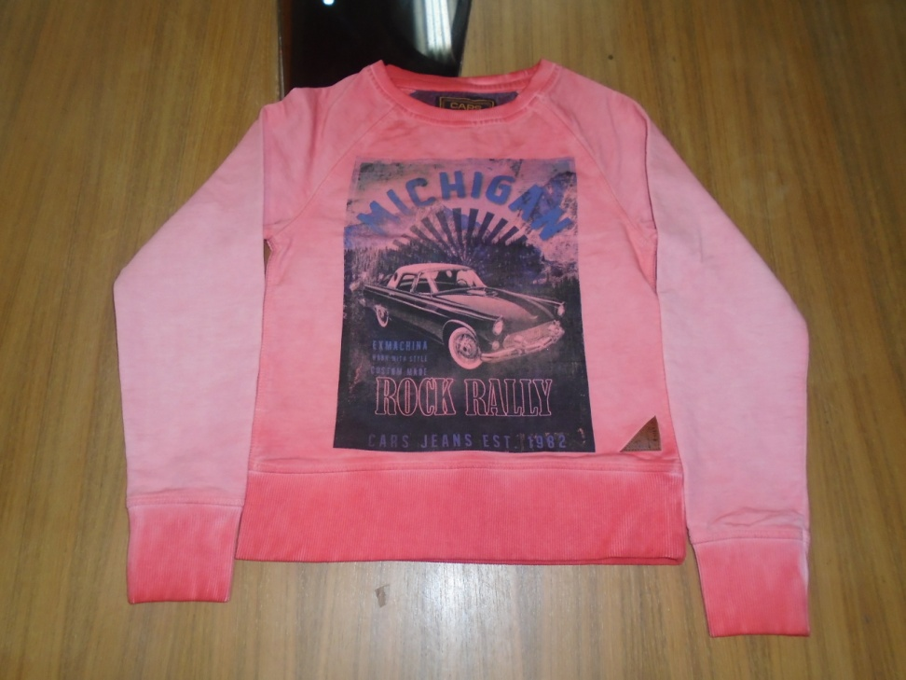
Hatem Fashion Ltd.
STYLE: GLEN WOOD
FABRIC:100% Ctn,Terry,280 GSM.
REMARKS: CPD Inside Out. Chest Photo Print.

Slide 7
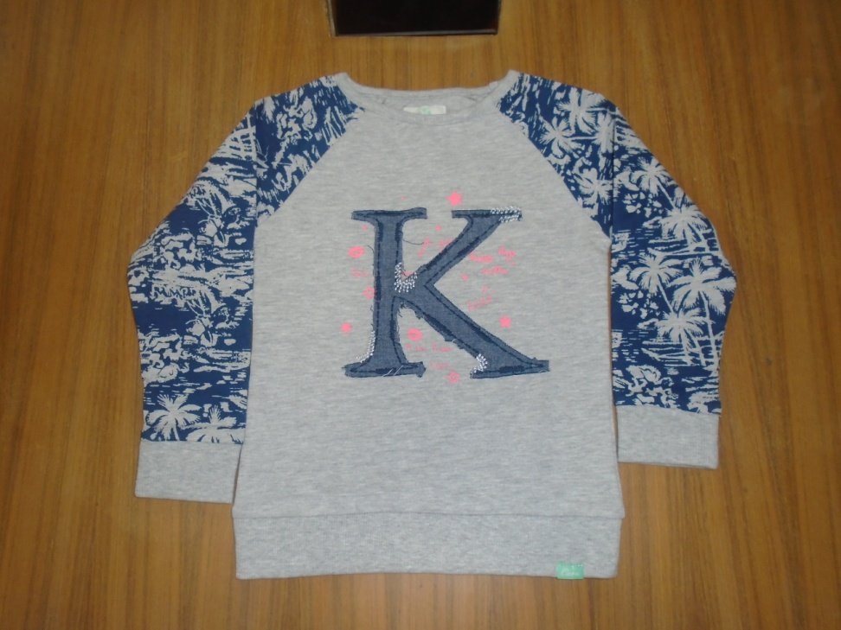
Hatem Fashion Ltd.
STYLE: CHARVI
FABRIC:90% Ctn,10% viscose, Terry,230 Gsm.
REMARKS:

Slide 8
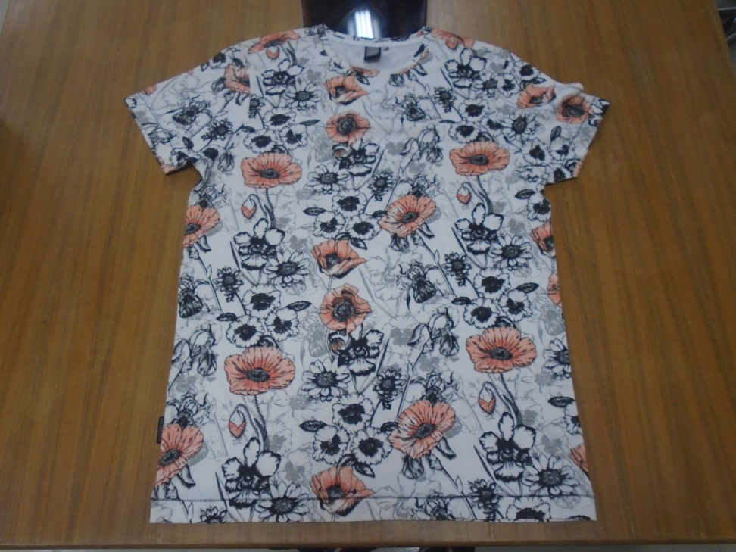
Hatem Fashion Ltd.
STYLE: CLASSY
FABRIC:100% COTTON S/JERSEY 160 GSM
REMARKS:

Slide 9
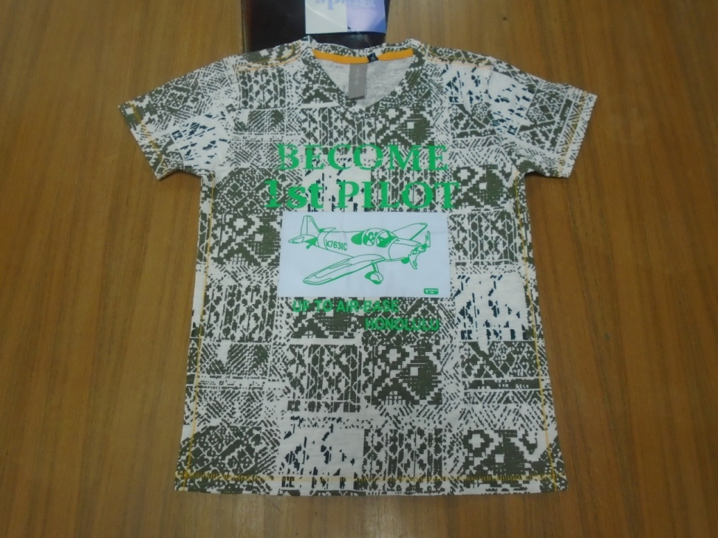
Hatem Fashion Ltd.
STYLE: ARMO
FABRIC:100% COTTON SLUB S/JERSEY 140 GSM
REMARKS:

Slide 10
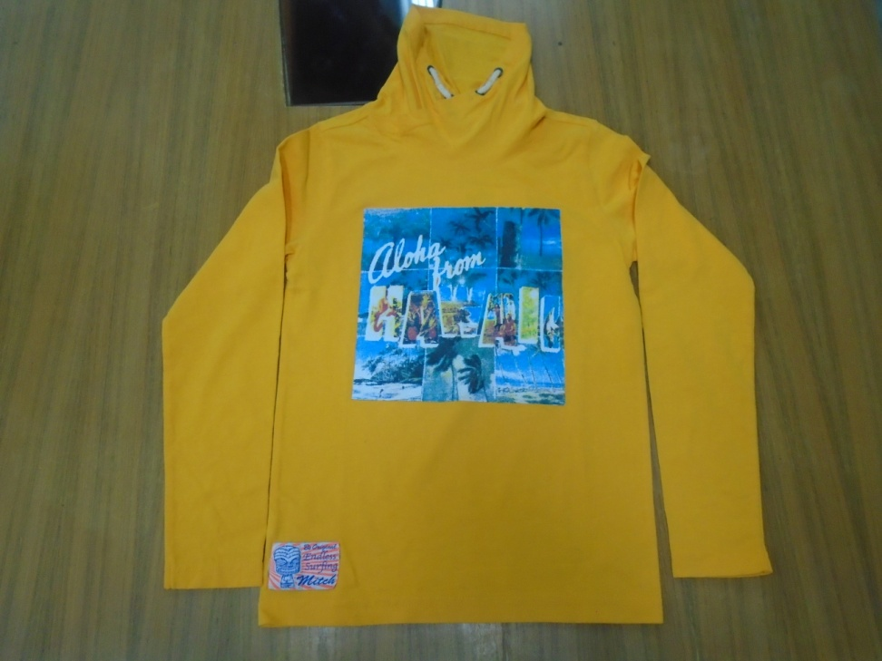
Hatem Fashion Ltd.
STYLE: COLLIN BOYS
FABRIC:100% COTTON S/JERSEY PEACHED 180 GSM
REMARKS:

Slide 11
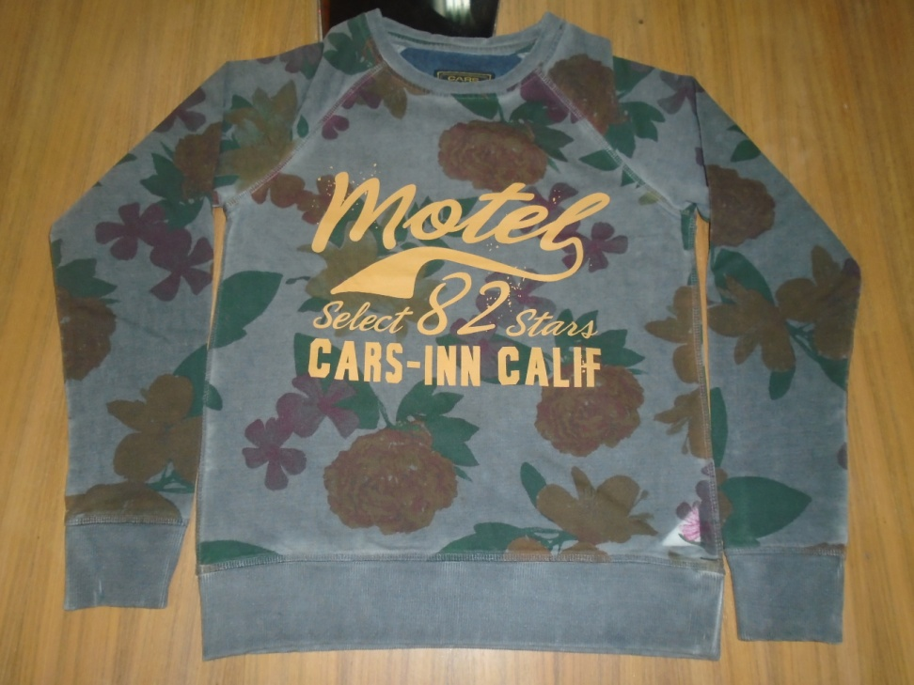
Hatem Fashion Ltd.
STYLE: ANZA
FABRIC:100% CTN, Terry, 280 GSM.All Over Print.
REMARKS:

Slide 12
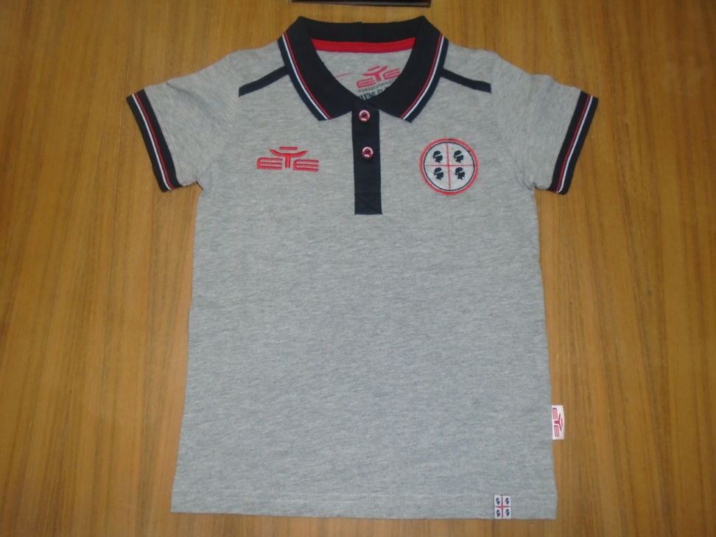
Hatem Fashion Ltd.
STYLE: PL02
FABRIC:85% COTTON 15% VISCOSE S/JERSEY 160 GSM
REMARKS:

Slide 13
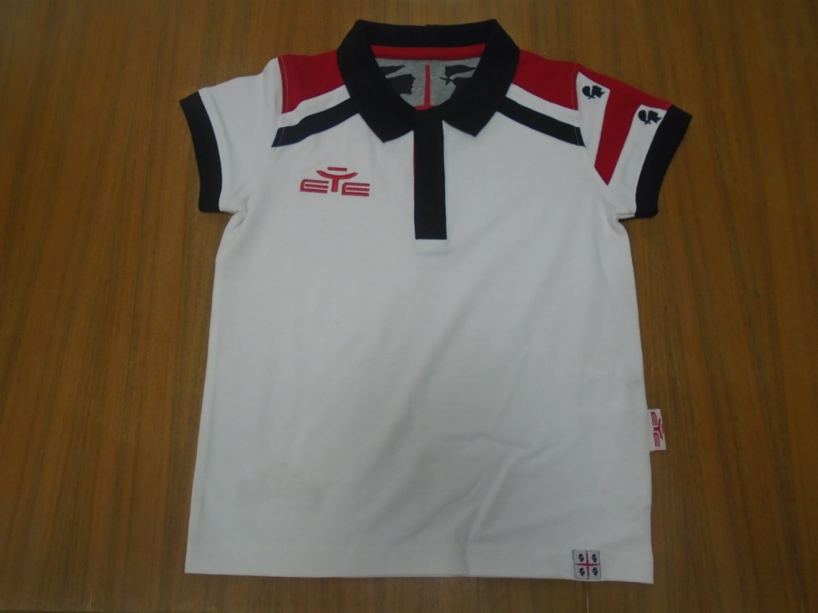
Hatem Fashion Ltd.
STYLE: PL03
FABRIC:95% COTTON 5% ELASTANE S/JERSEY 180 GSM
REMARKS:

Slide 14
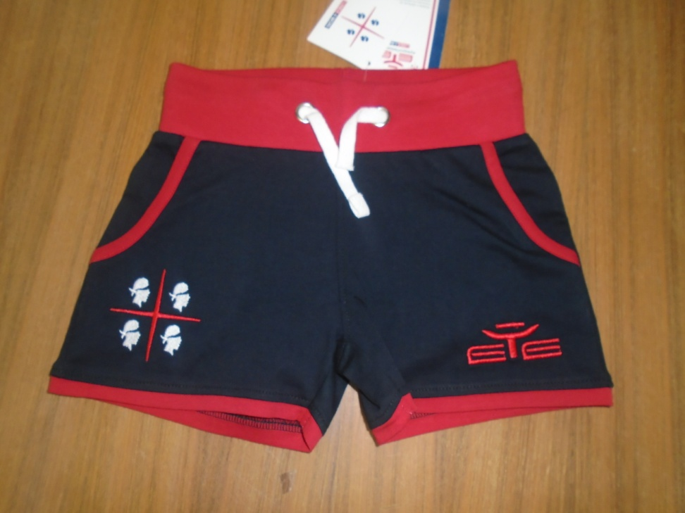
Hatem Fashion Ltd.
STYLE:SM01W
FABRIC:100% COTTON 220 GSM
REMARKS:

Slide 15
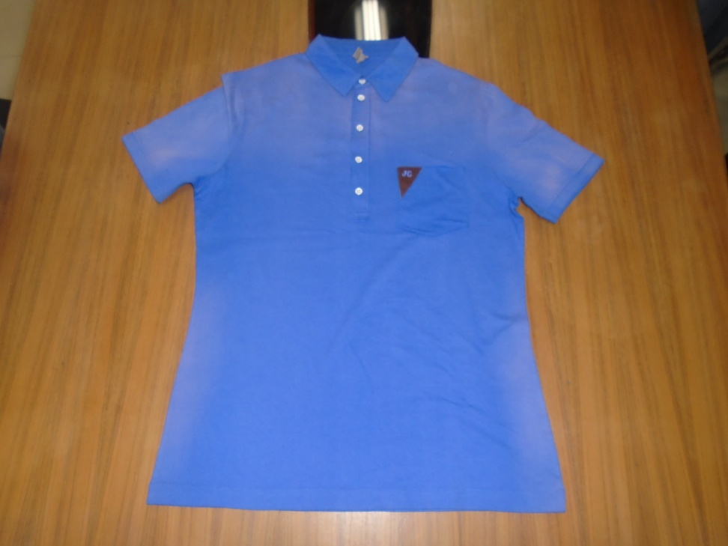
Hatem Fashion Ltd.
STYLE: Arma(Annette)
FABRIC:100%ctn s/j 160 gsm
REMARKS:With spray wash

Slide 16
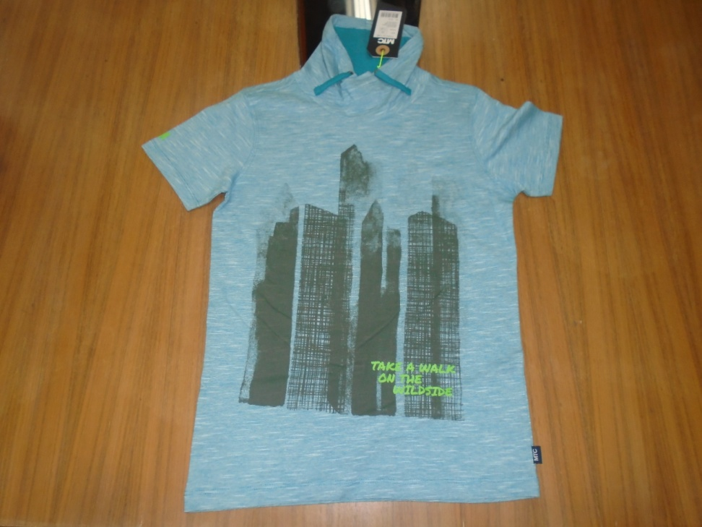
Hatem Fashion Ltd.
STYLE: Tyder(Shoeby)
FABRIC:100%ctn slub Y/D160 gsm.
REMARKS:pin stripe

Slide 17
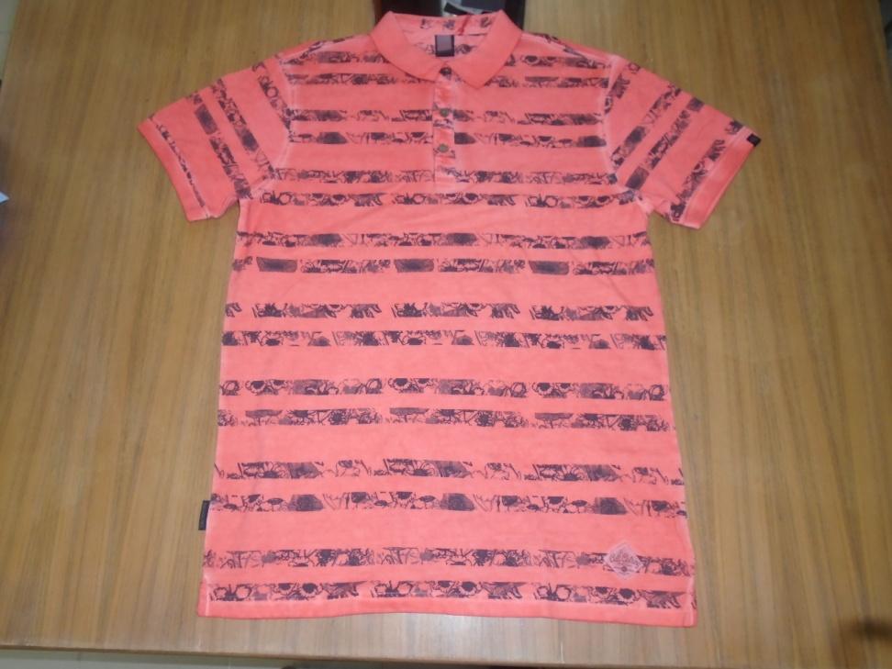
Hatem Fashion Ltd.
STYLE: CASE POLO(Shoeby)
FABRIC:100%ctn pique 180gsm
REMARKS:CPD-AOP

Slide 18
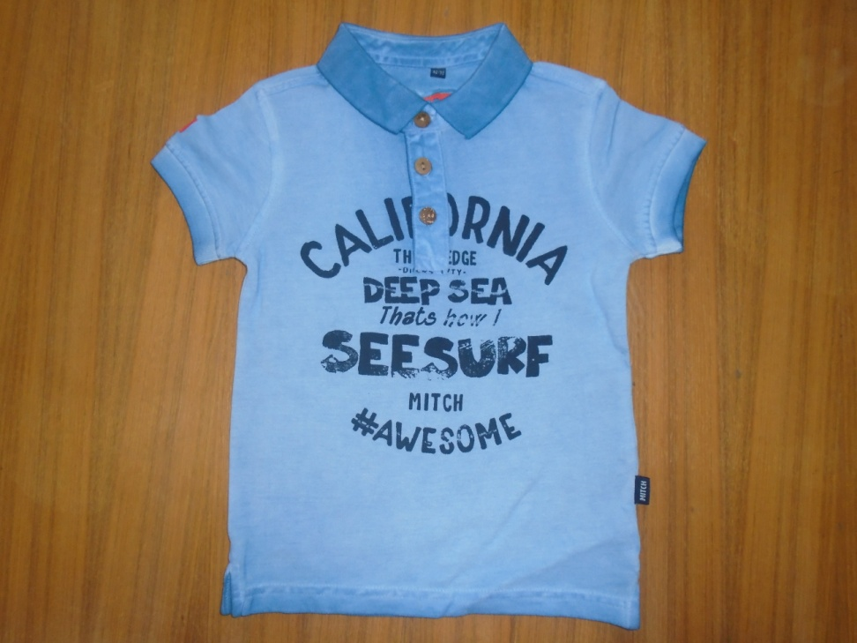
Hatem Fashion Ltd.
STYLE: CAINE POLO(Shoeby)
FABRIC:100%ctn pique 180gsm
REMARKS: CPD

Slide 19
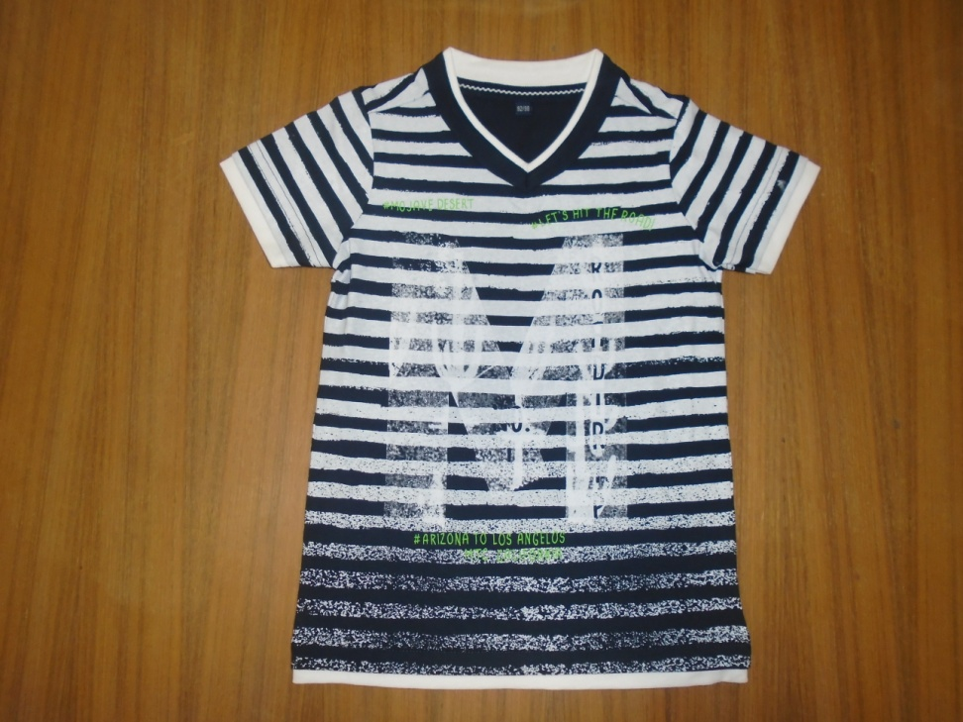
Hatem Fashion Ltd.
STYLE:Tarlo(Shoeby)
FABRIC:STYLE:100%CTN S/J 160 gsm
REMARKS: Screen gradient -Aop

Slide 20
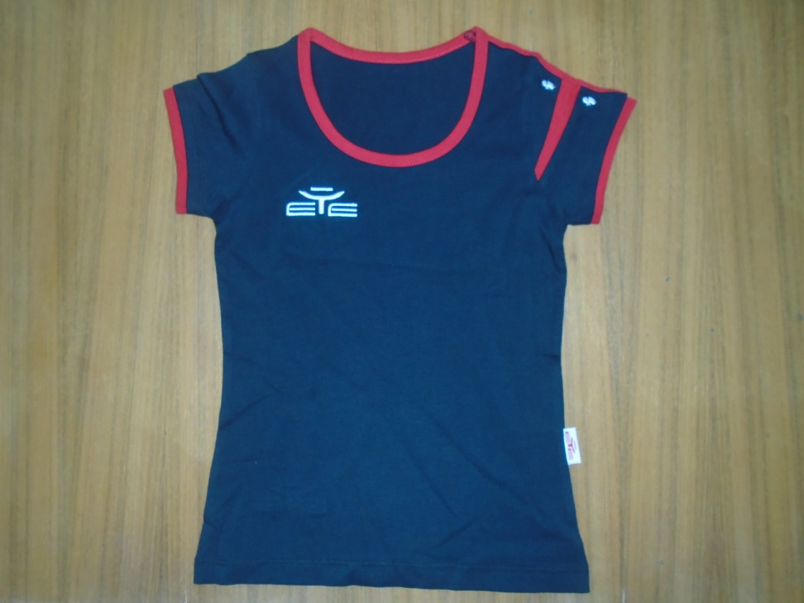
Hatem Fashion Ltd.
STYLE:TS01W
FABRIC:100% COTTON S/J,160 GSM
REMARKS:

Slide 21
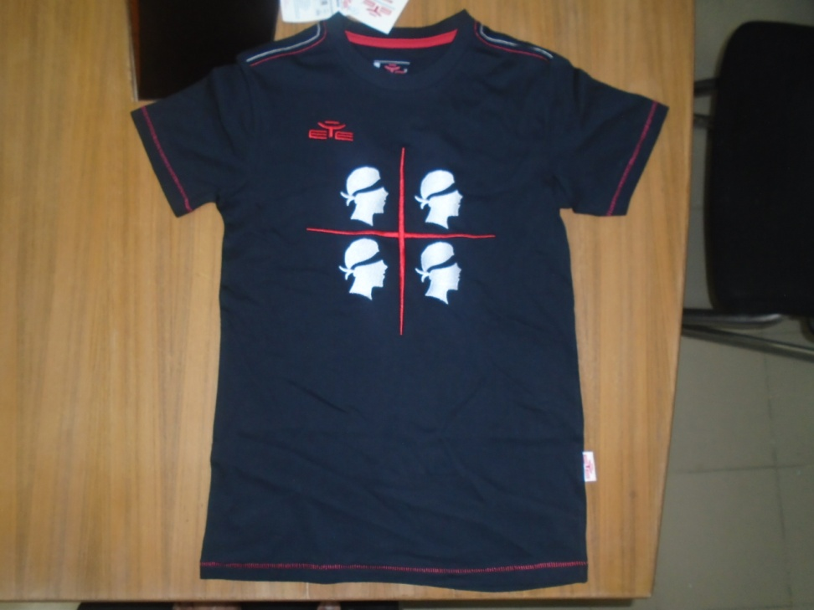
Hatem Fashion Ltd.
STYLE: T-SHIRT SCANTU
FABRIC:100% COTTON S/J,160 GSM
REMARKS:

