Slide 1
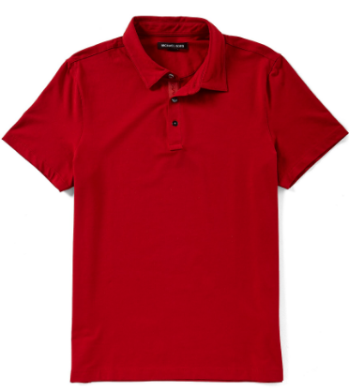
Hatem Fashion Ltd.
STYLE: TBD25
FABRIC:100%ctn pique 180gsm
REMARKS:

Slide 2
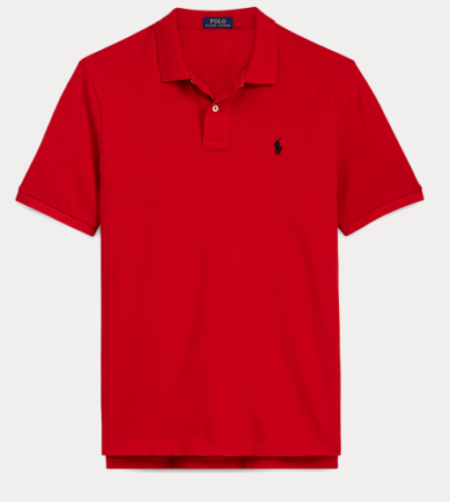
Hatem Fashion Ltd.
STYLE: TBD26
FABRIC:100%ctn pique 180gsm
REMARKS:

Slide 3
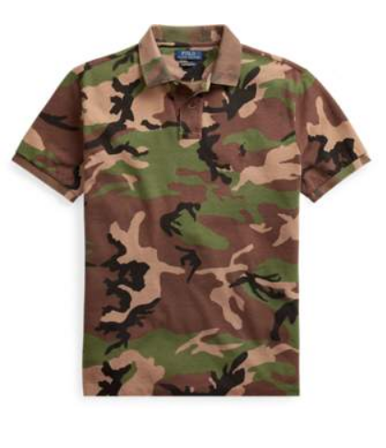
Hatem Fashion Ltd.
STYLE: TBD27
FABRIC:85% COTTON 15% VISCOSE S/JERSEY 180 GSM
REMARKS:

Slide 4
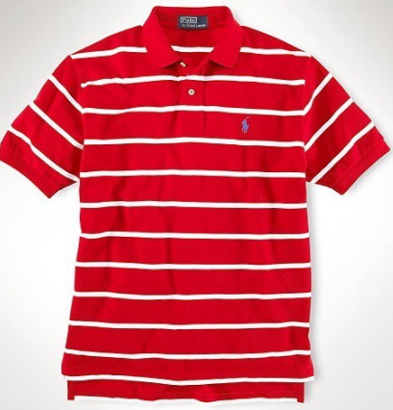
Hatem Fashion Ltd.
STYLE: TBD28
FABRIC:100%ctn pique 180gsm
REMARKS:

Slide 5
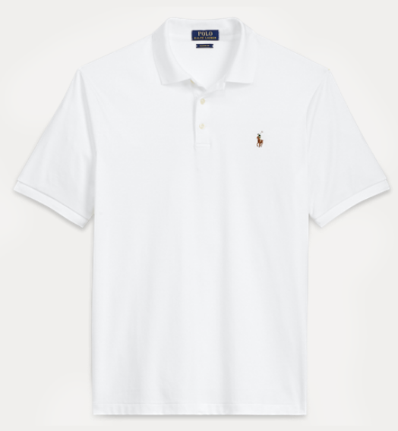
Hatem Fashion Ltd.
STYLE: TBD29
FABRIC:100%ctn pique 180gsm
REMARKS:

Slide 6
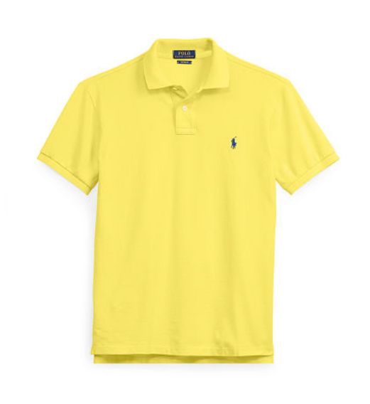
Hatem Fashion Ltd.
STYLE: TBD30
FABRIC:100%ctn pique 180gsm
REMARKS:

Slide 7
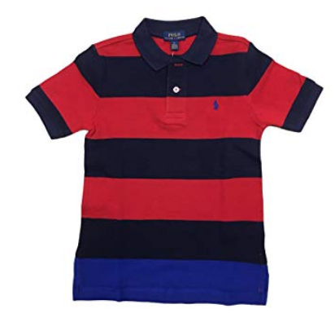
Hatem Fashion Ltd.
STYLE: TBD31
FABRIC:85% COTTON 15% VISCOSE S/JERSEY 160 GSM
REMARKS:

Slide 8
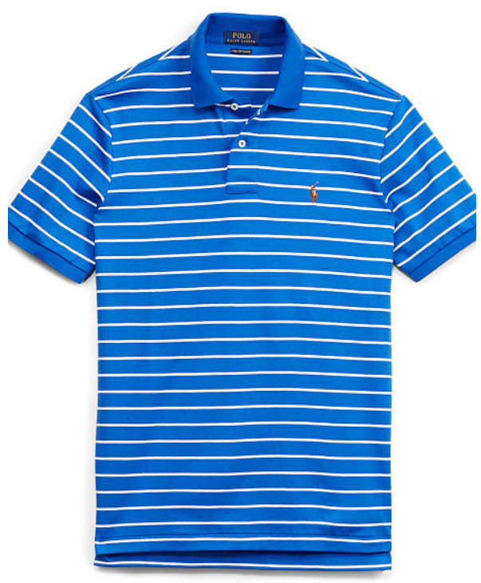
Hatem Fashion Ltd.
STYLE: TBD31
FABRIC:100%ctn pique 180gsm
REMARKS:

Slide 9
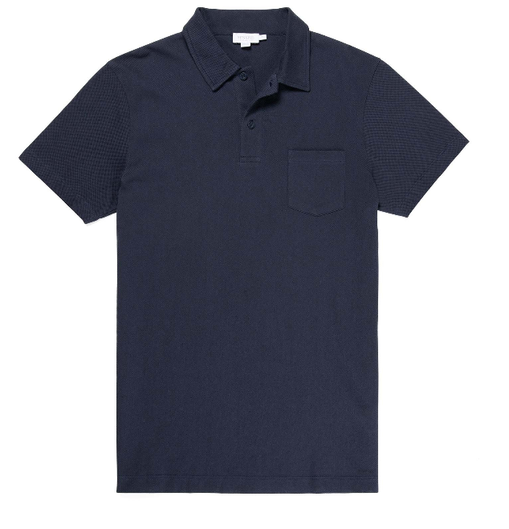
Hatem Fashion Ltd.
STYLE: TBD31
FABRIC:100%ctn pique 180gsm
REMARKS:

Slide 10
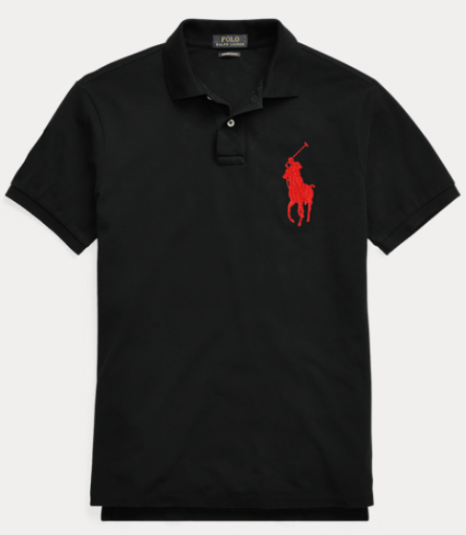
Hatem Fashion Ltd.
STYLE: TBD31
FABRIC:100%ctn pique 180gsm
REMARKS:

