Slide 1
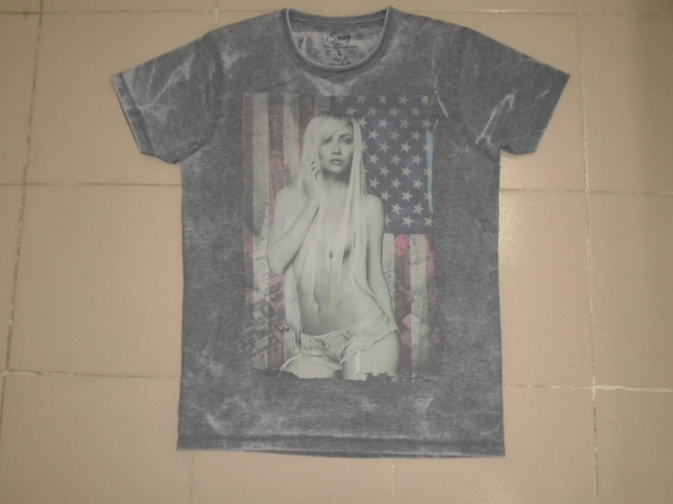
Hatem Fashion Ltd.
STYLE: 19-RE-702
FABRIC: 65% POLYESTER 35% CTN S/JERSEY 160GSM
REMARKS: GARMENTS BURN OUT AND BIG PHOTO PRINT ON CHEST.

Slide 2
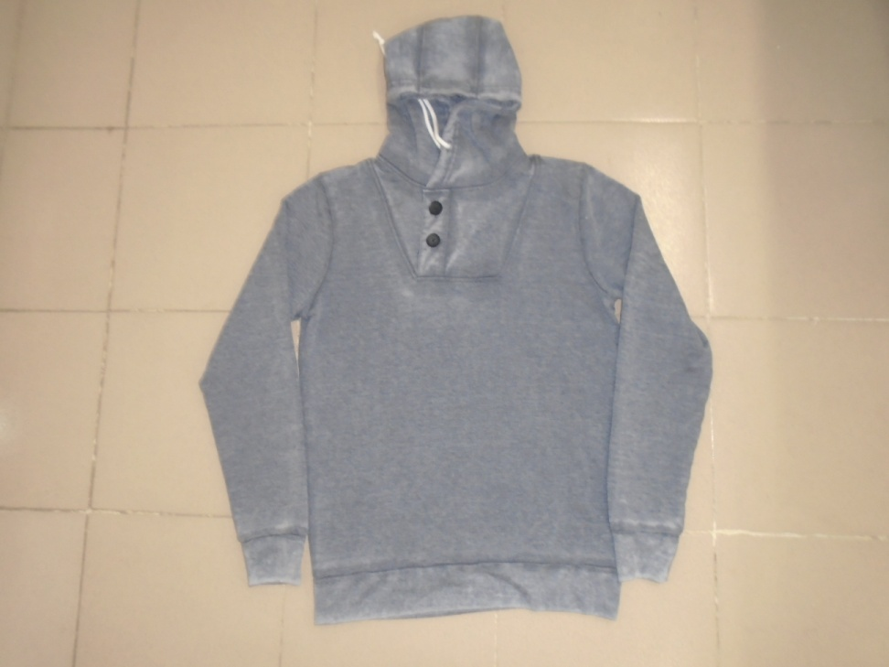
Hatem Fashion Ltd.
STYLE: 25-109
FABRIC: 65% POLYESTER 35% COTTON FLEECE INSIDE BRUSH 260 GSM
REMARKS: GARMENTS BURN OUT

Slide 3
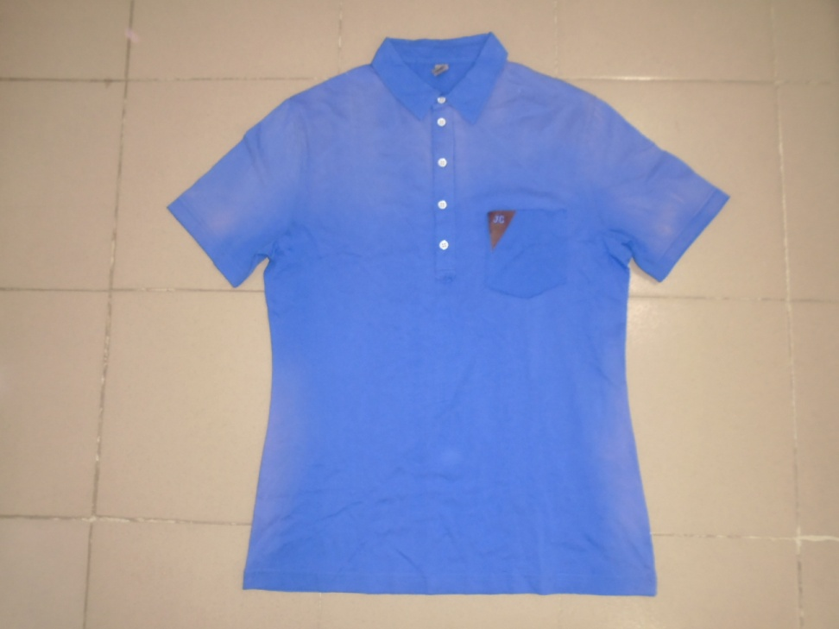
Hatem Fashion Ltd.
STYLE: ARMA (ANNETTE)
FABRIC: 100% COTTON S/JERSEY 160 GSM
REMARKS: SPRAY WASH

Slide 4
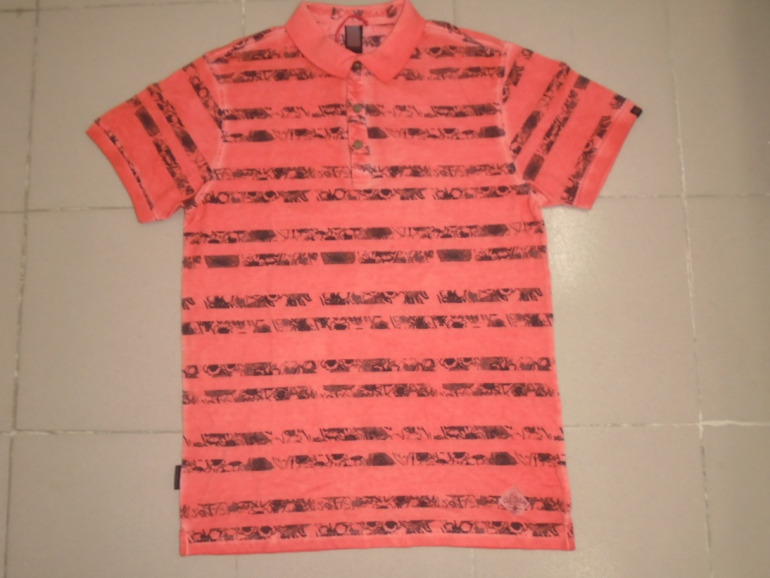
Hatem Fashion Ltd.
STYLE: CASE POLO(SHOBEY)
FABRIC: 100% COTTON PIQUE 180 GSM
REMARKS: COLD PIGMENT DYED AOP

Slide 5
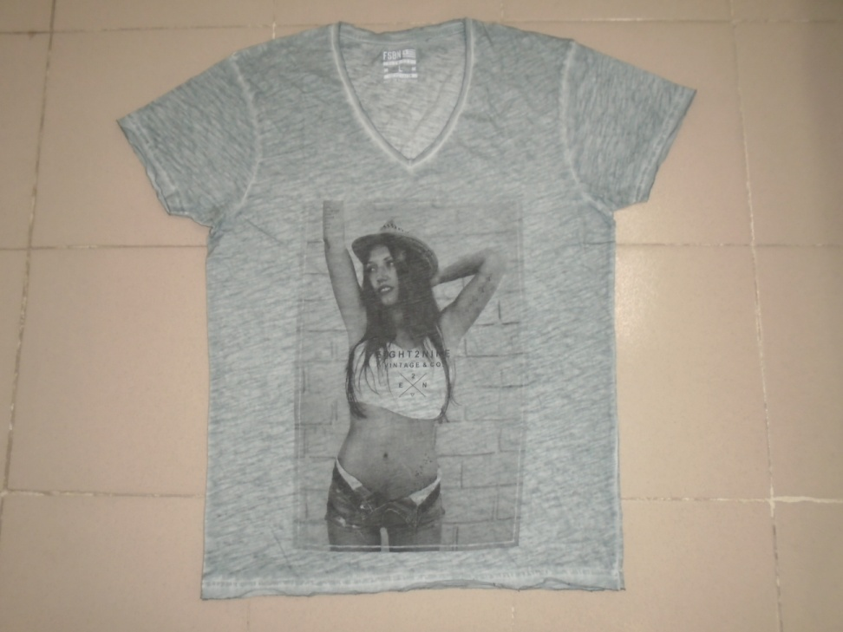
Hatem Fashion Ltd.
STYLE: NT-109
FABRIC: 60% COTTON 40% POLYESTER S/JERSEY 140-145 GSM
REMARKS: GARMENTS OIL WASH

