Slide 1
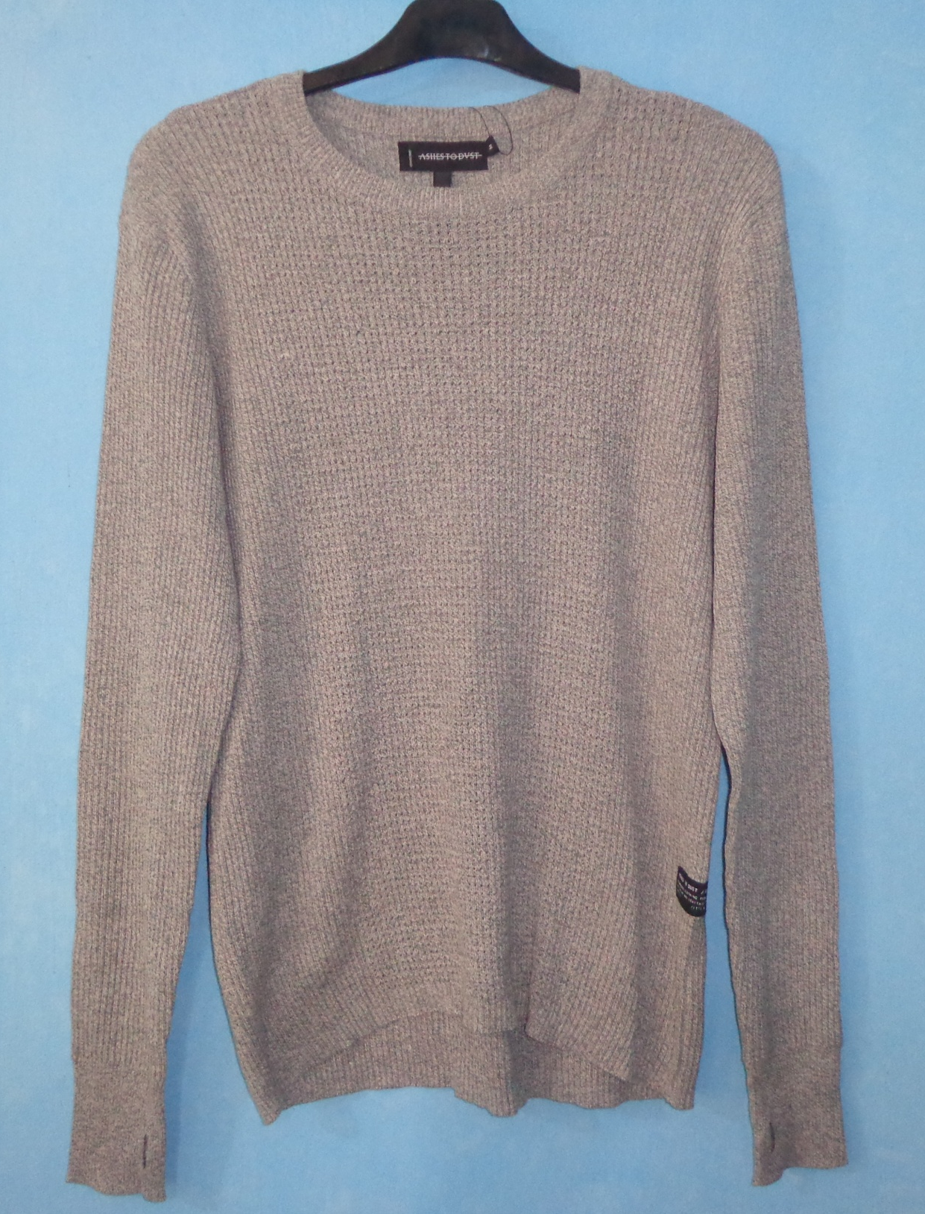
STYLE : HF2018040
YARN : 100% COTTON
GAUGE : 5 GG
DES: MENS PULLOVER

Slide 2
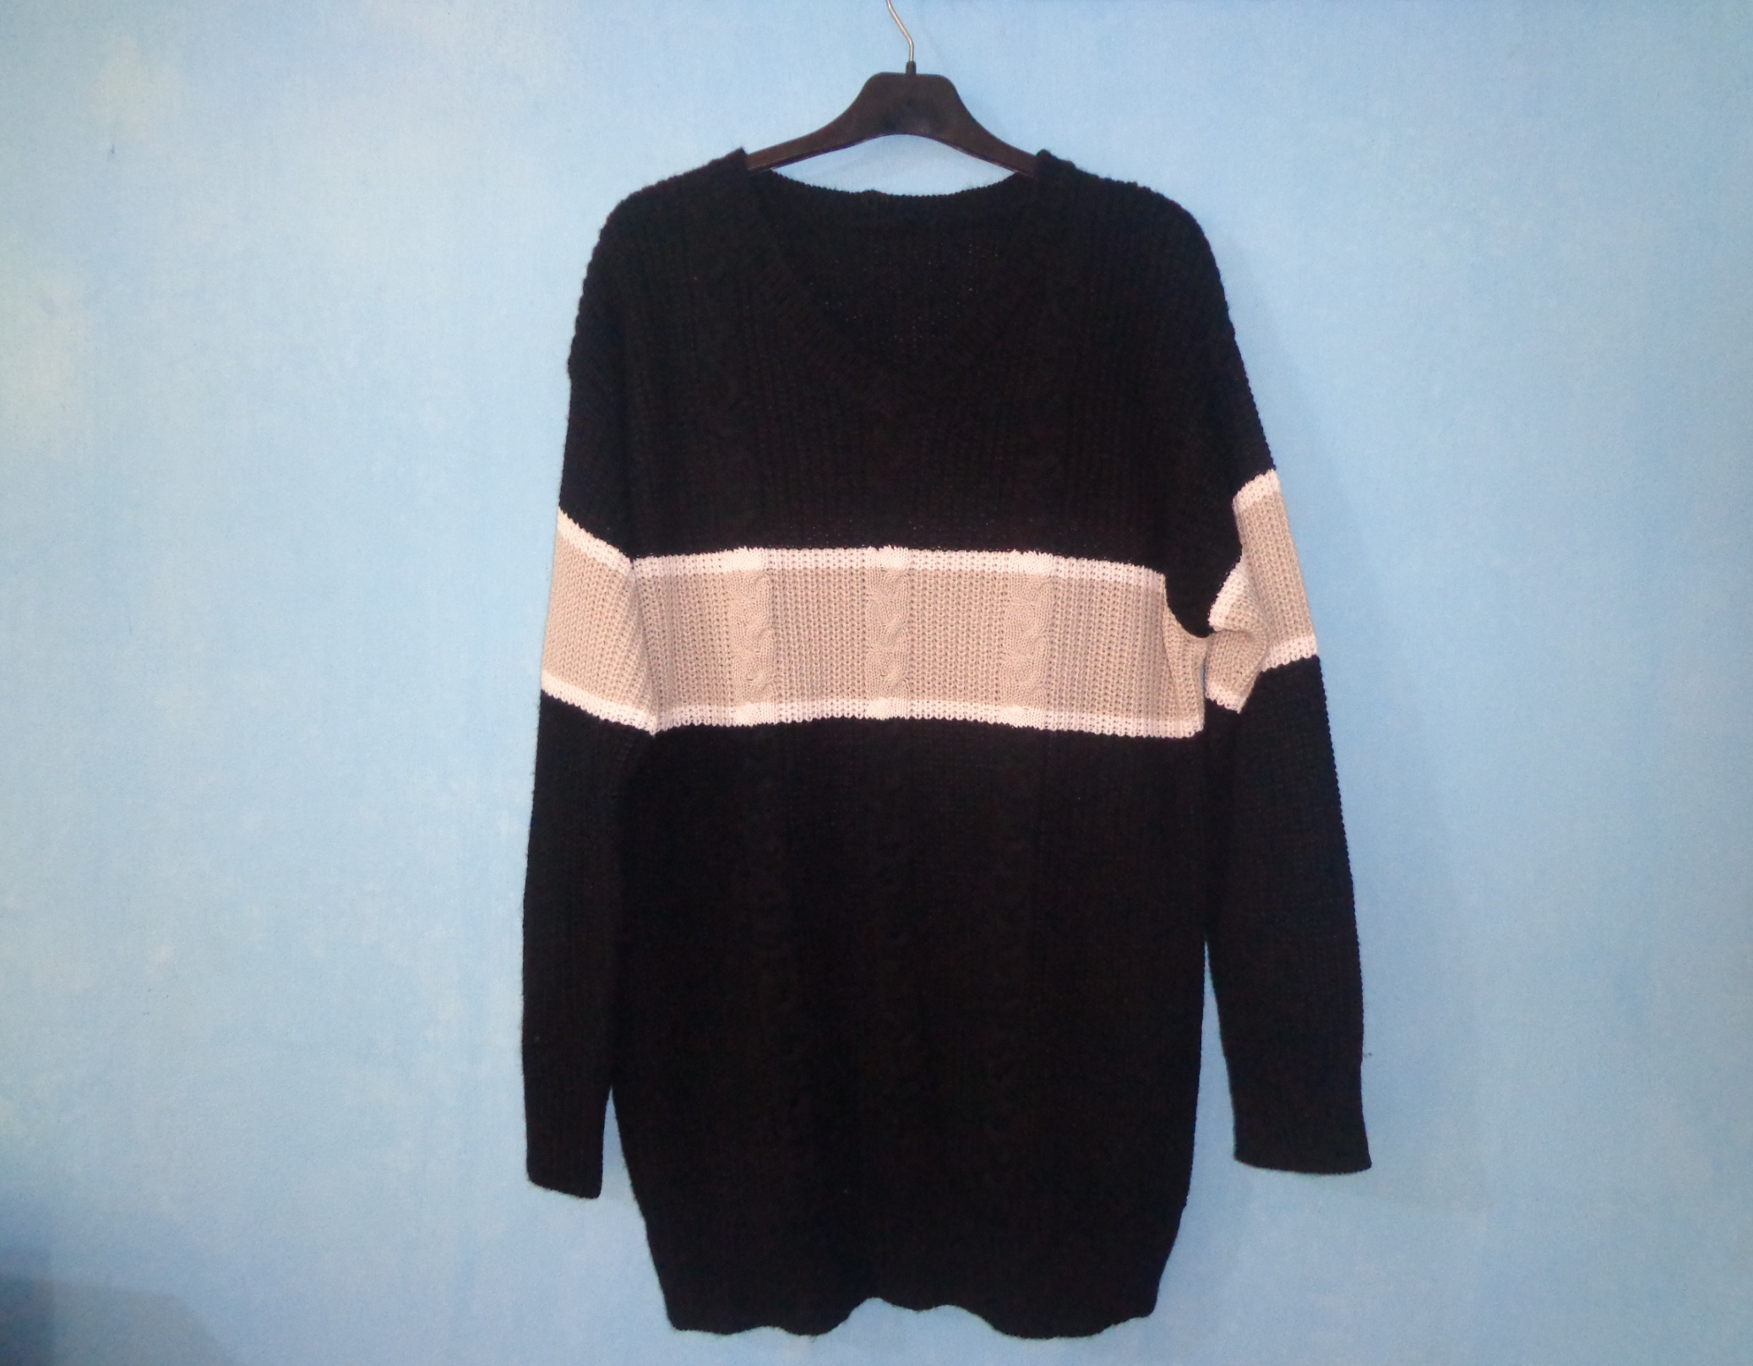
STYLE : HF2018041
YARN : 100% ACRYLIC
GAUGE : 5 GG
DES: MENS PULLOVER

Slide 3
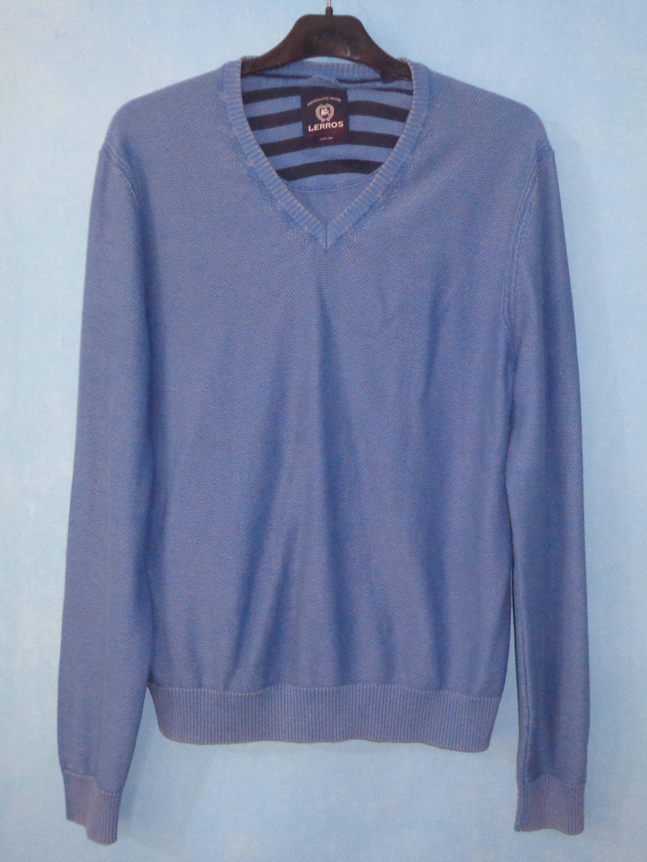
STYLE : HF2018042
YARN : 100% COTTON
GAUGE : 12 GG
DES: MENS PULLOVER

Slide 4
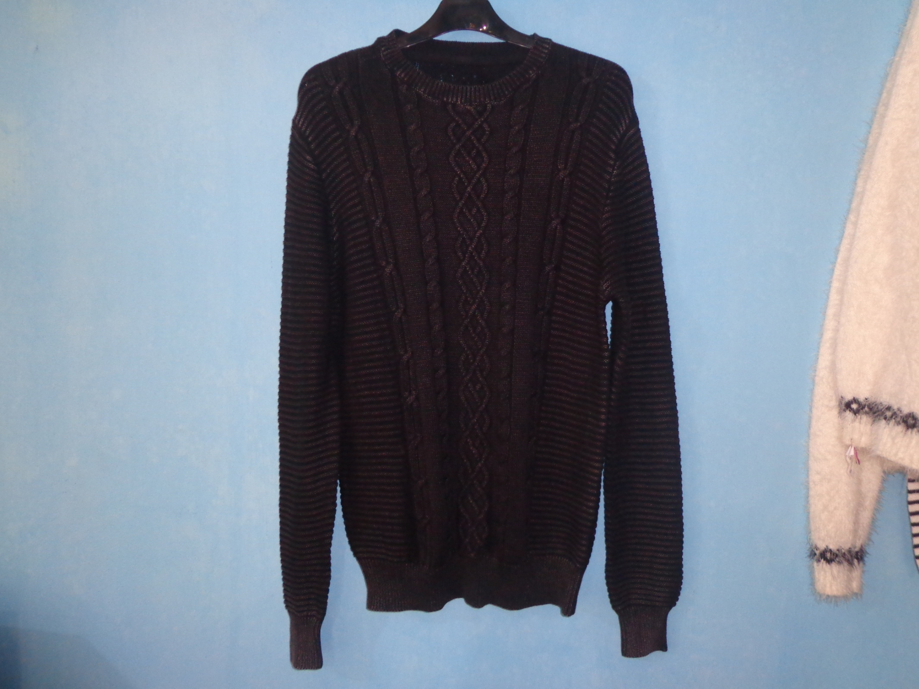
STYLE : HF2018043
YARN : 100% COTTON STONE WASH
GAUGE : 5 GG
DES: MENS PULLOVER

Slide 5
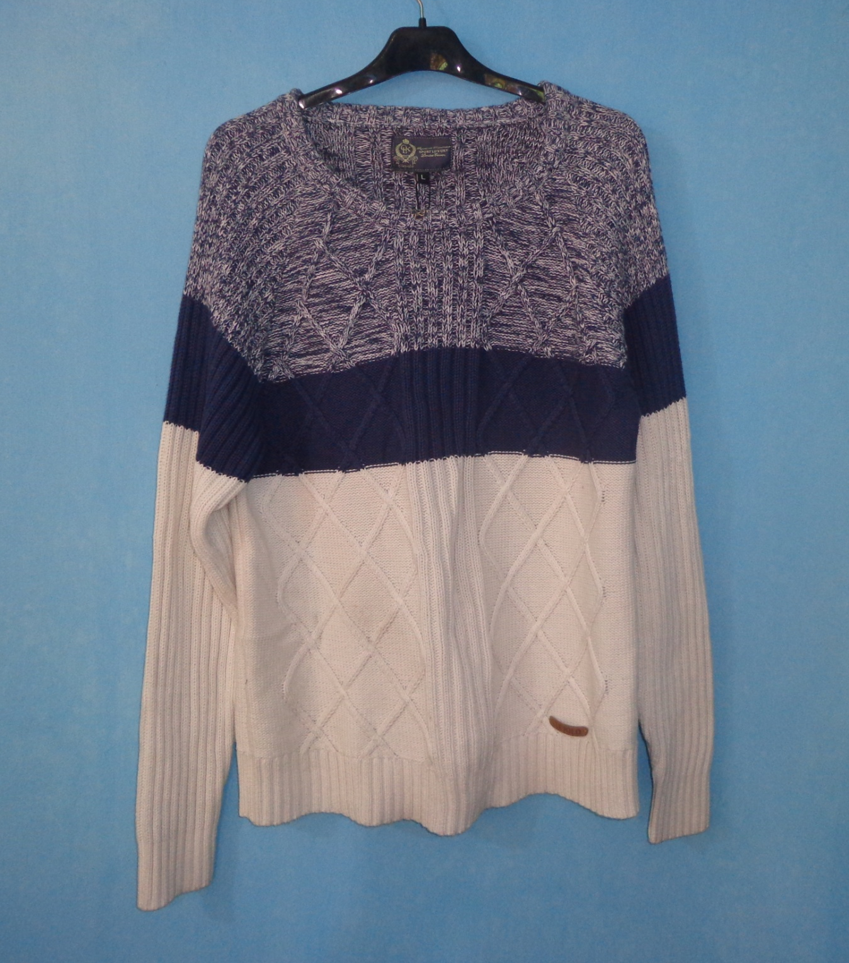
STYLE : HF2018044
YARN : 100% COTTON
GAUGE : 5 GG
DES: MENS PULLOVER

Slide 6
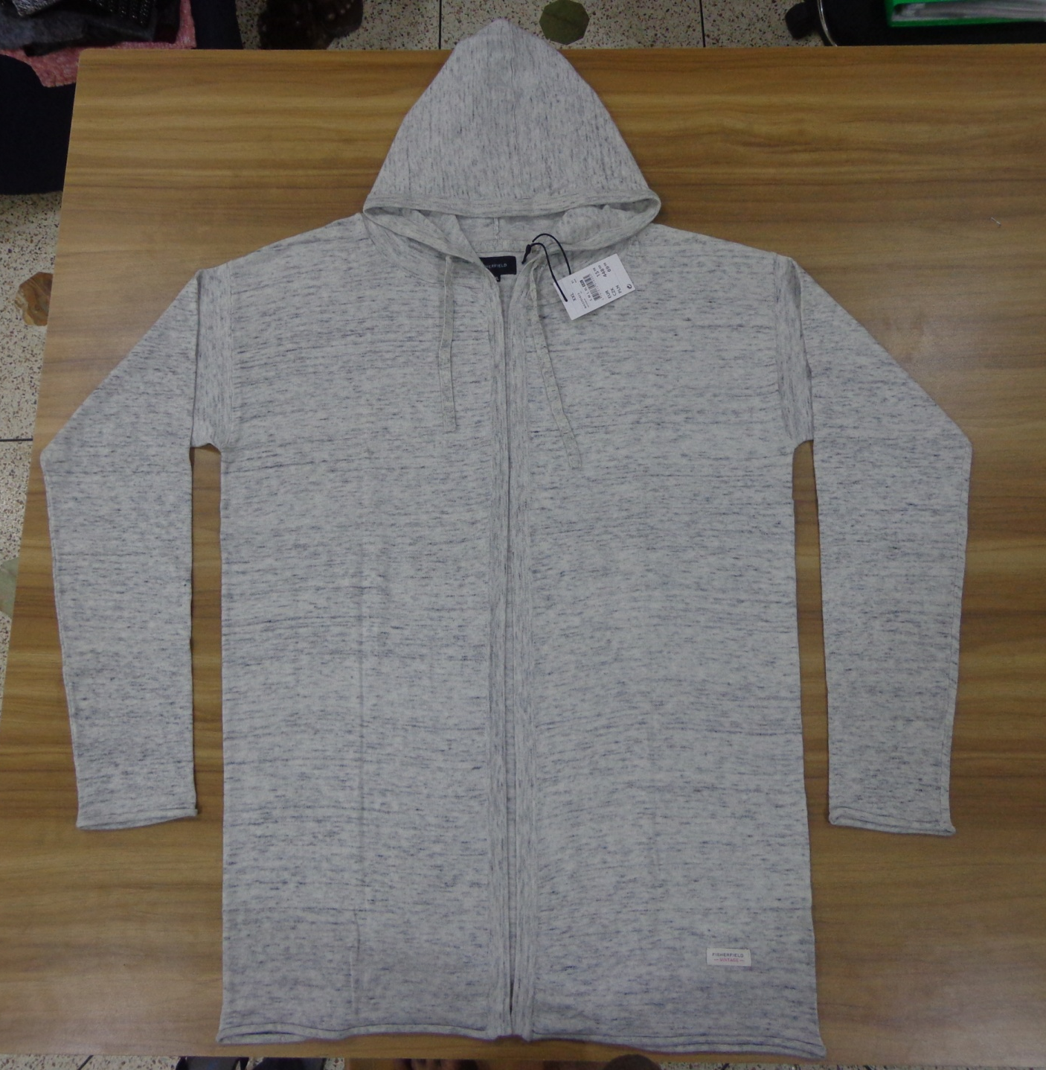
STYLE : HF2018045
YARN : 100% COTTON
GAUGE : 12 GG
DES: MENS PULLOVER

Slide 7
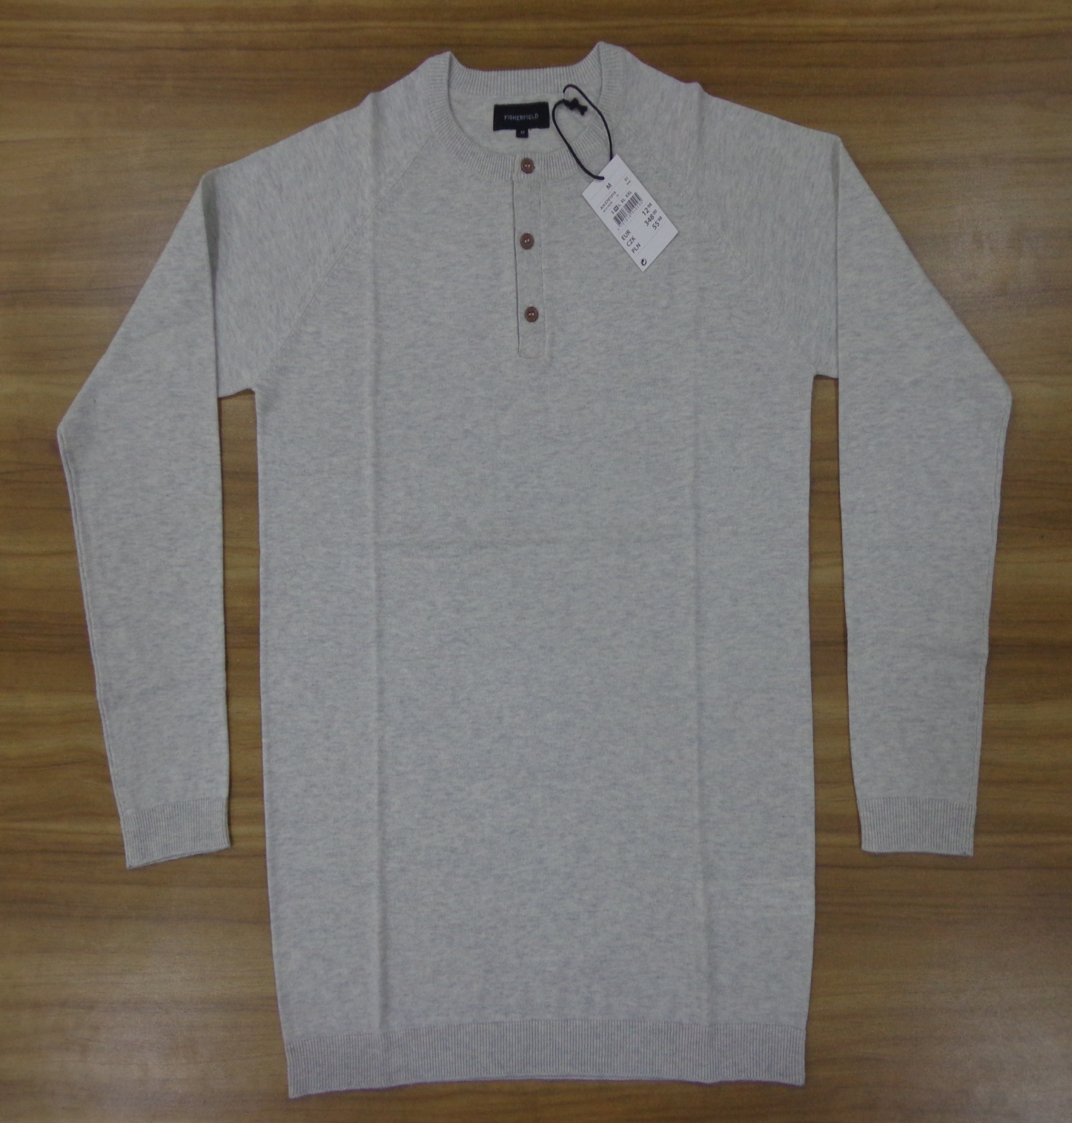
STYLE : HF2018046
YARN : 100% COTTON
GAUGE : 12 GG
DES: MENS PULLOVER

