Slide 1
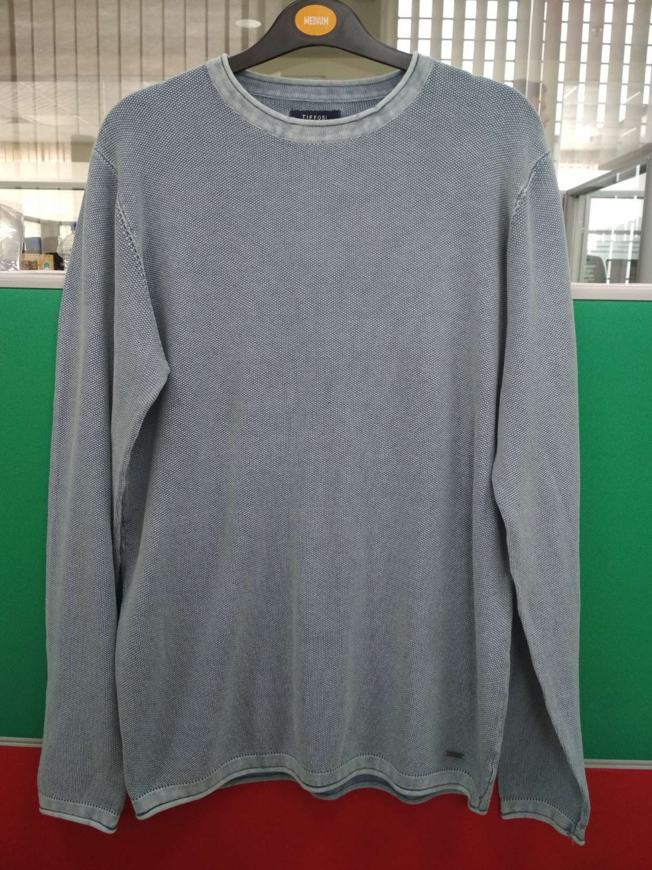
Style # wallace
Description: Mens pullover jacquard stitch ACID wash sweater
Yarn: 100% Cotton
Gauge: 12 gg
Weight : 8.50 lbs/dz
Size Range: S-XL

Slide 2
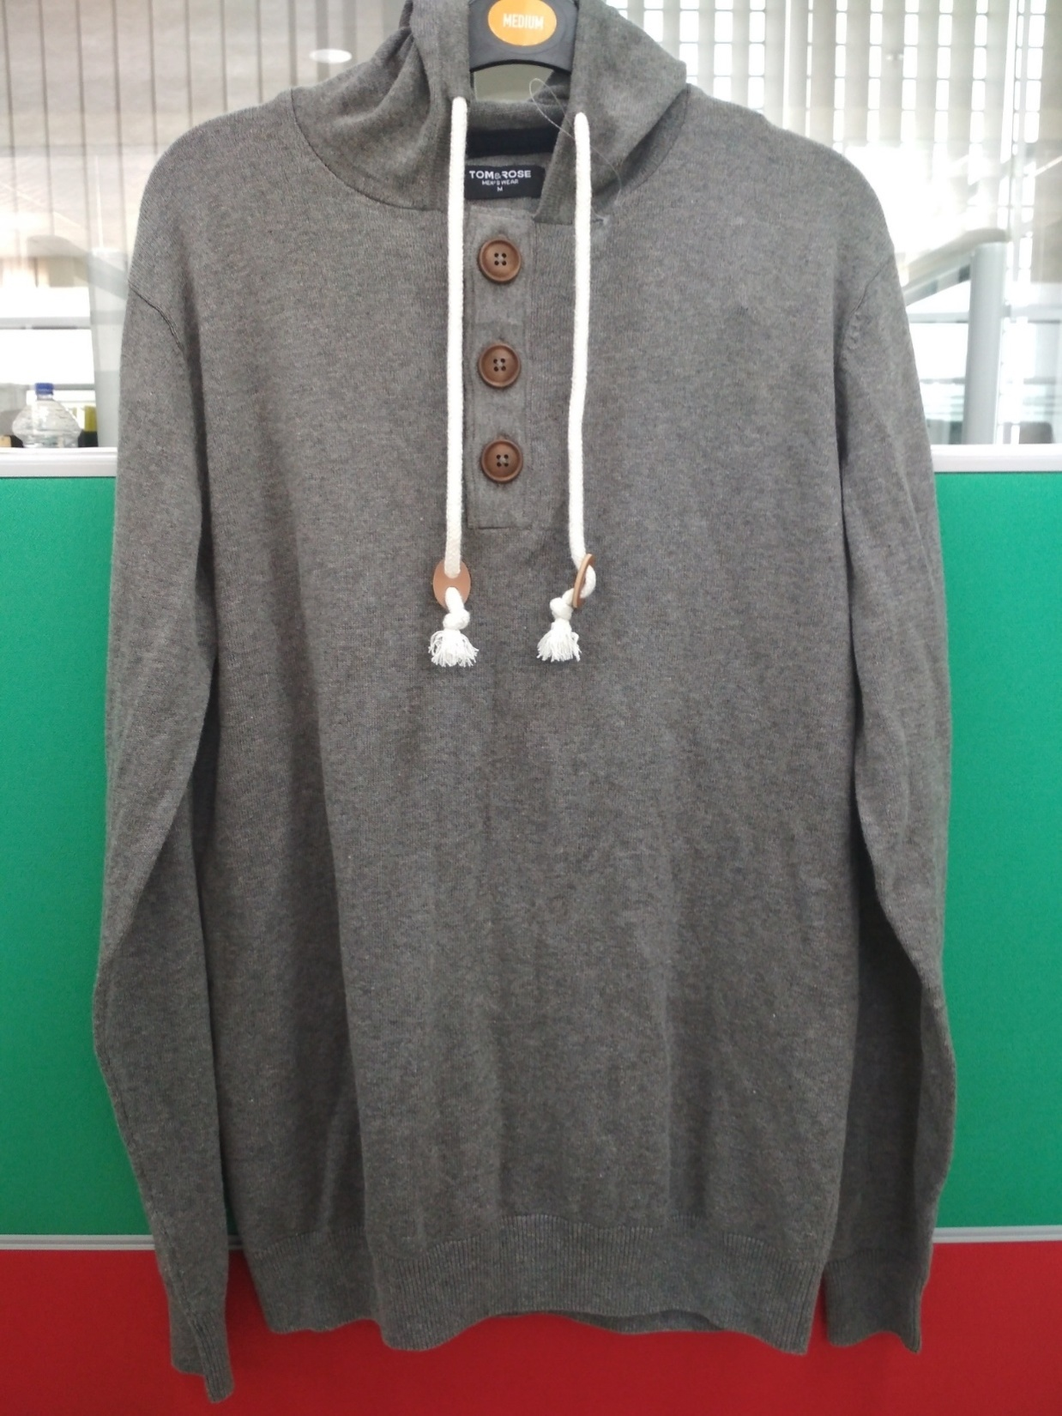
Style # men17
Description: Mens l/slv hooded sweater
Yarn: 100% Cotton
Gauge: 12 gg
Weight : 11.50 Lbs
Size Range: S-XL

Slide 3
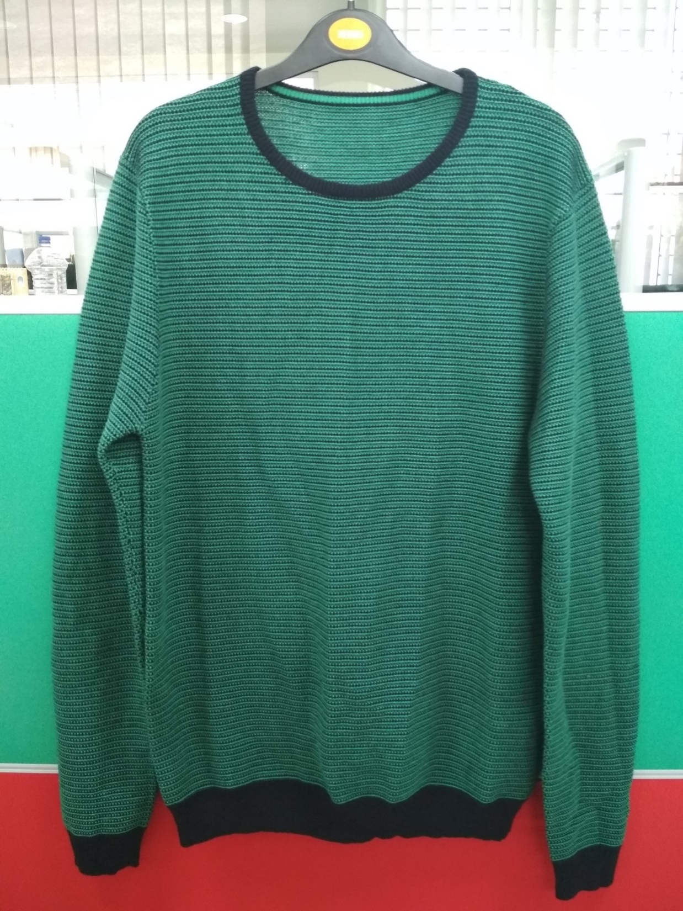
Style # para11
Description: Mens l/slv round neck jacquard sweater.
Yarn: 100% Cotton
Gauge: 12 gg
Weight : 10.50 lbs/dz
Size Range: S-XL

Slide 4
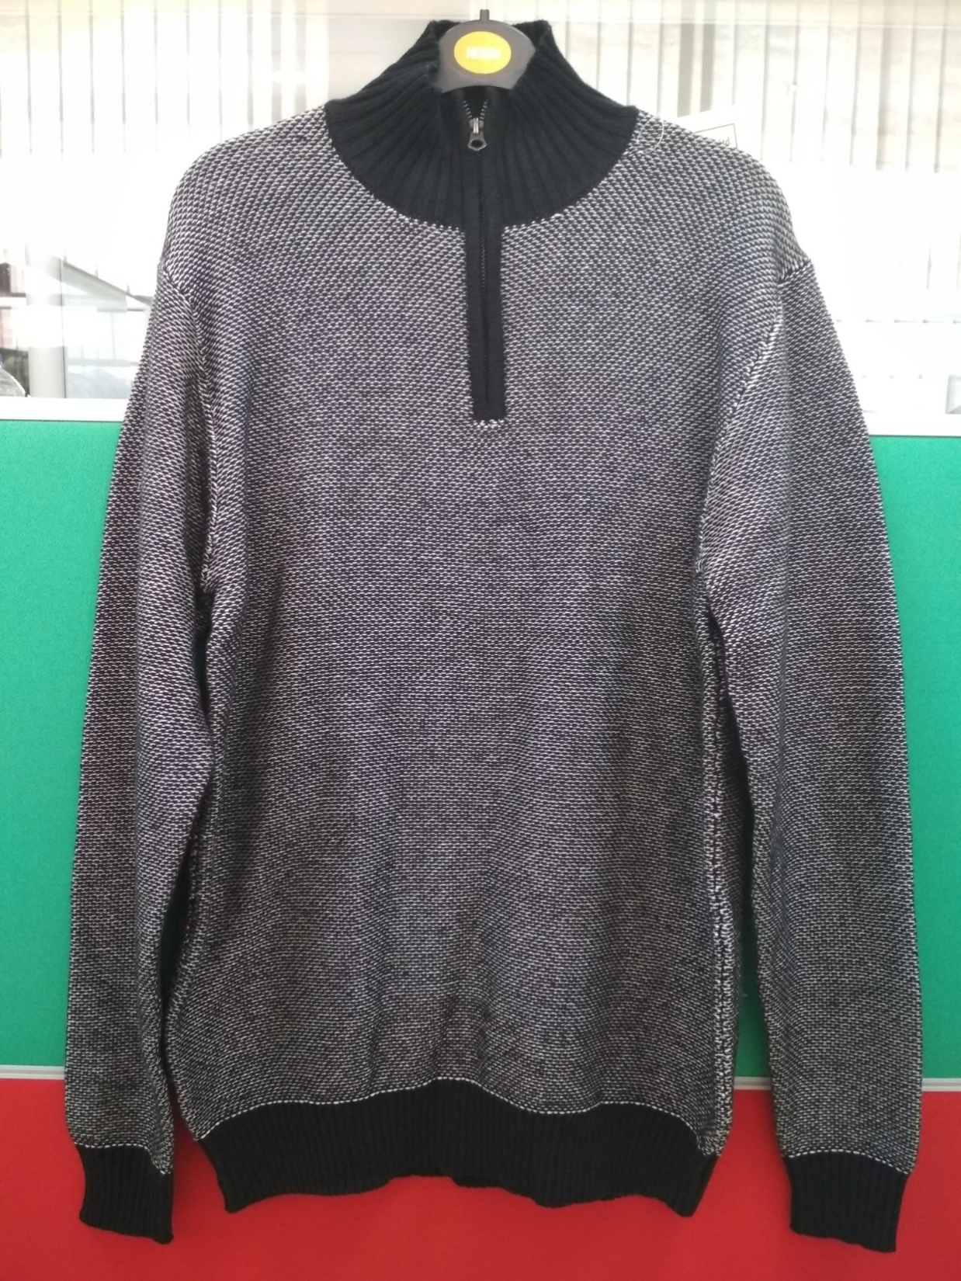
Style # para12
Description: Mens l/slv mock neck jacquard sweater
Yarn: 100% Cotton
Gauge: 5 gg
Weight : 14.50 lbs/dz
Size Range: S-XXL

Slide 5
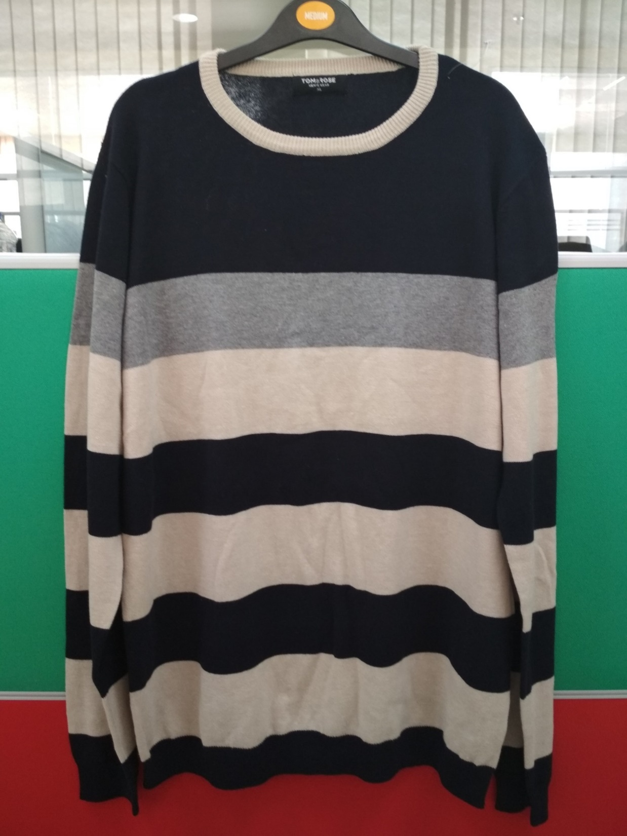
Style # men16
Description: Mens l/slv round neck stripe sweater
Yarn: 100% Cotton
Gauge: 12 gg
Weight : 8.50 lbs/dz
Size Range: S-XXL

Slide 6
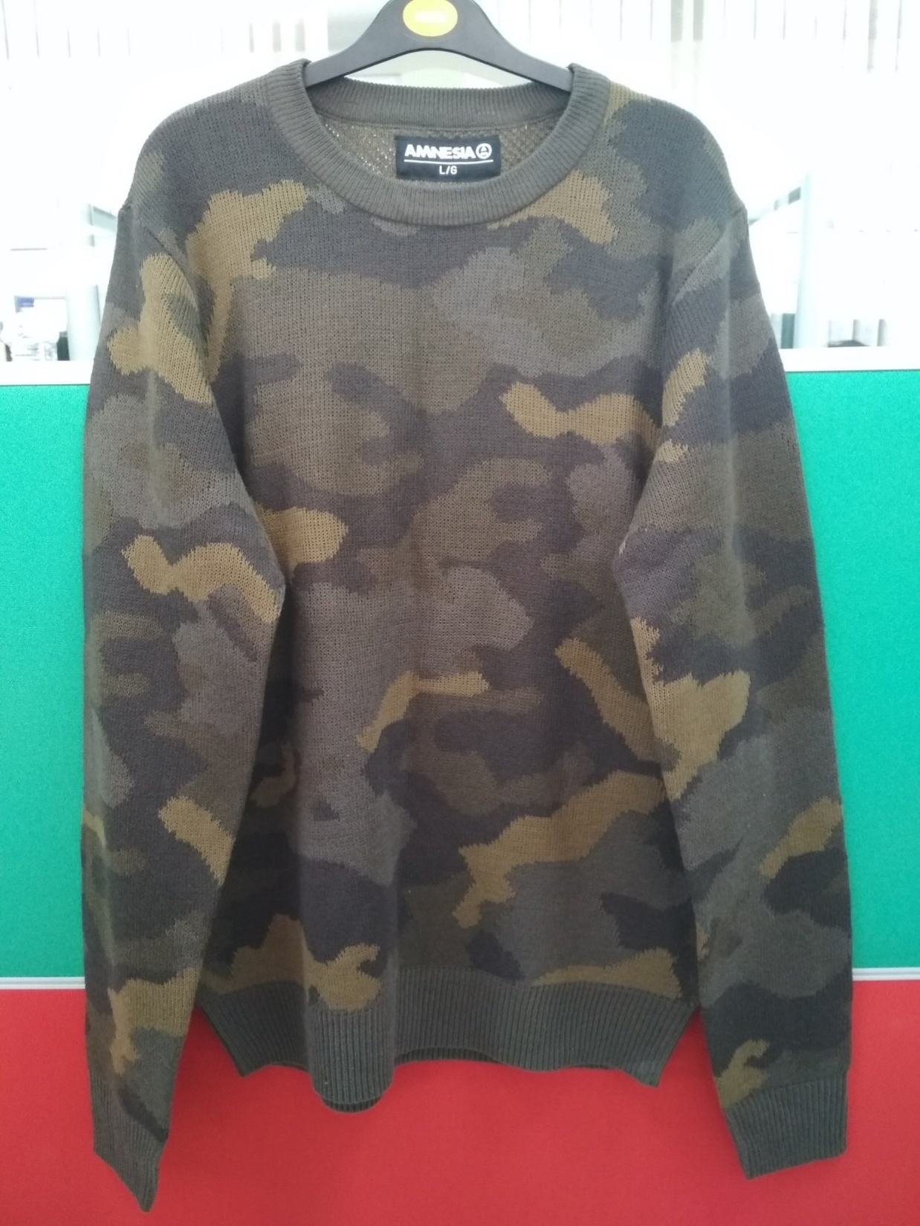
Style # camo
Description: Mens l/slv army design sweater
Yarn: 100% Acrylic
Gauge: 12 gg
Weight : 13.00 lbs/dz
Size Range: S-XXL

Slide 7
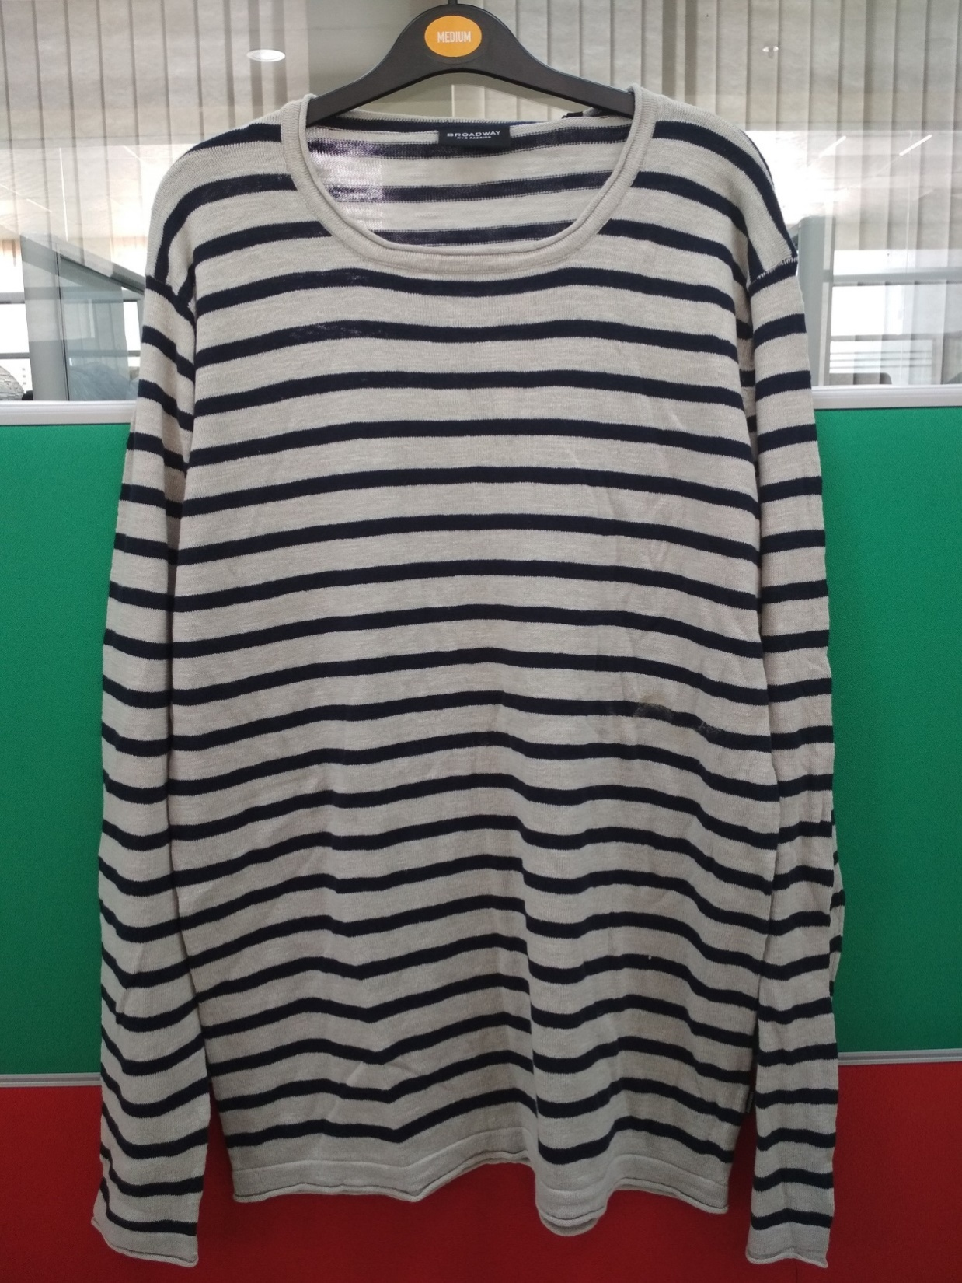
Style # 820
Description: Mens l/slv round neck stripe sweater
Yarn: 100% Cotton slub
Gauge: 12 gg
Weight : 8.50 lbs/dz
Size Range: S-XXL

Slide 8
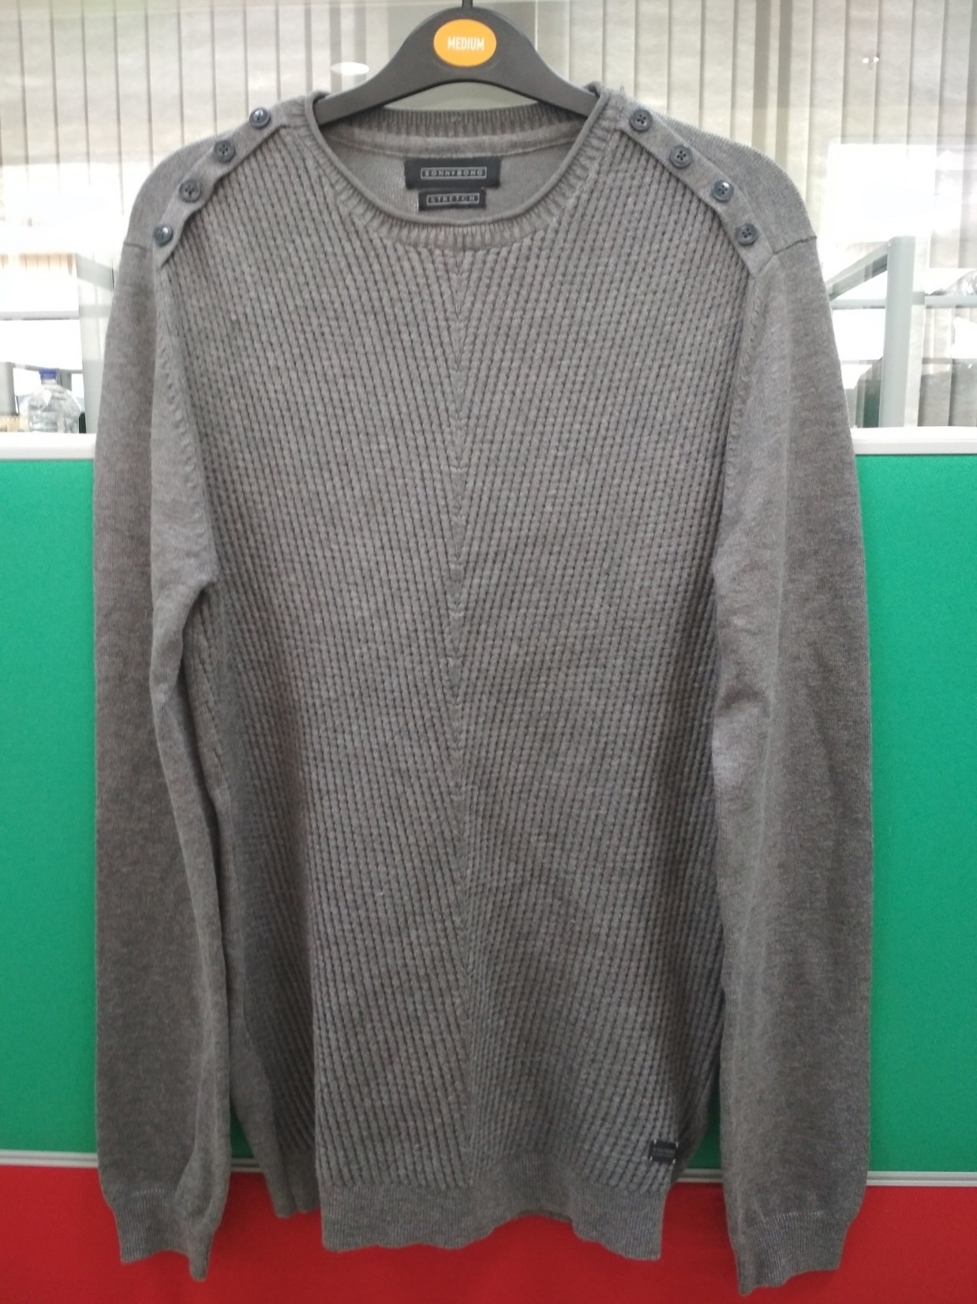
Style # Sonobono
Description: Mens l/slv round neck front jacquard sweater
Yarn: 70% Viscose 30% Nylon
Gauge: 12 gg
Weight : 10.00 lbs/dz
Size Range: S-XXL

