Slide 1
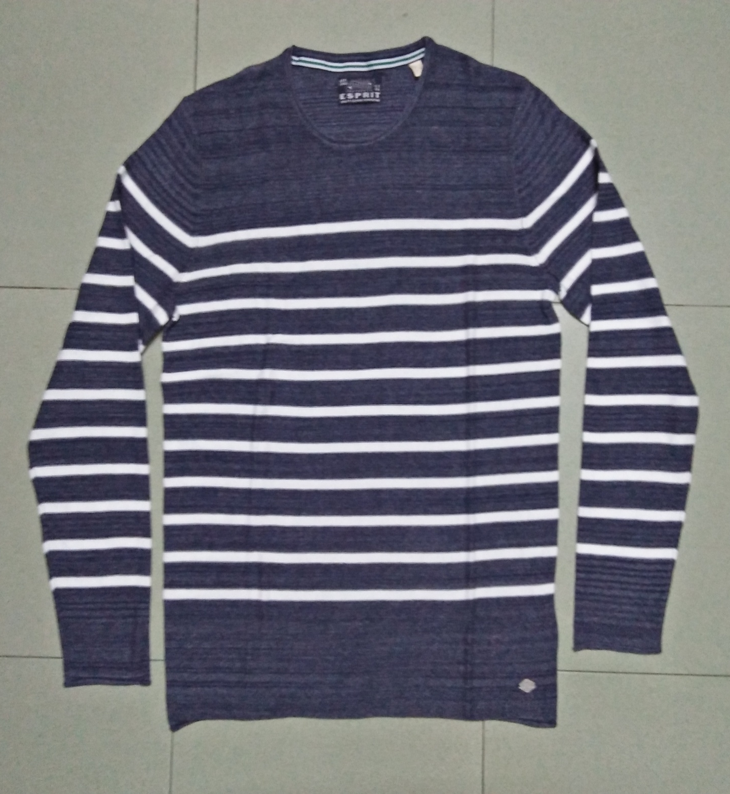
STYLE : HF2018071
YARN : 100% COTTON
GAUGE : 12 GG
DES: MENS PULLOVER

Slide 2
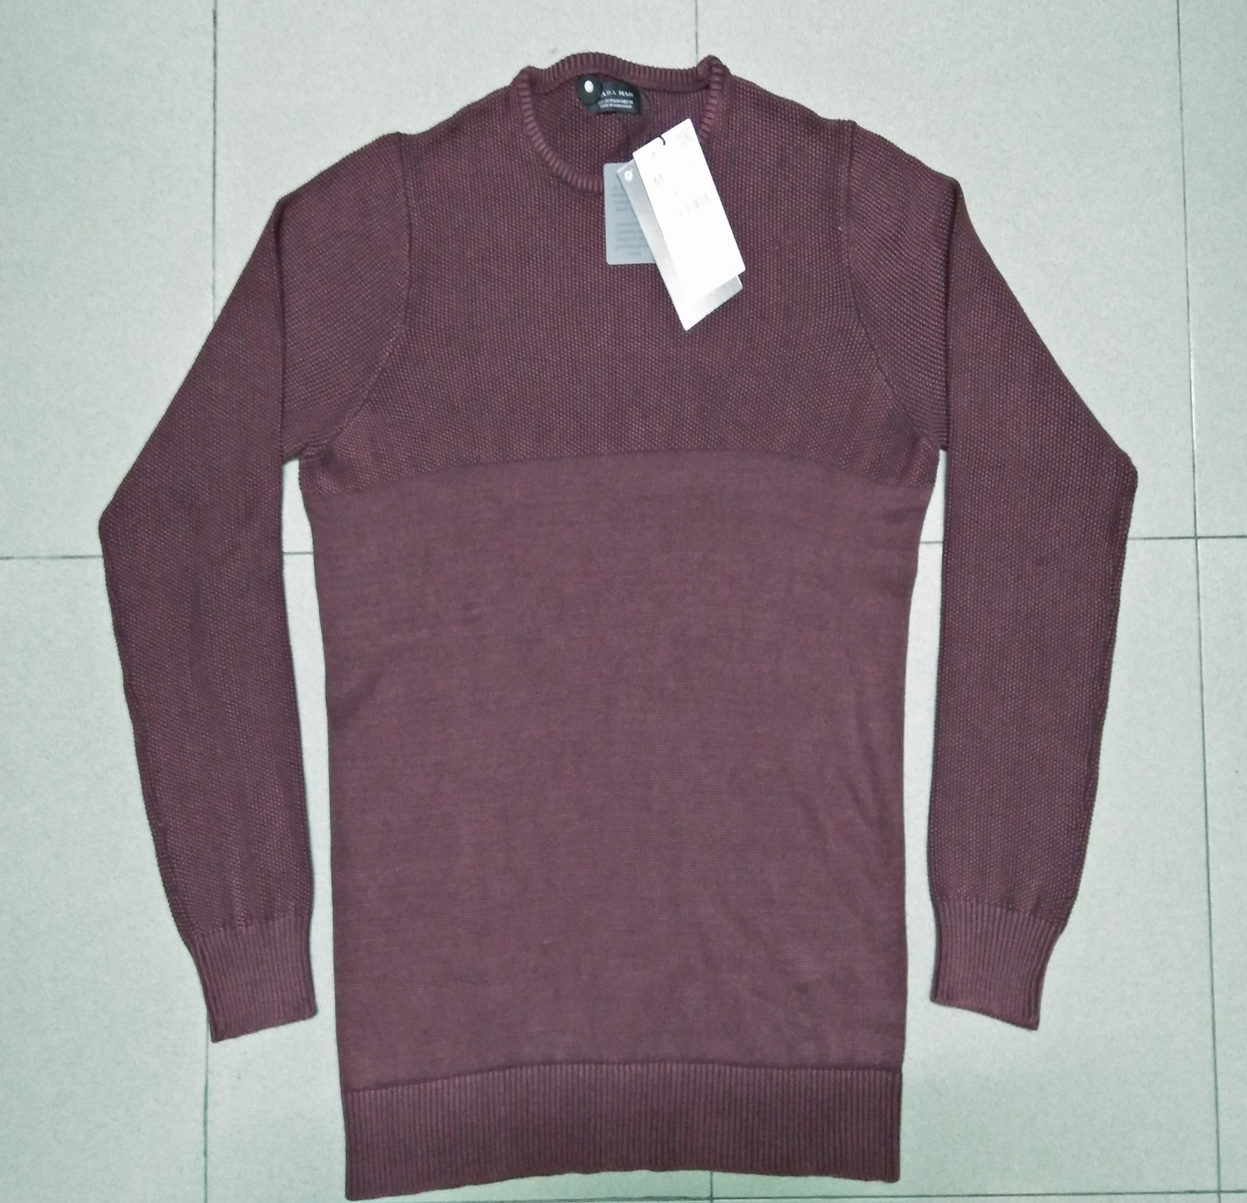
STYLE : HF2018072
YARN : 100% COTTON
GAUGE : 12 GG
DES: MENS PULLOVER

Slide 3
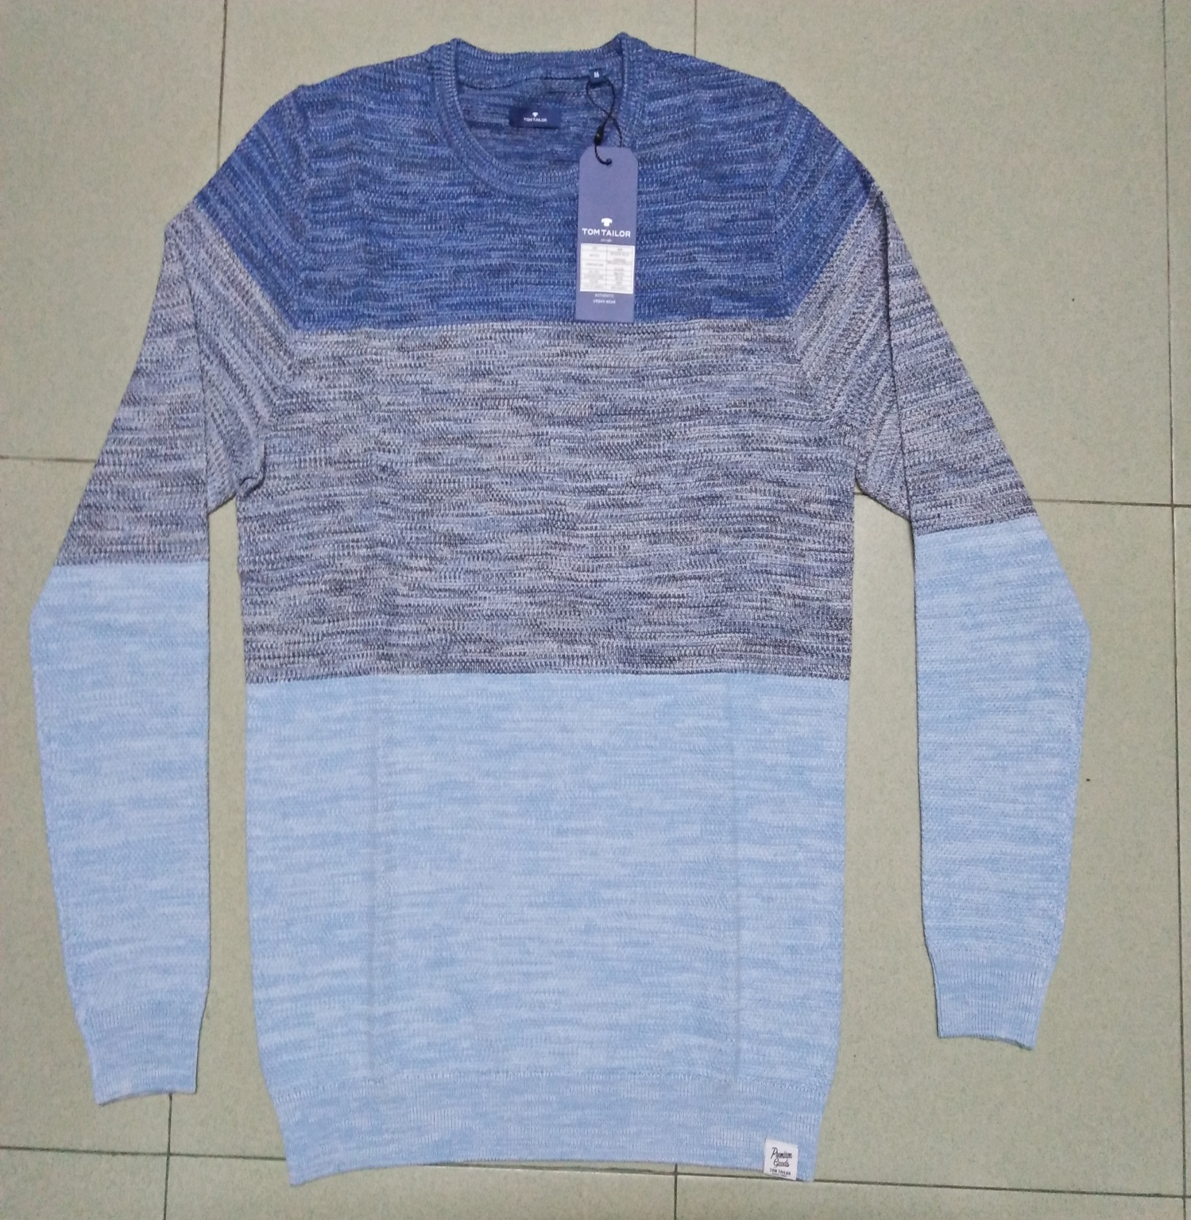
STYLE : HF2018073
YARN : 100% COTTON
GAUGE : 12 GG
DES: MENS PULLOVER

Slide 4
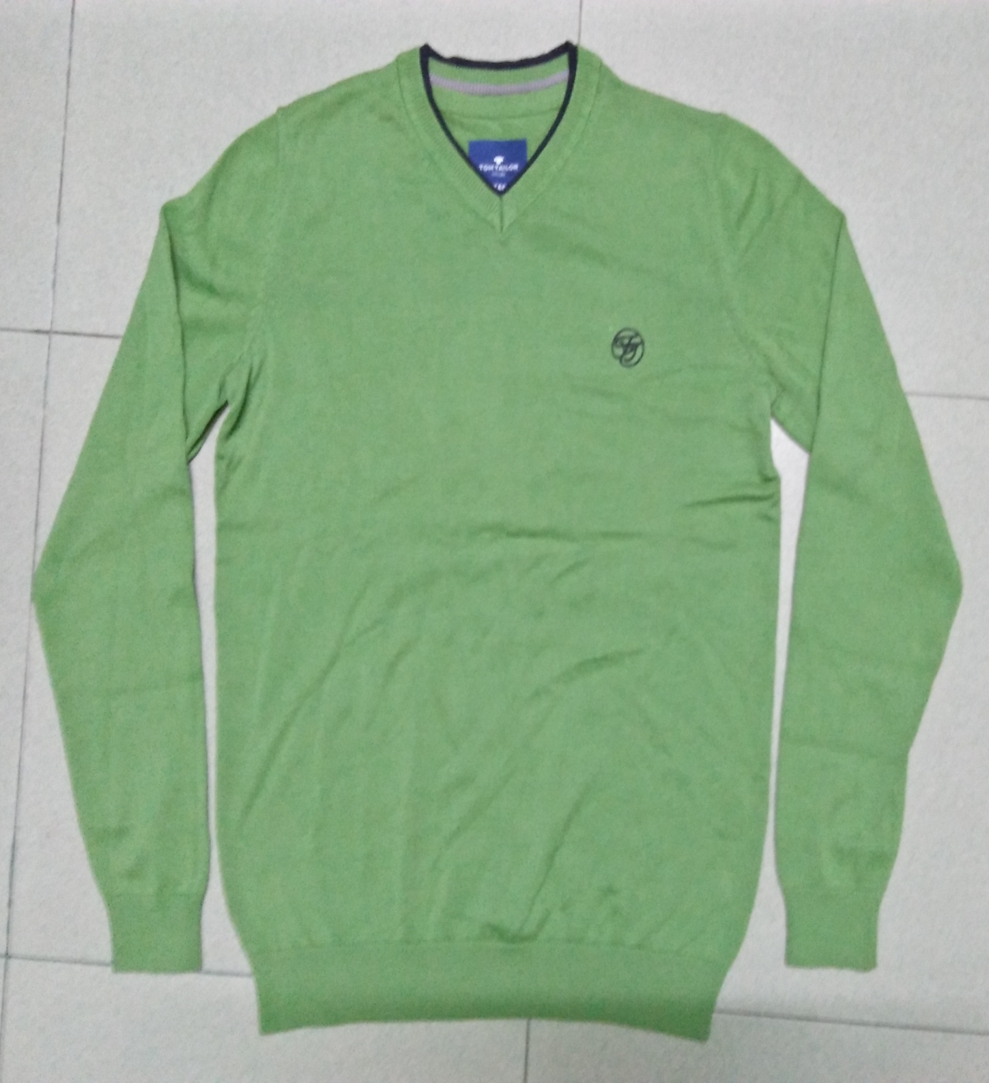
STYLE : HF2018074
YARN : 100% COTTON
GAUGE : 12 GG
DES: MENS PULLOVER

Slide 5
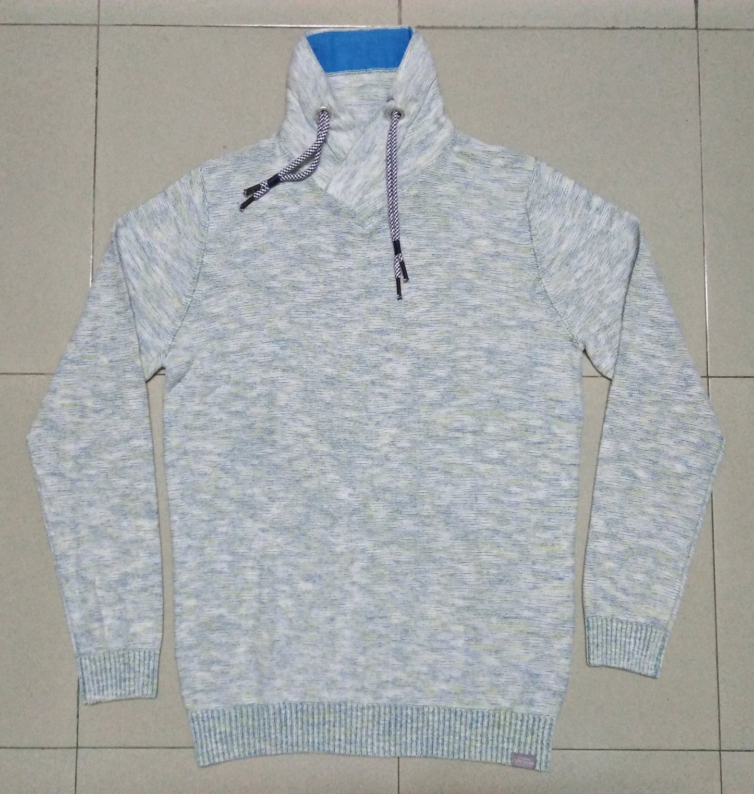
STYLE : HF2018075
YARN : 100% COTTON
GAUGE : 5 GG
DES: MENS PULLOVER

