Slide 1
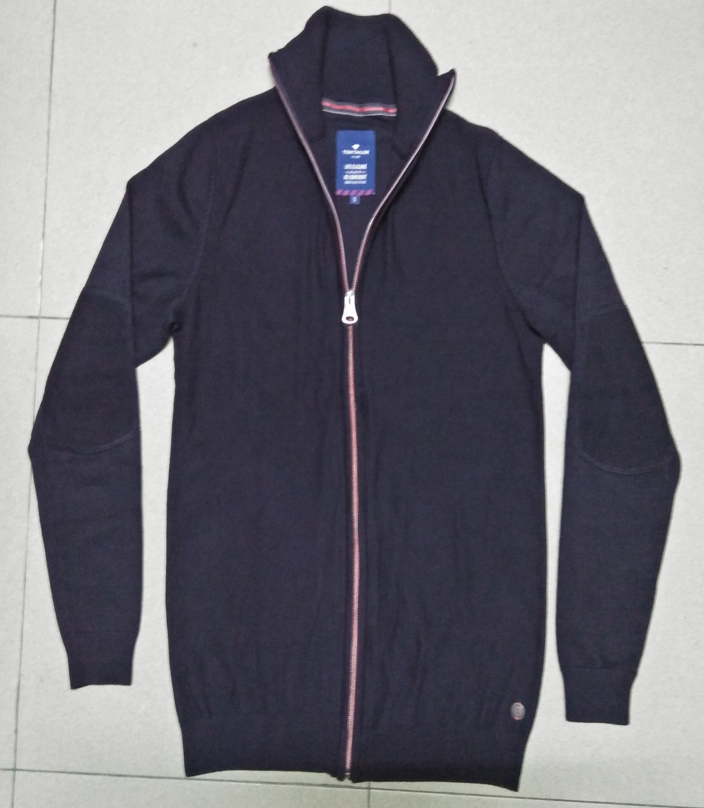
STYLE : HF2018065
YARN : 100% COTTON
GAUGE : 12 GG
DES: MENS CARDIGAN

Slide 2
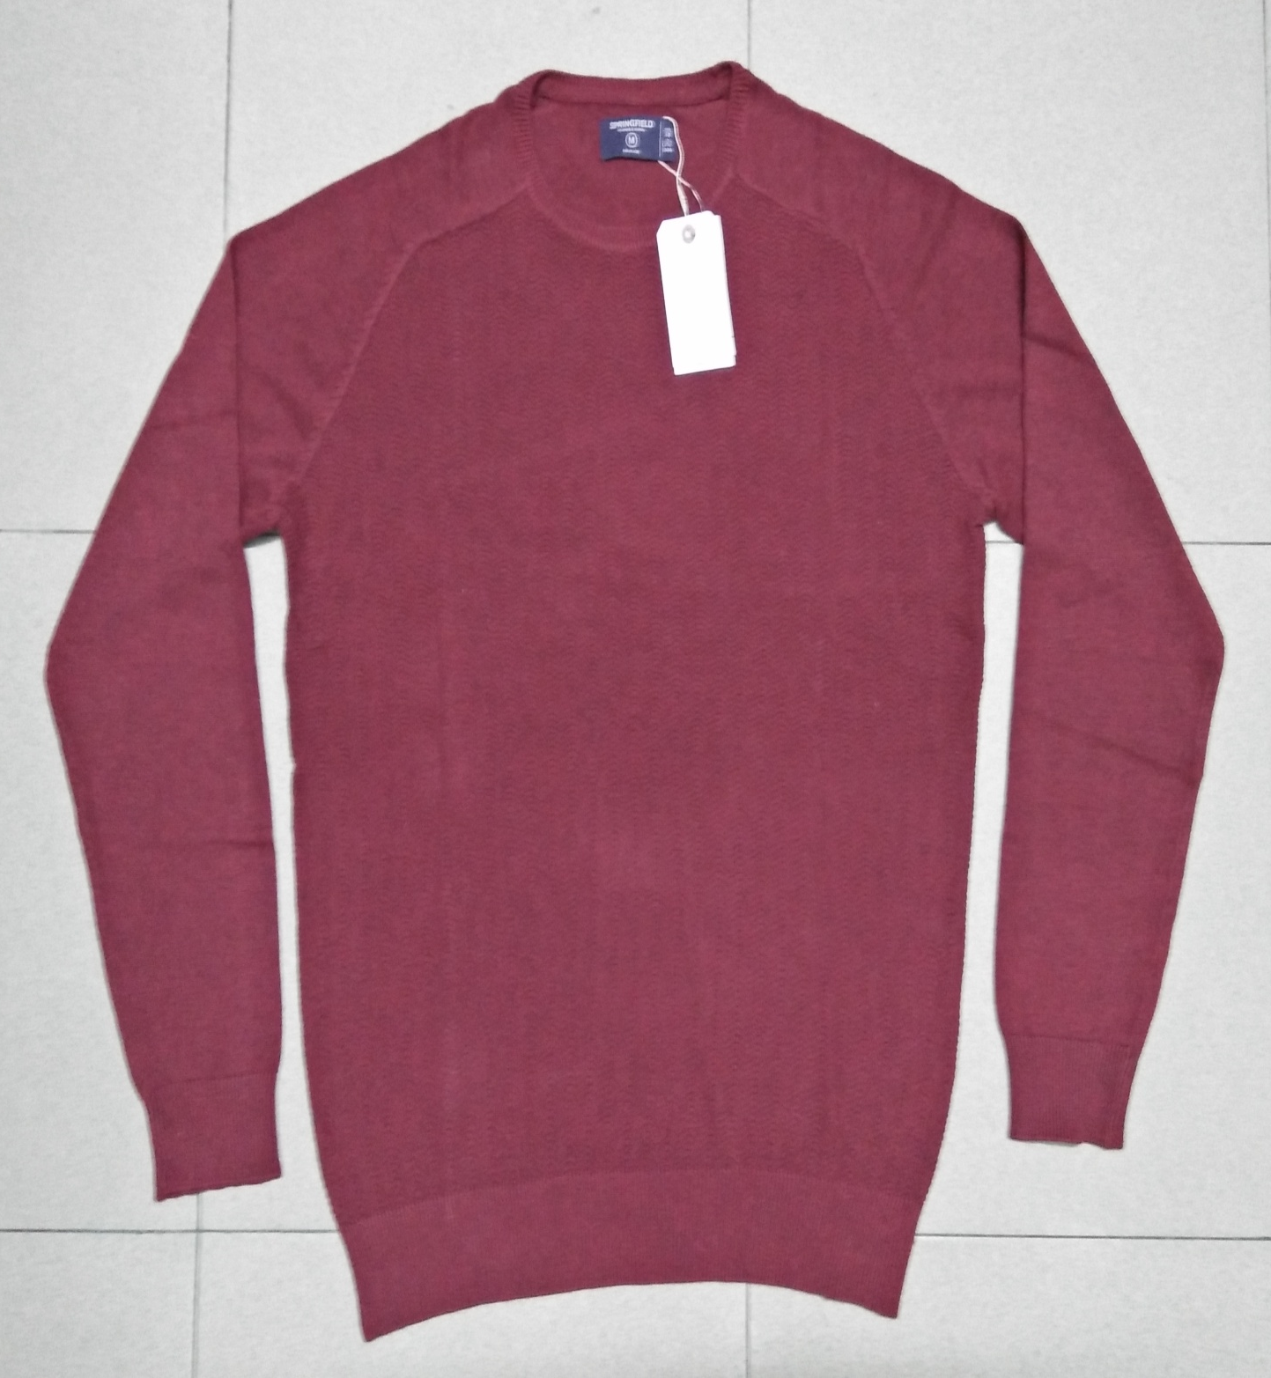
STYLE : HF2018066
YARN : 100% COTTON
GAUGE : 12 GG
DES: MENS PULLOVER

Slide 3
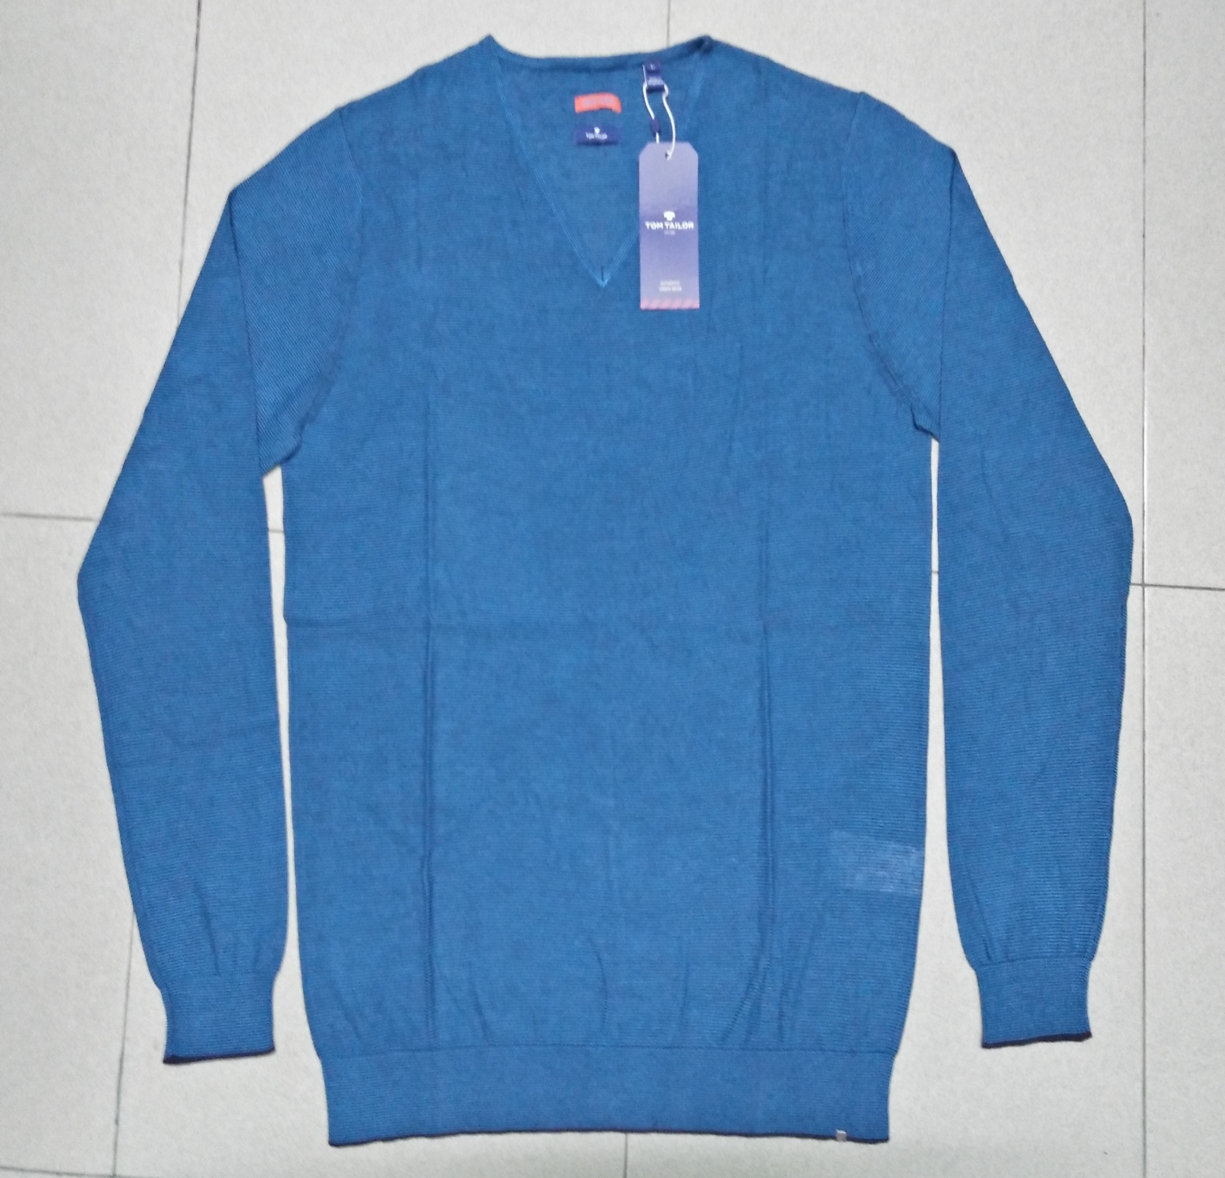
STYLE : HF2018067
YARN : 100% COTTON
GAUGE : 12 GG
DES: MENS PULLOVER

Slide 4
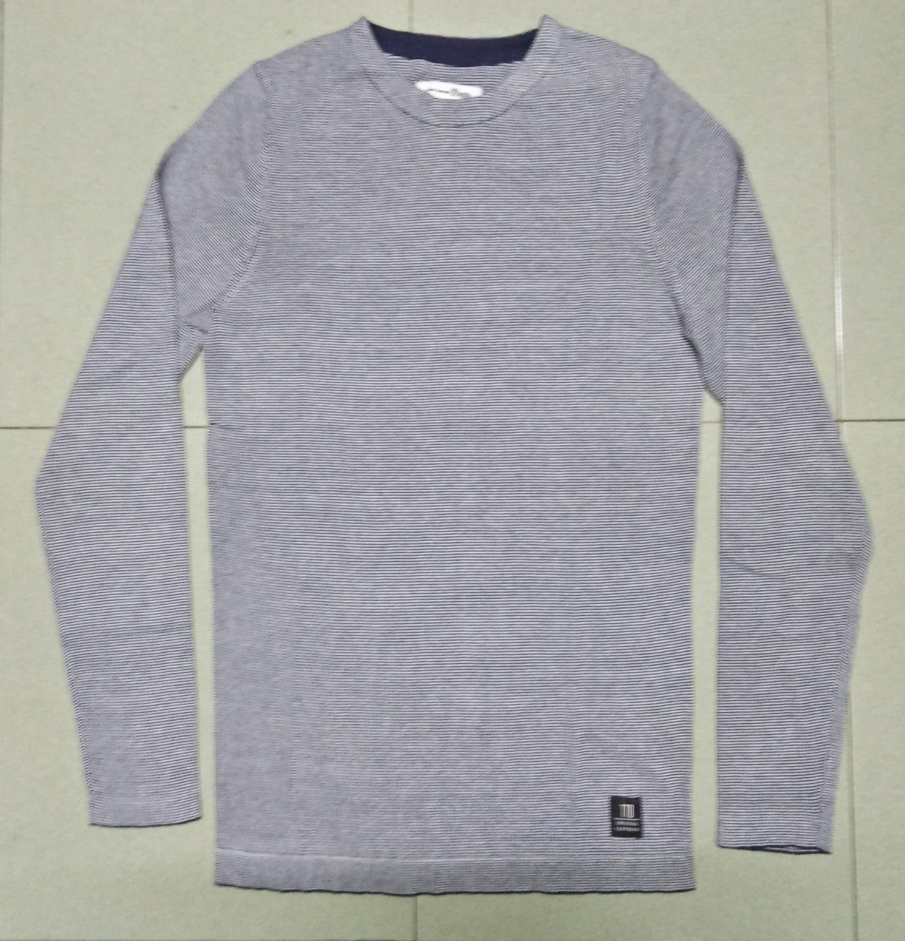
STYLE : HF2018068
YARN : 100% COTTON
GAUGE : 12 GG
DES: MENS PULLOVER

Slide 5
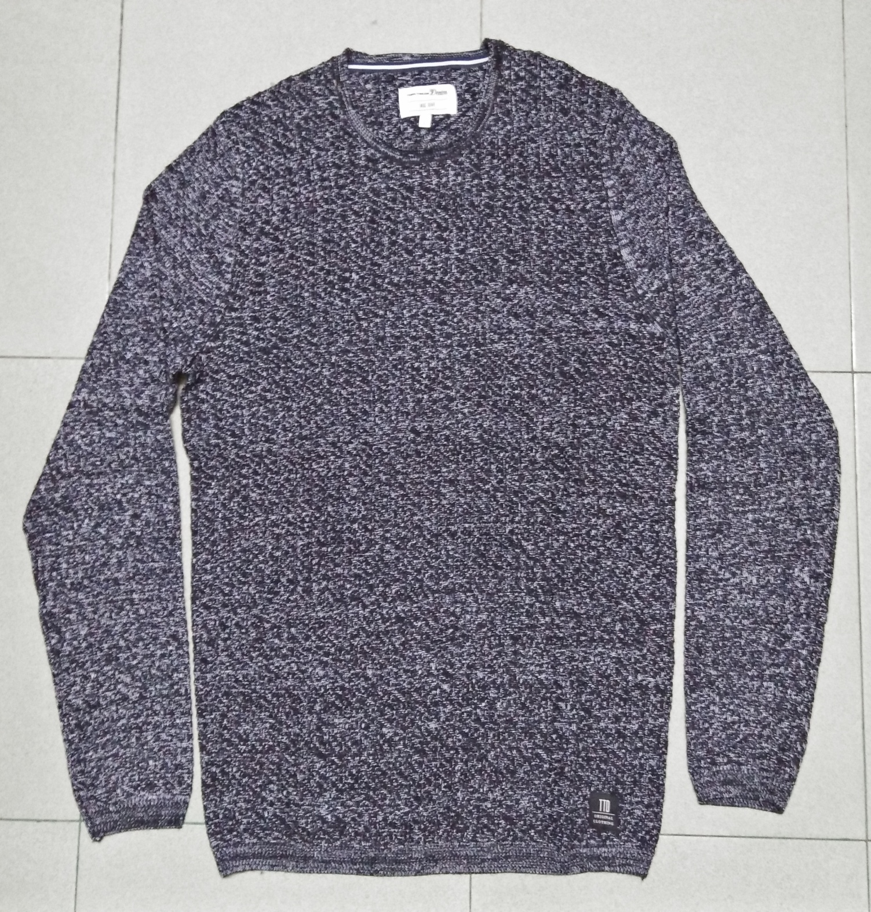
STYLE : HF2018069
YARN : 100% COTTON
GAUGE : 5 GG
DES: MENS PULLOVER

Slide 6
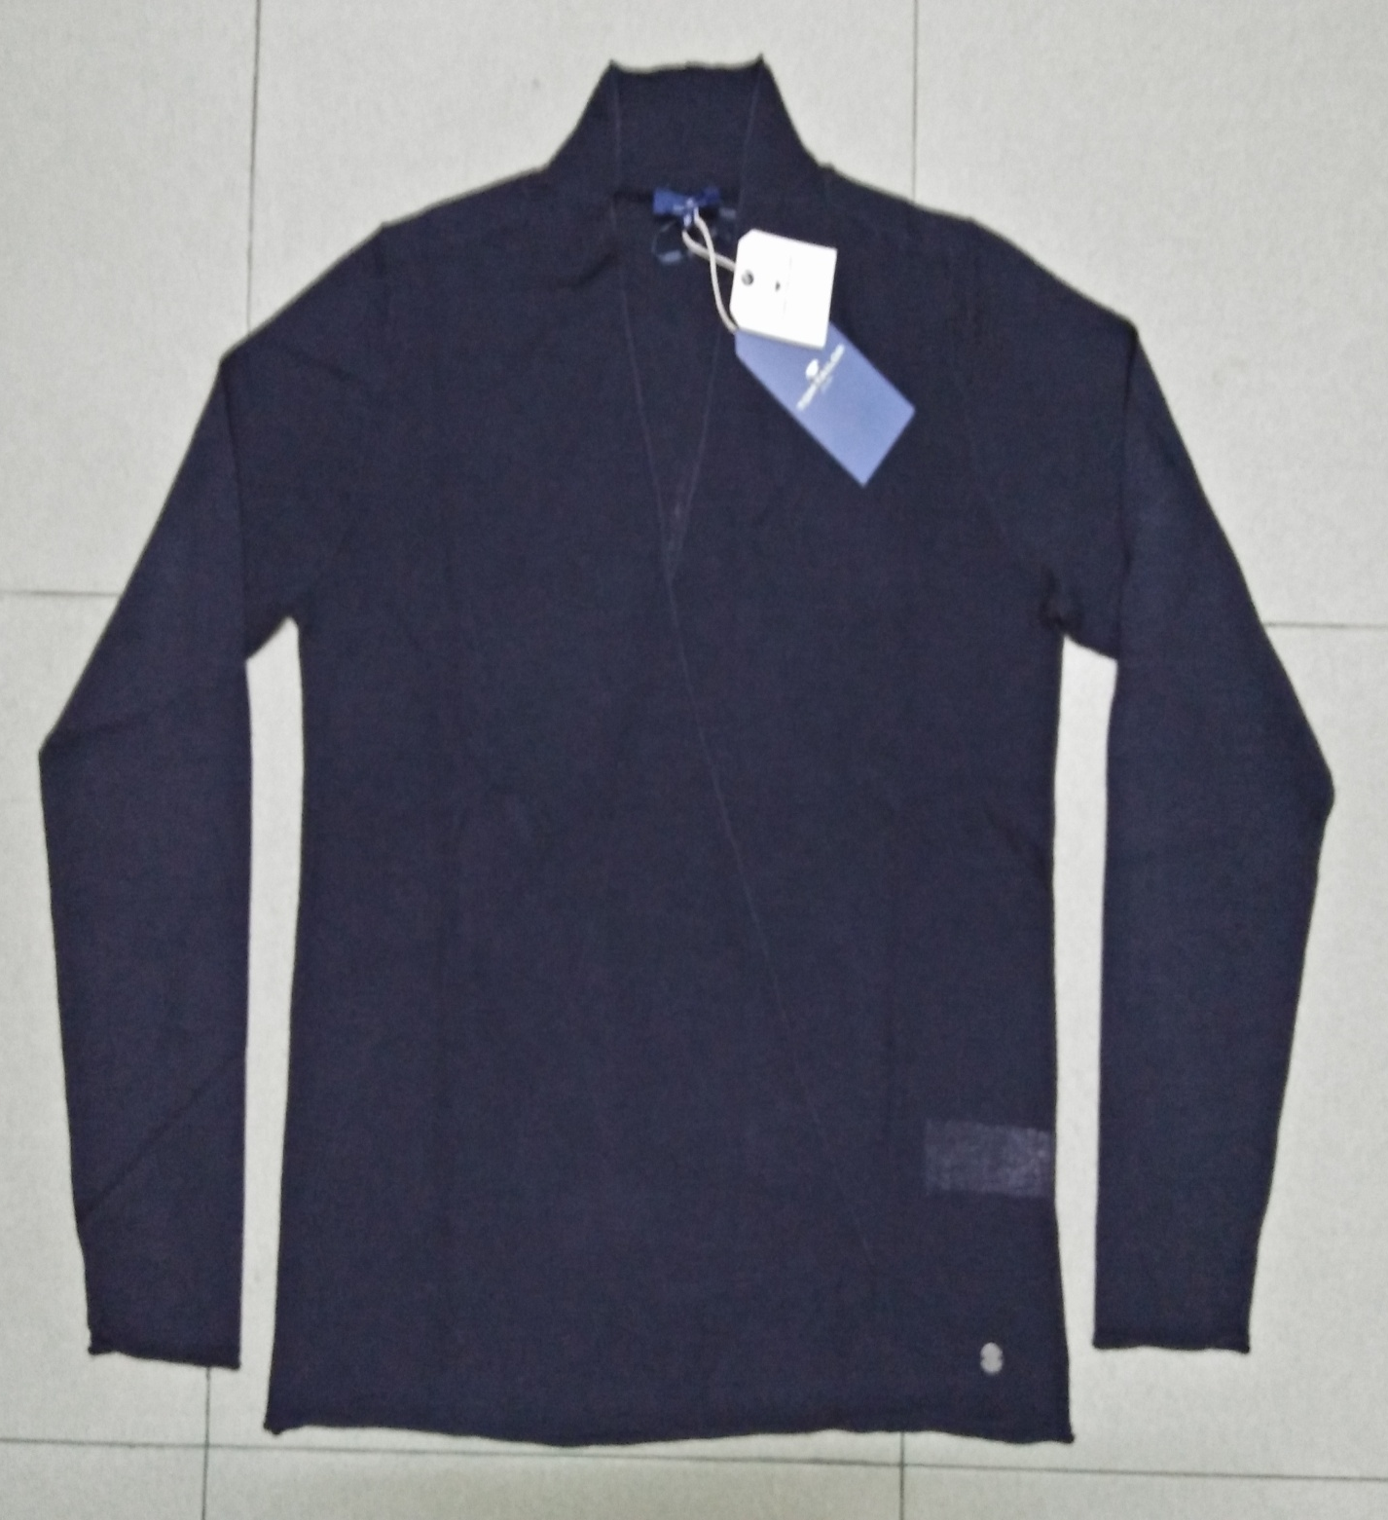
STYLE : HF2018070
YARN : 100% COTTON
GAUGE : 12 GG
DES: MENS CARDIGAN

