Slide 1
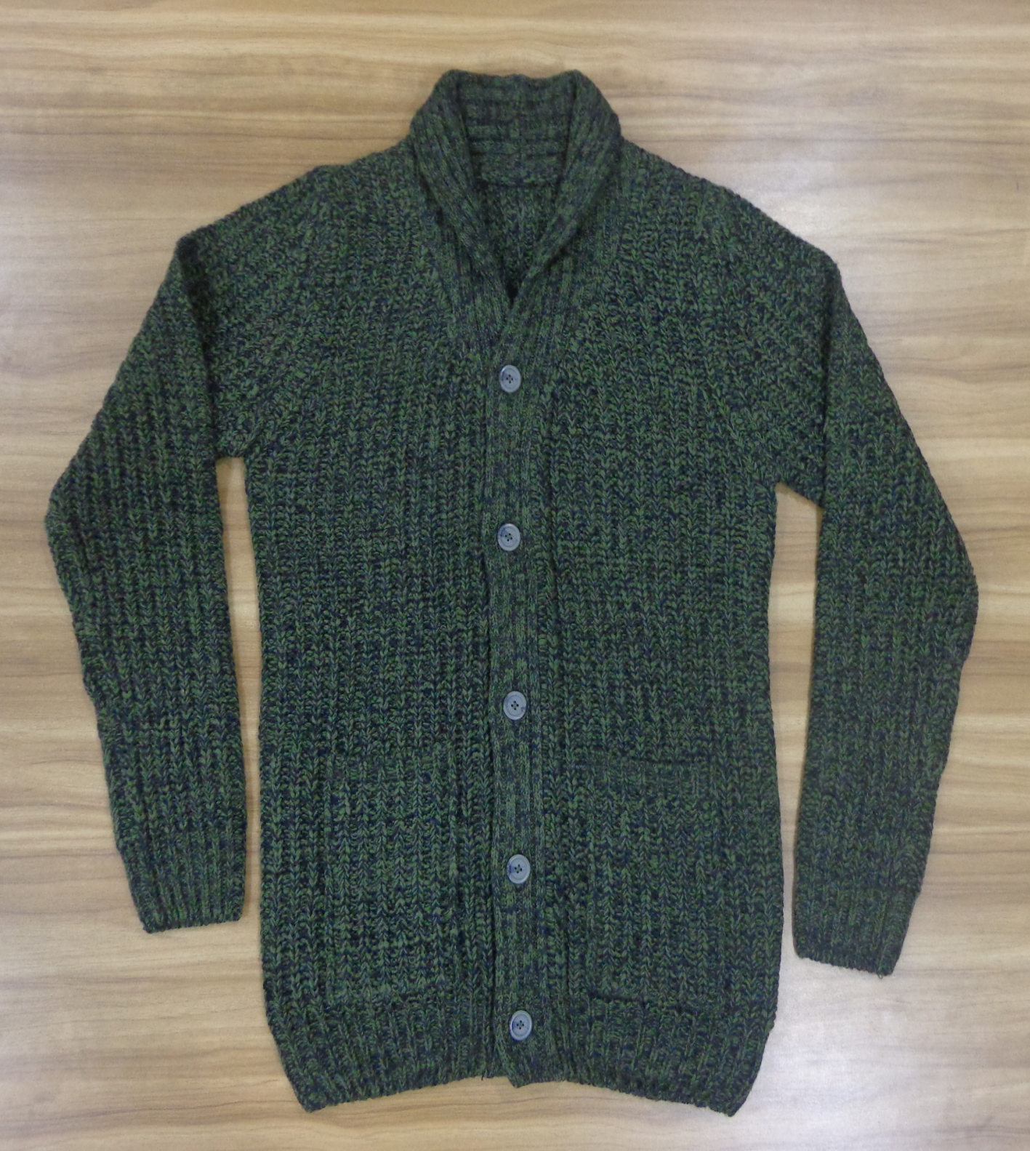
STYLE : HF2018053
YARN : 100% ACRYLIC
GAUGE : 3 GG
DES: MENS CARDIGAN

Slide 2
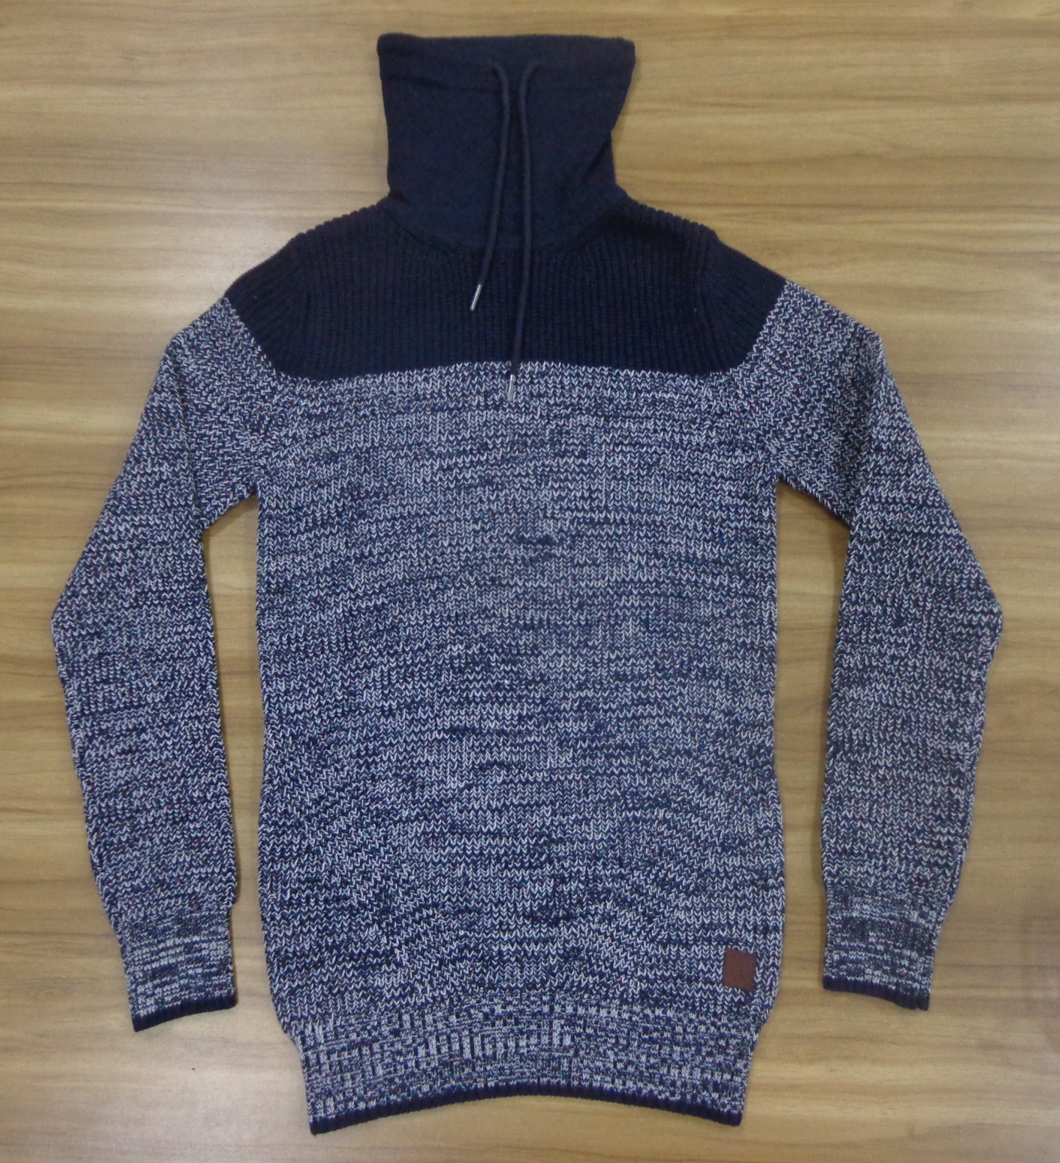
STYLE : HF2018054
YARN : 100% COTTON
GAUGE : 3 GG
DES: MENS PULLOVER

Slide 3
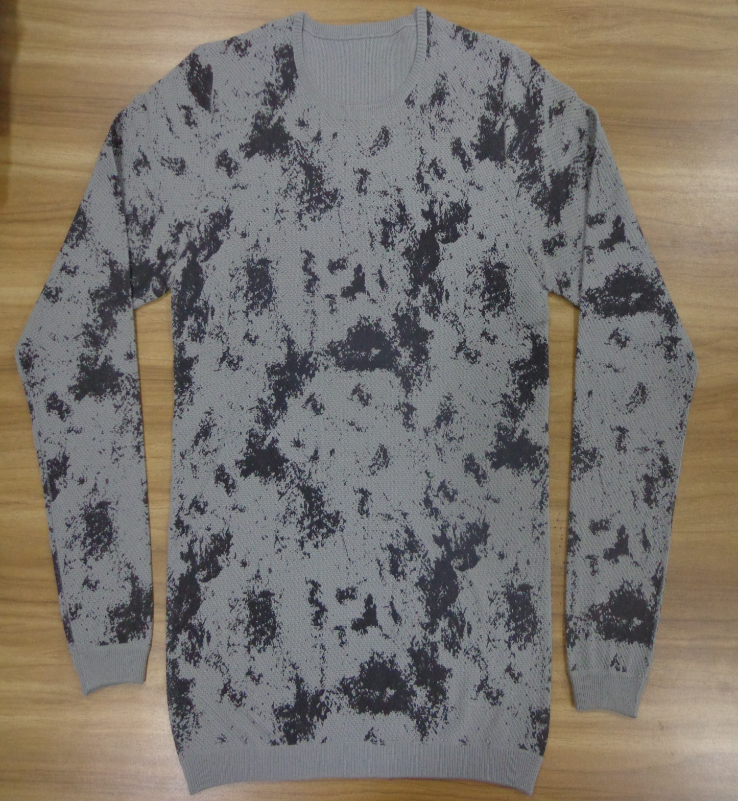
STYLE : HF2018055
YARN : 100% COTTON
GAUGE : 12 GG
DES: MENS PULLOVER

Slide 4
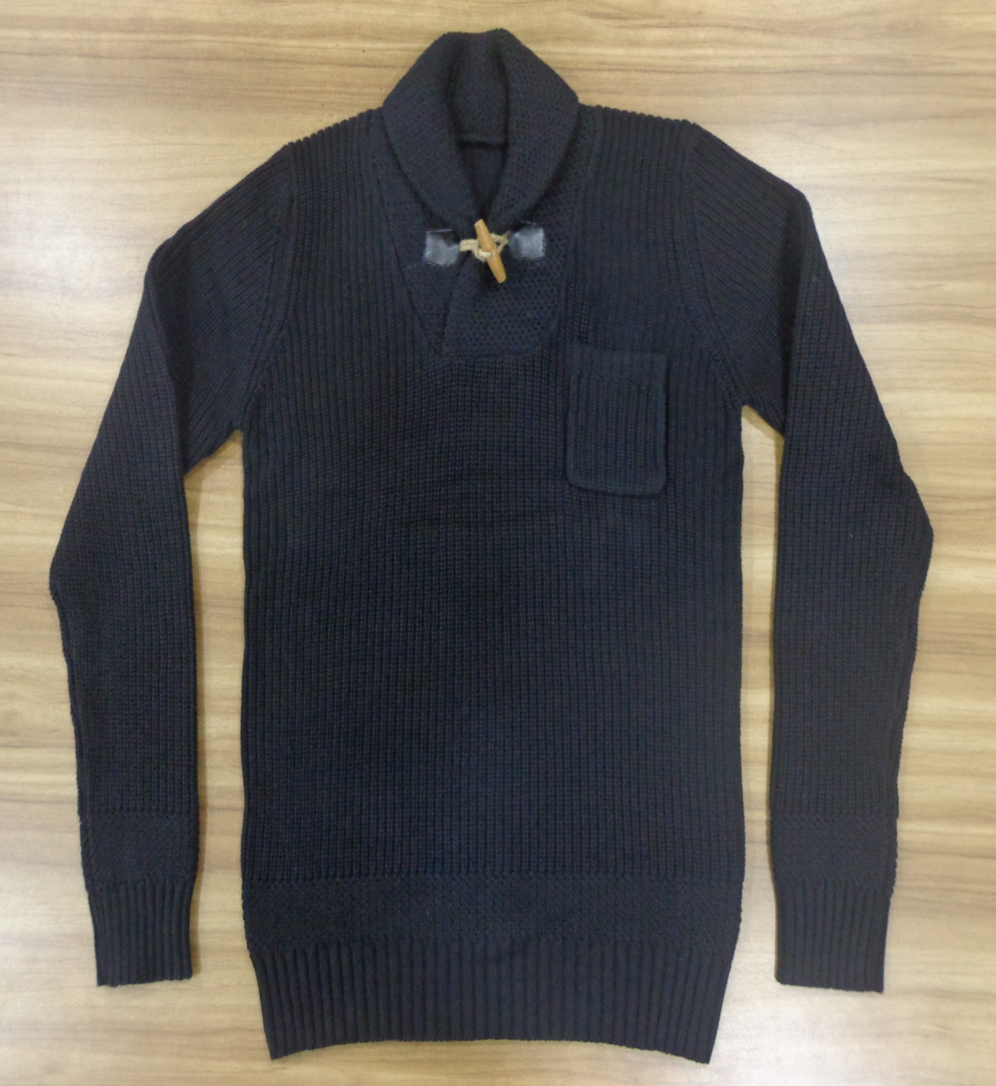
STYLE : HF2018056
YARN : 100% COTTON
GAUGE : 5 GG
DES: MENS PULLOVER

Slide 5
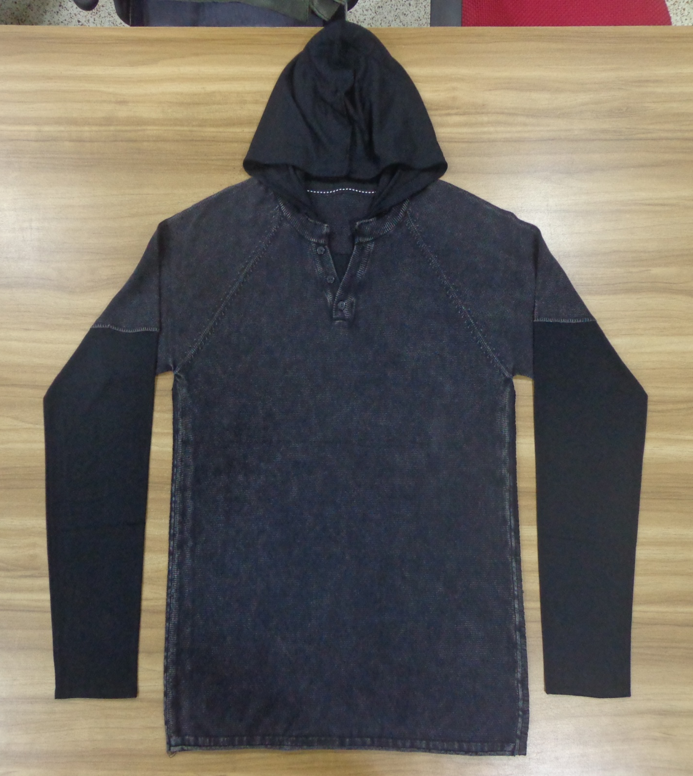
STYLE : HF2018057
YARN : 100% COTTON
GAUGE : 12 GG
DES: MENS PULLOVER

Slide 6
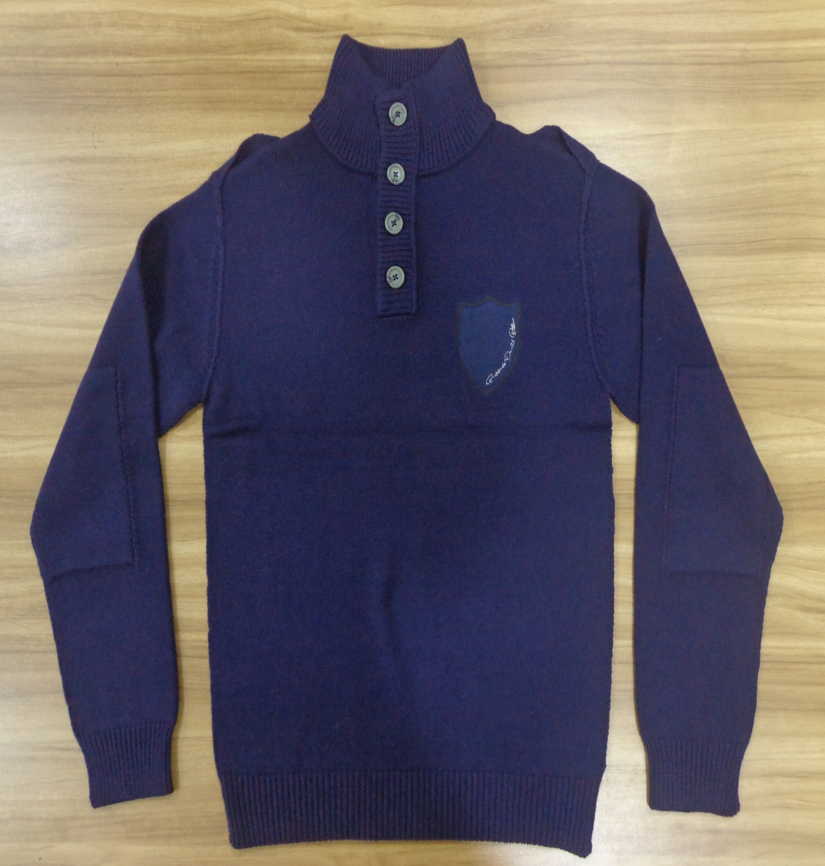
STYLE : HF2018058
YARN : 100% COTTON
GAUGE : 5 GG
DES: MENS PULLOVER

