Slide 1
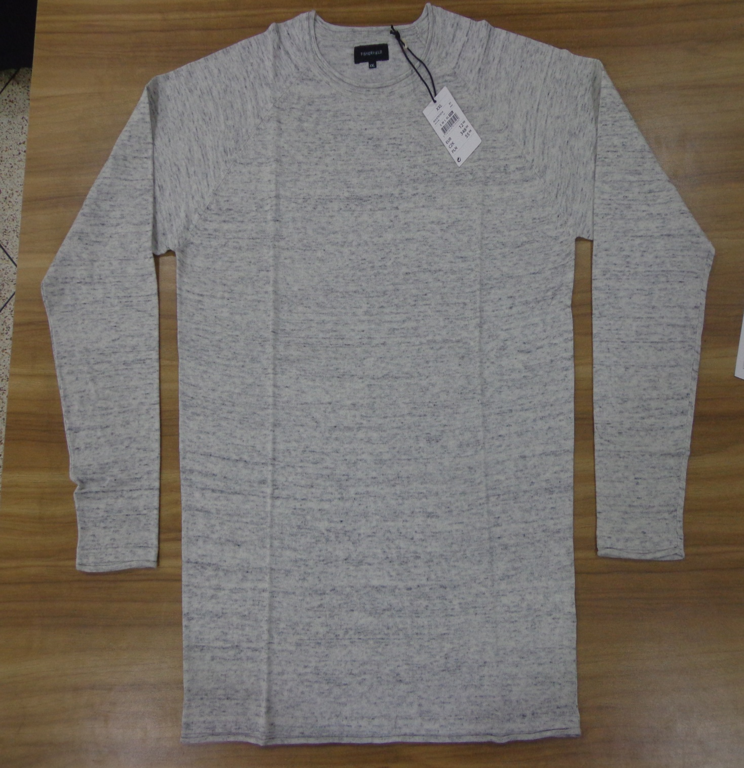
STYLE : HF2018047
YARN : 100% COTTON
GAUGE : 12 GG
DES: MENS PULLOVER

Slide 2
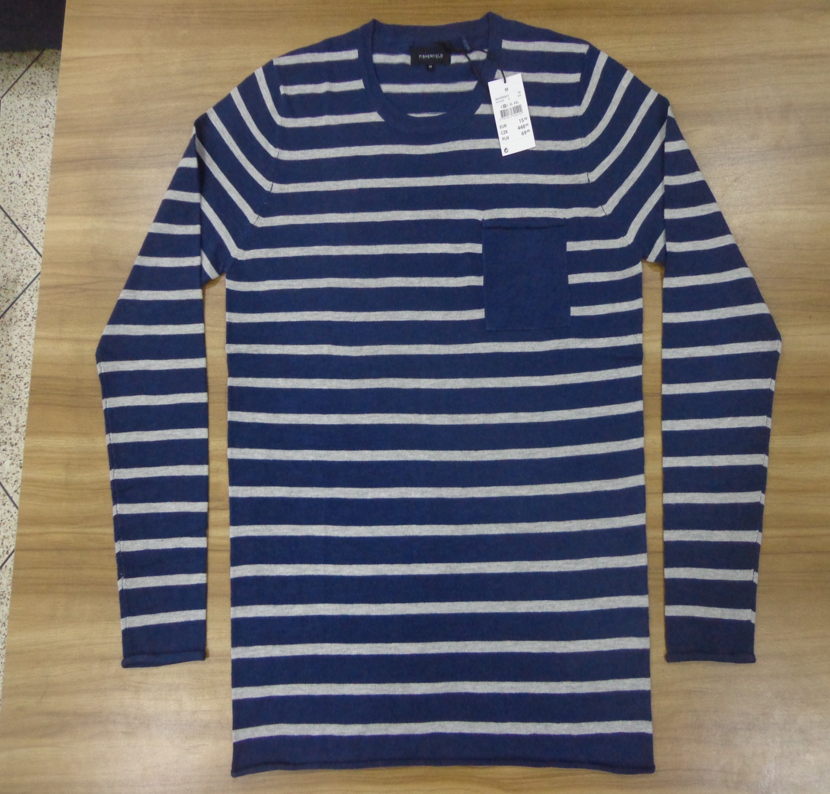
STYLE : HF2018048
YARN : 100% COTTON
GAUGE : 12 GG
DES: MENS PULLOVER

Slide 3
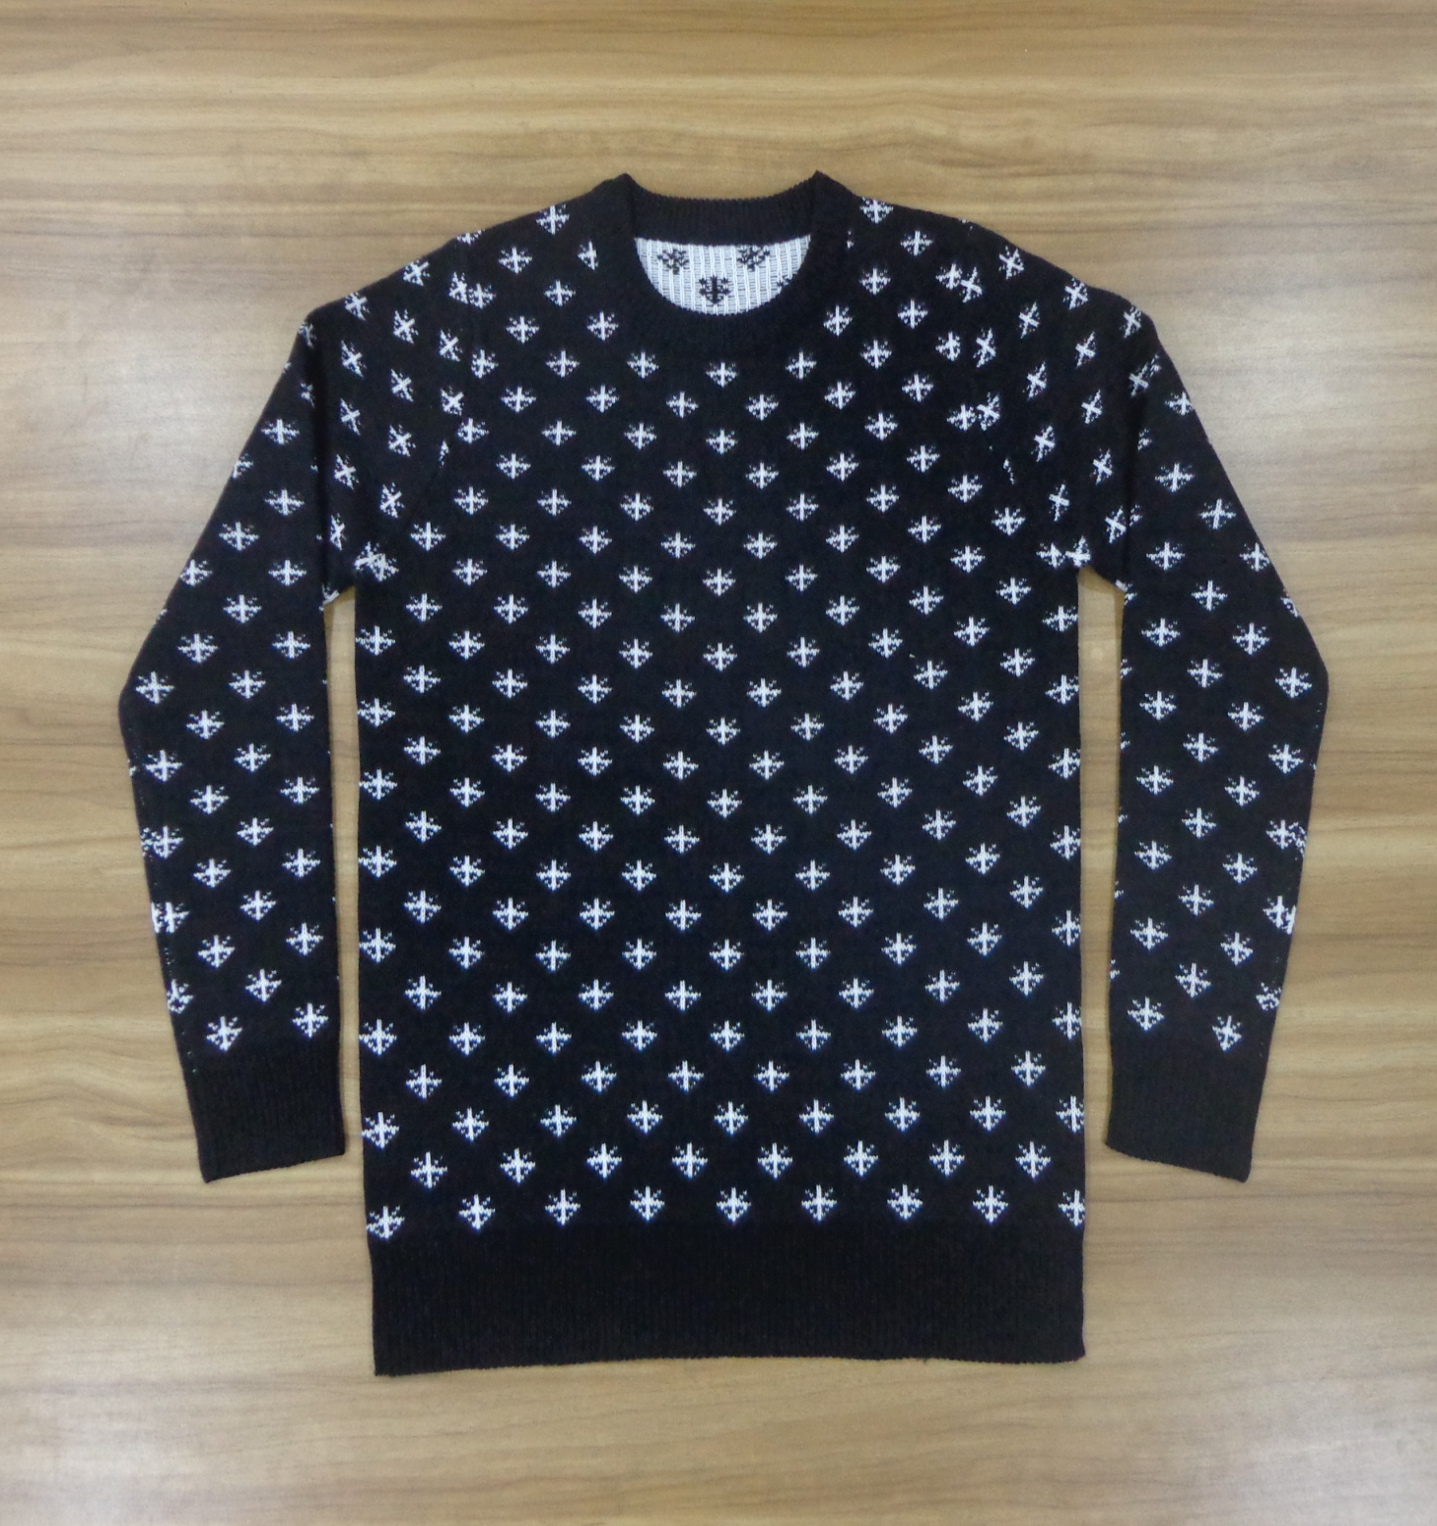
STYLE : HF2018049
YARN : 100% ACRYLIC
GAUGE : 7 GG
DES: MENS PULLOVER

Slide 4
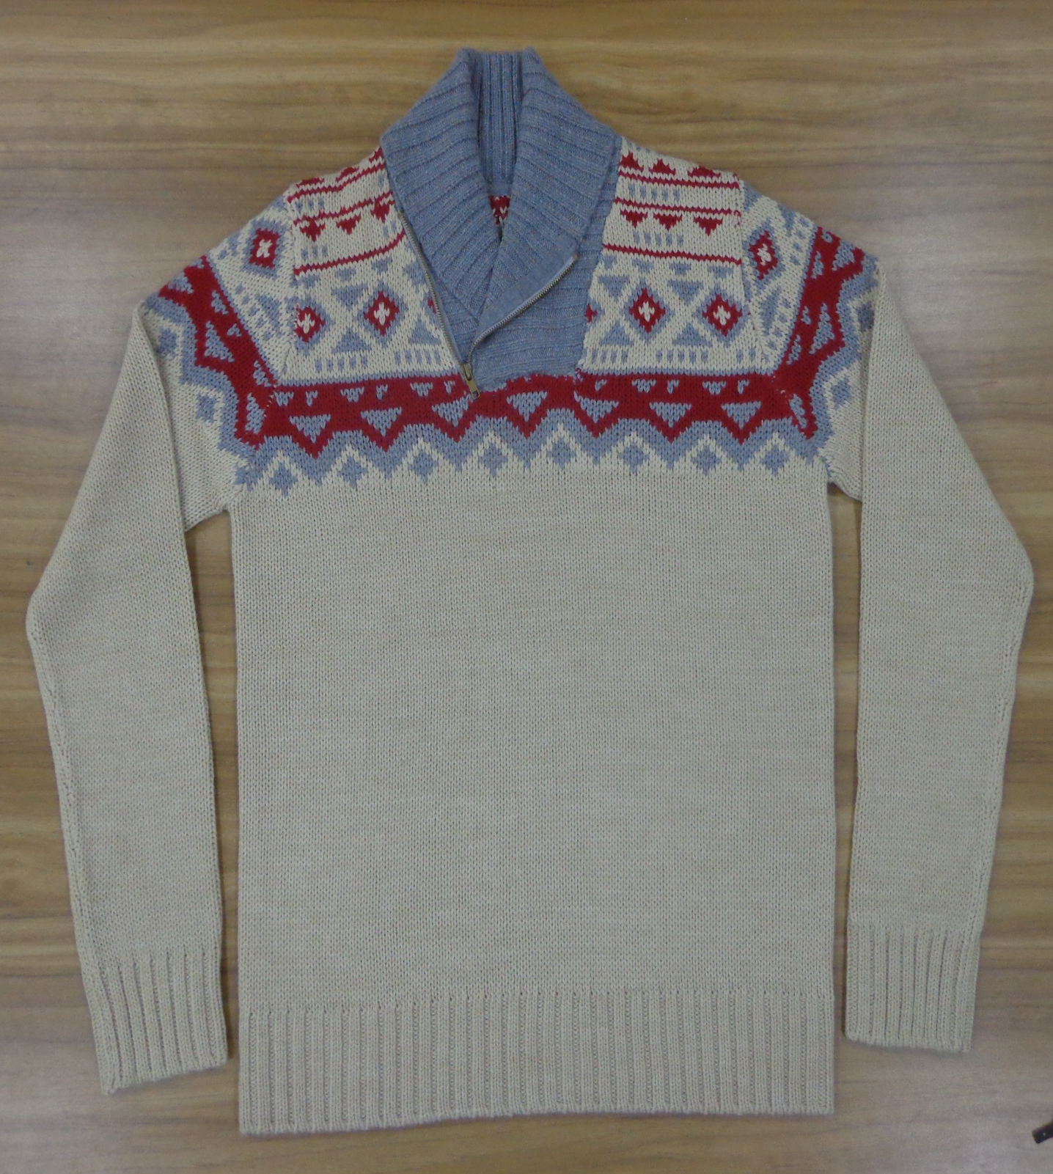
STYLE : HF2018050
YARN : 100% COTTON
GAUGE : 5 GG
DES: MENS PULLOVER

Slide 5
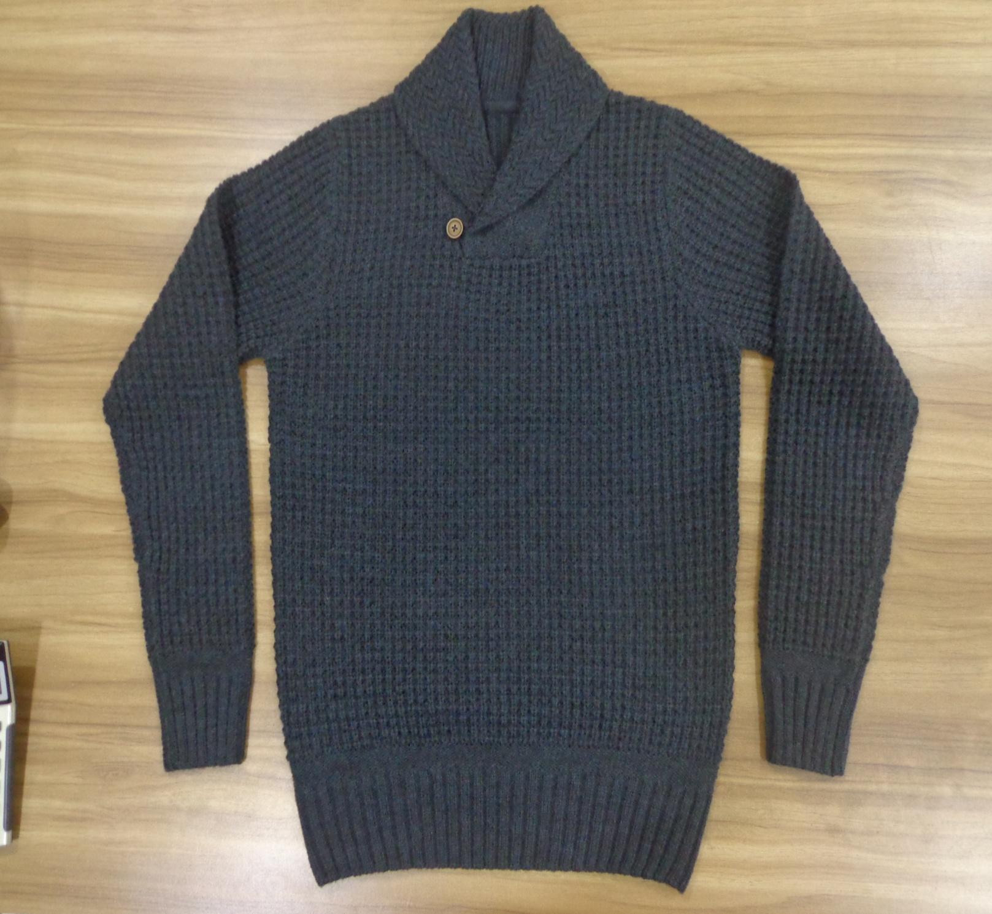
STYLE : HF2018050
YARN : 100% ACRYLIC
GAUGE : 3 GG
DES: MENS PULLOVER

Slide 6
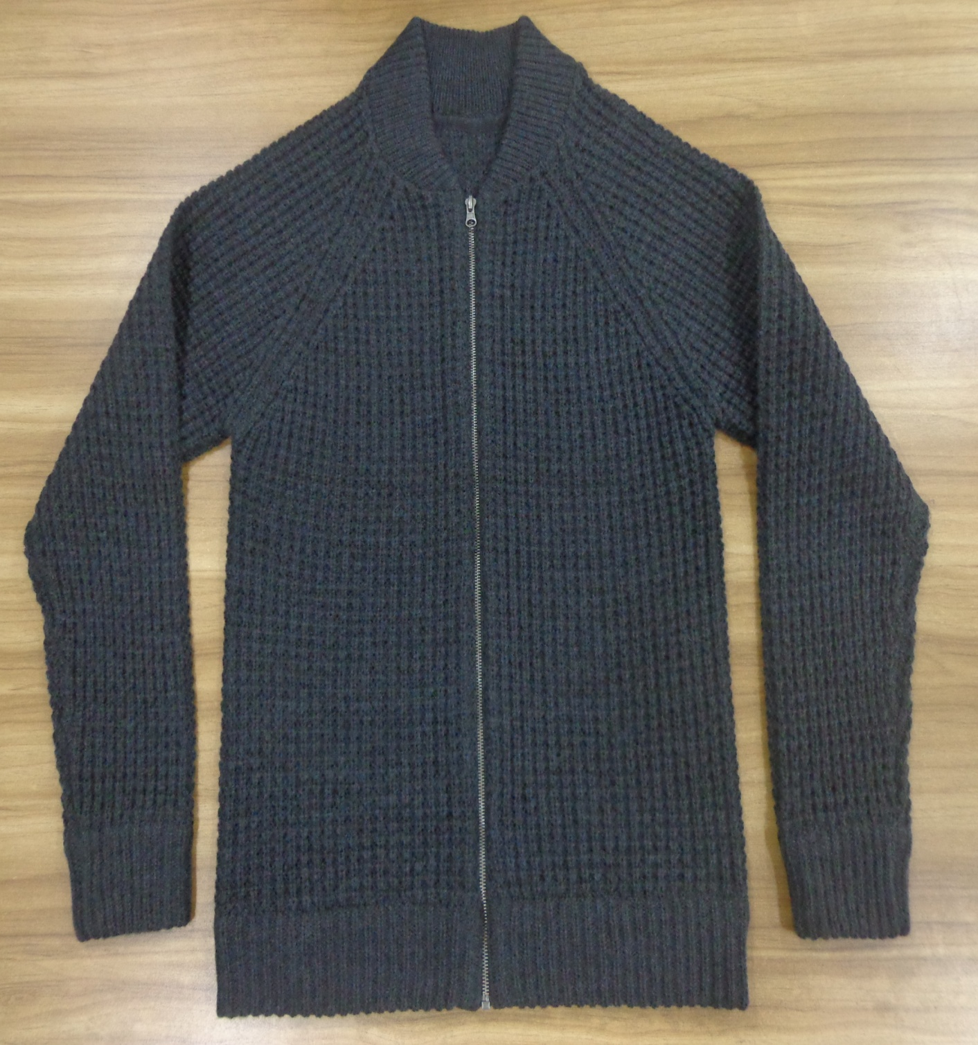
STYLE : HF2018051
YARN : 100% ACRYLIC
GAUGE : 3 GG
DES: MENS CARDIGAN

Slide 7
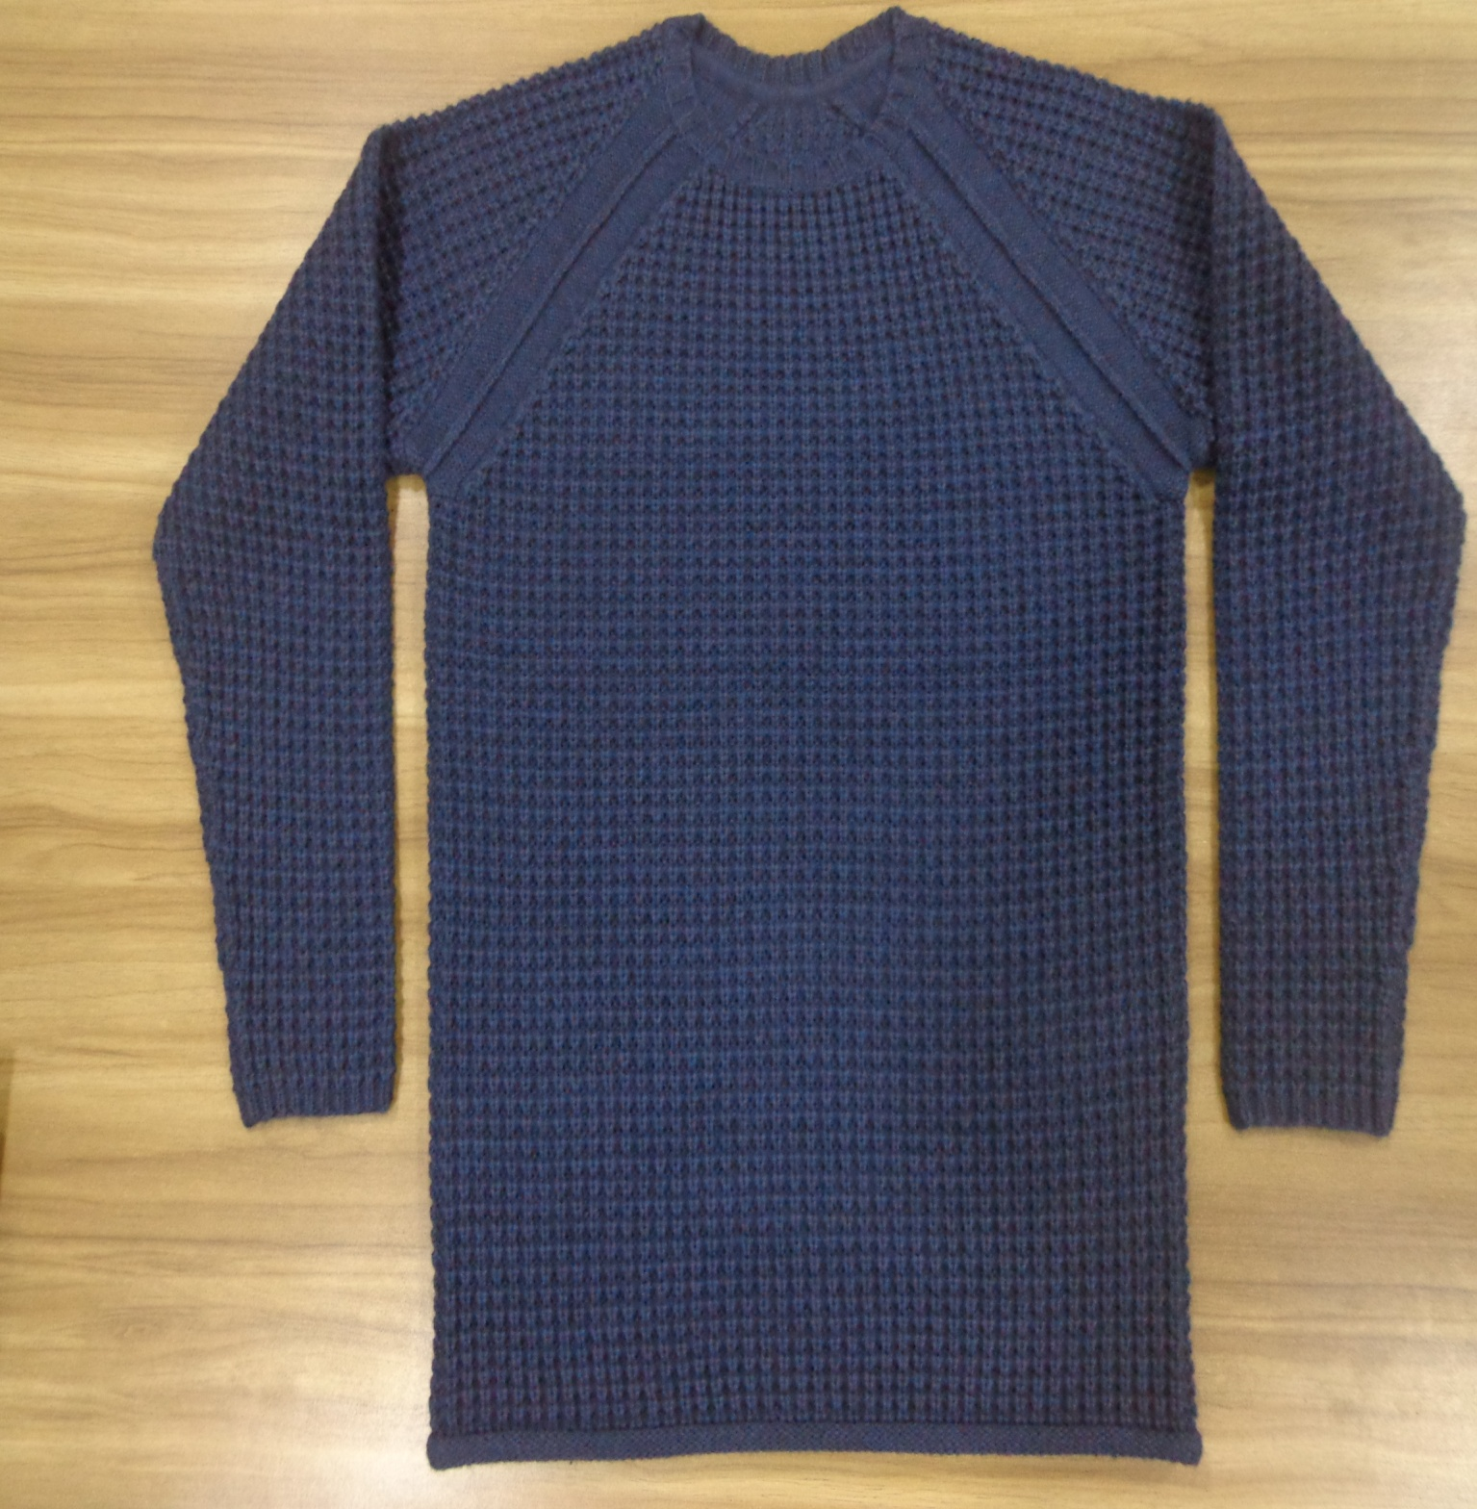
STYLE : HF2018052
YARN : 100% COTTON
GAUGE : 3 GG
DES: MENS PULLOVER

