Slide 1
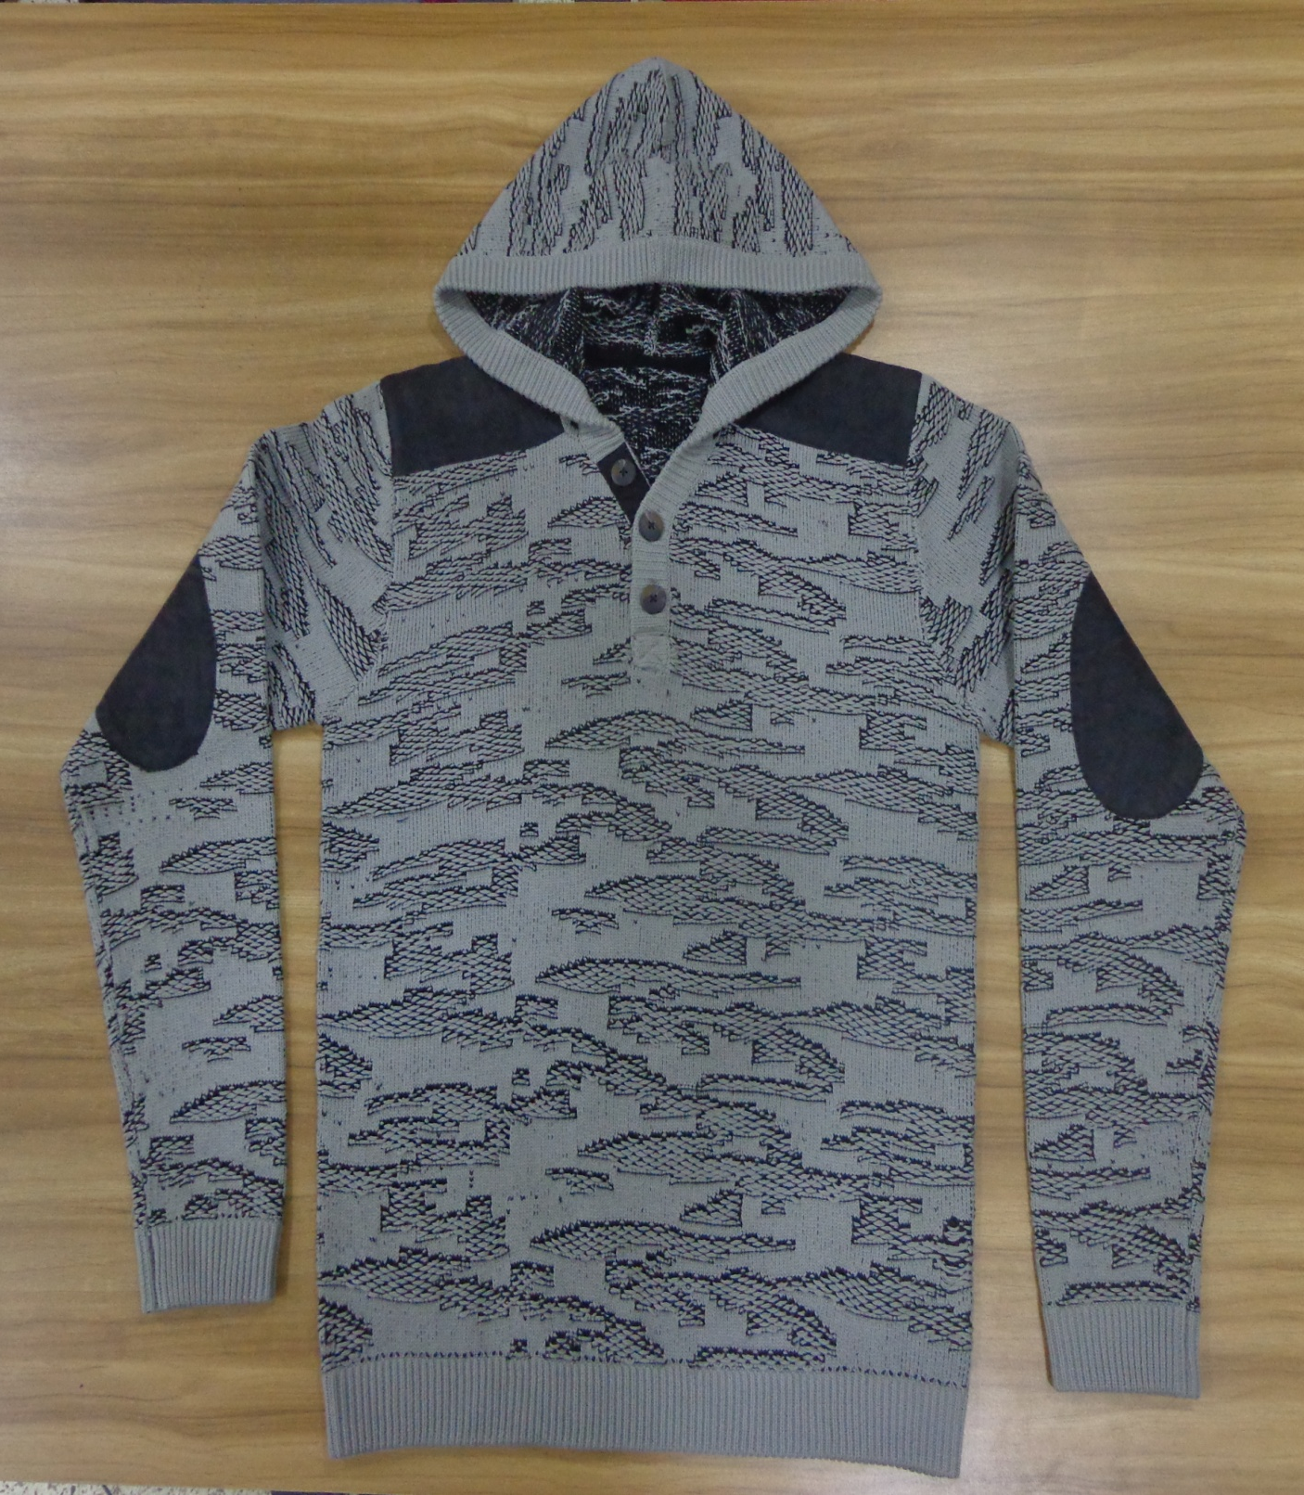
STYLE : HF2018059
YARN : 100% COTTON
GAUGE : 7 GG
DES: MENS PULLOVER

Slide 2
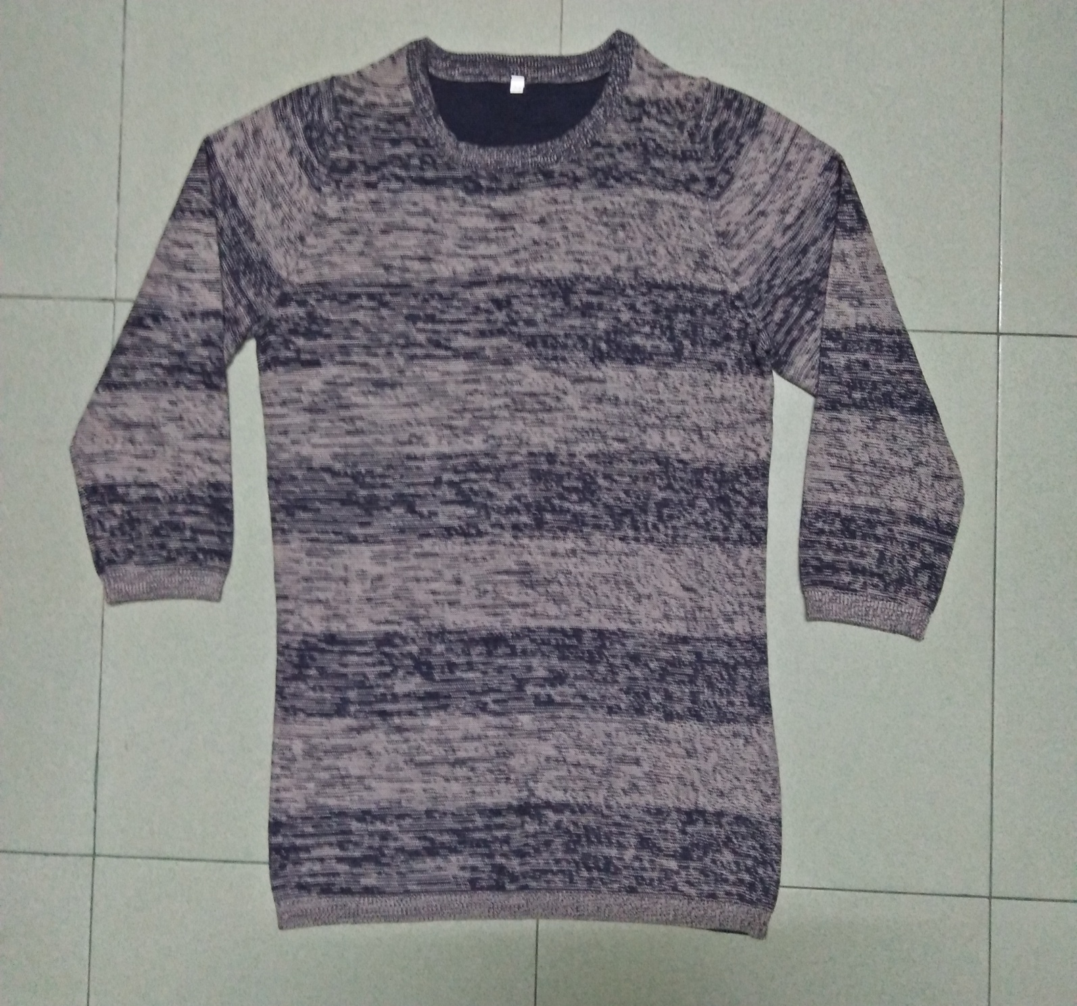
STYLE : HF2018060
YARN : 100% COTTON
GAUGE : 7 GG
DES: MENS PULLOVER

Slide 3
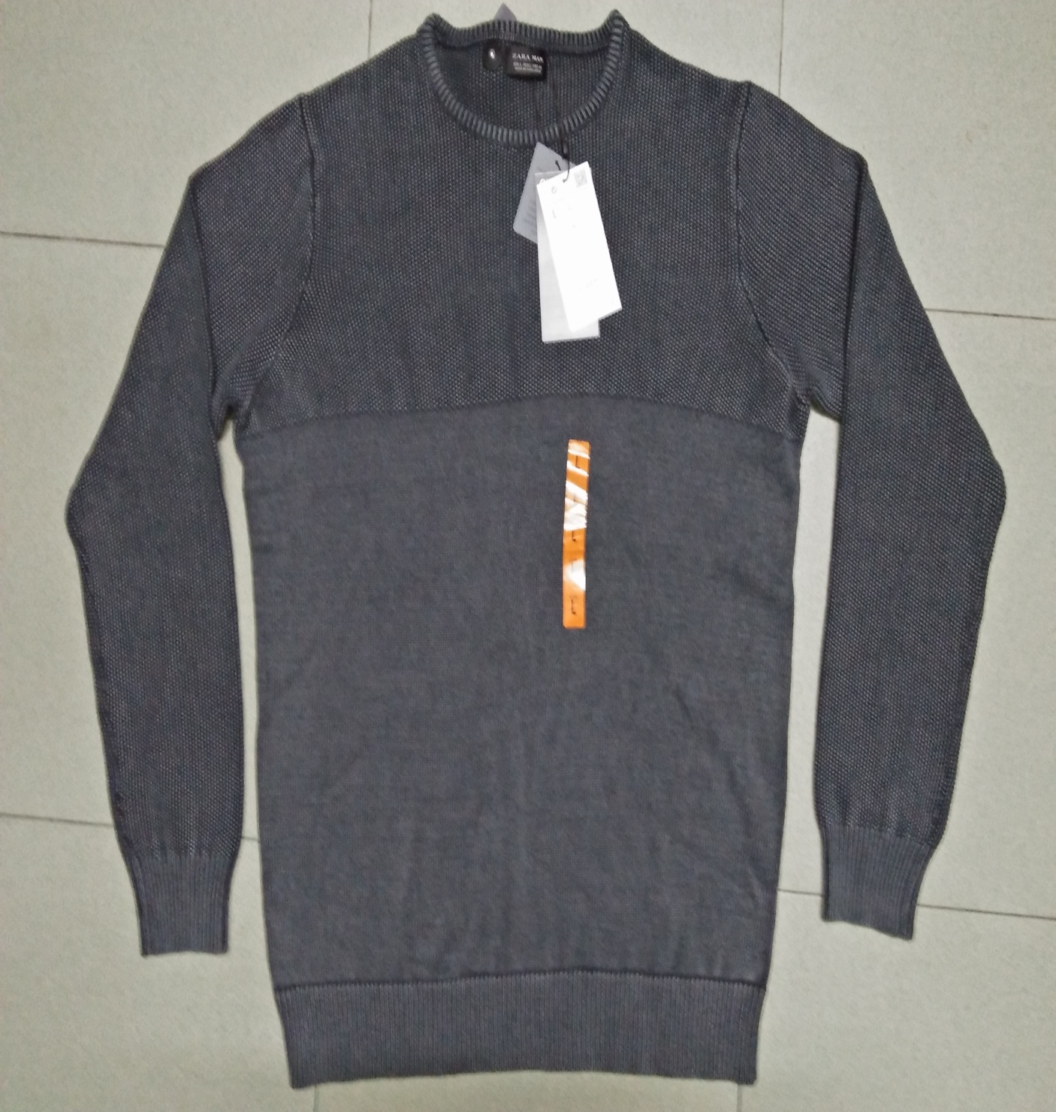
STYLE : HF2018061
YARN : 100% COTTON
GAUGE : 12 GG
DES: MENS PULLOVER

Slide 4
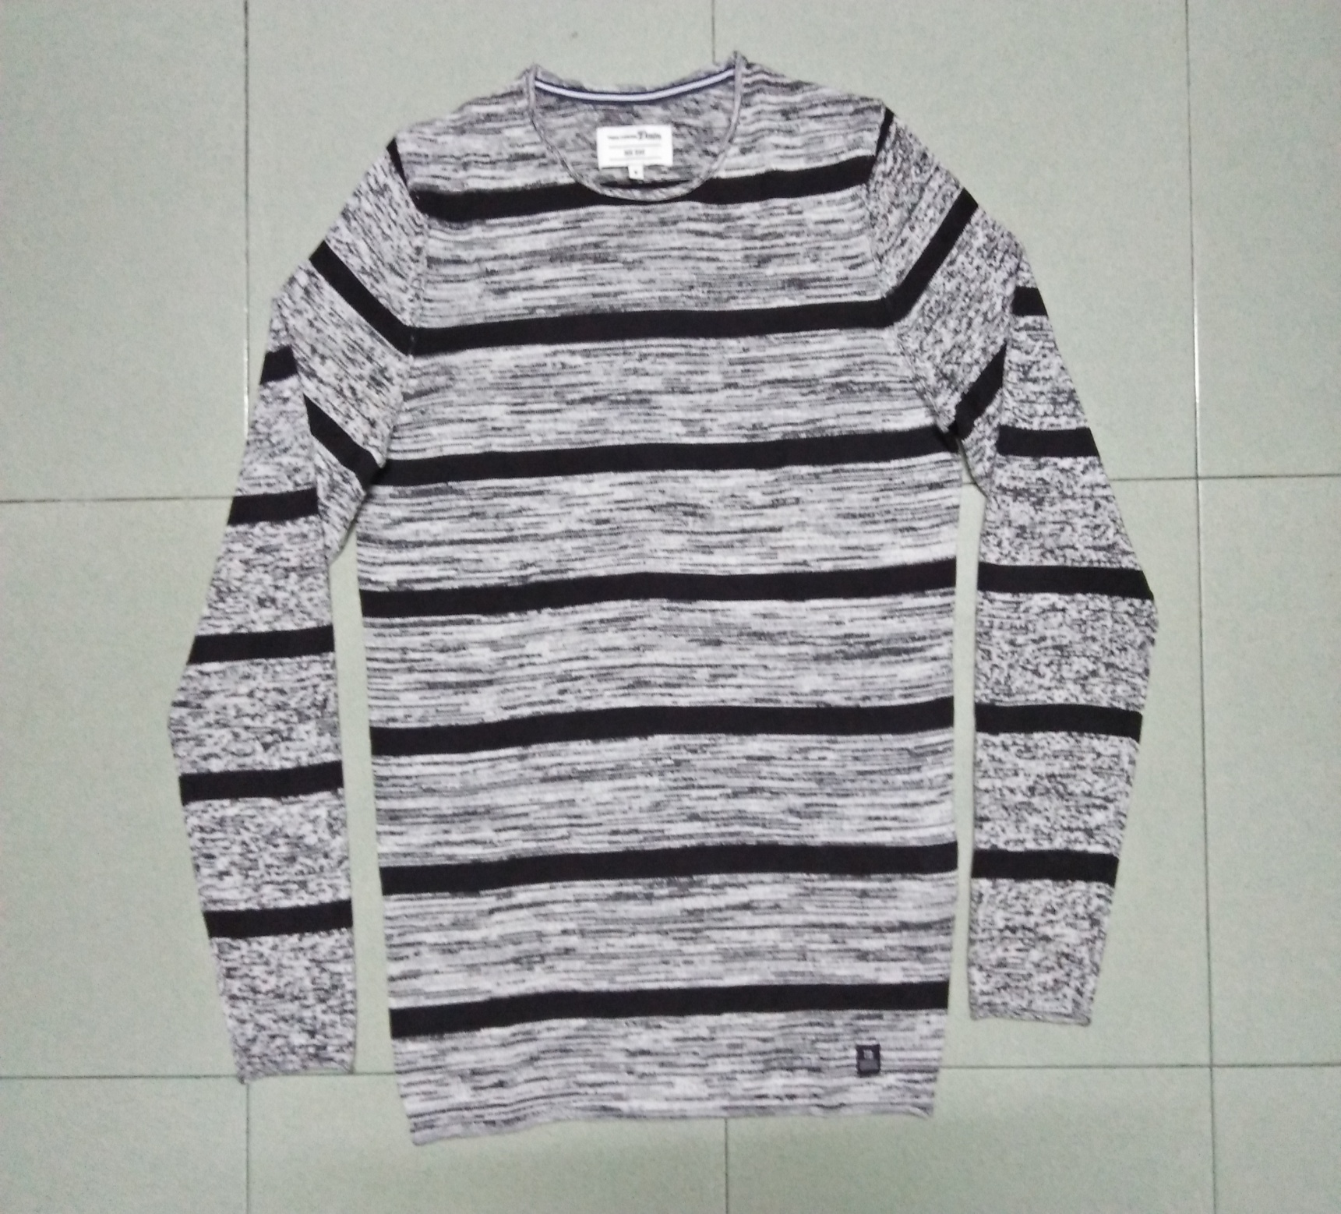
STYLE : HF2018062
YARN : 100% COTTON
GAUGE : 12 GG
DES: MENS PULLOVER

Slide 5
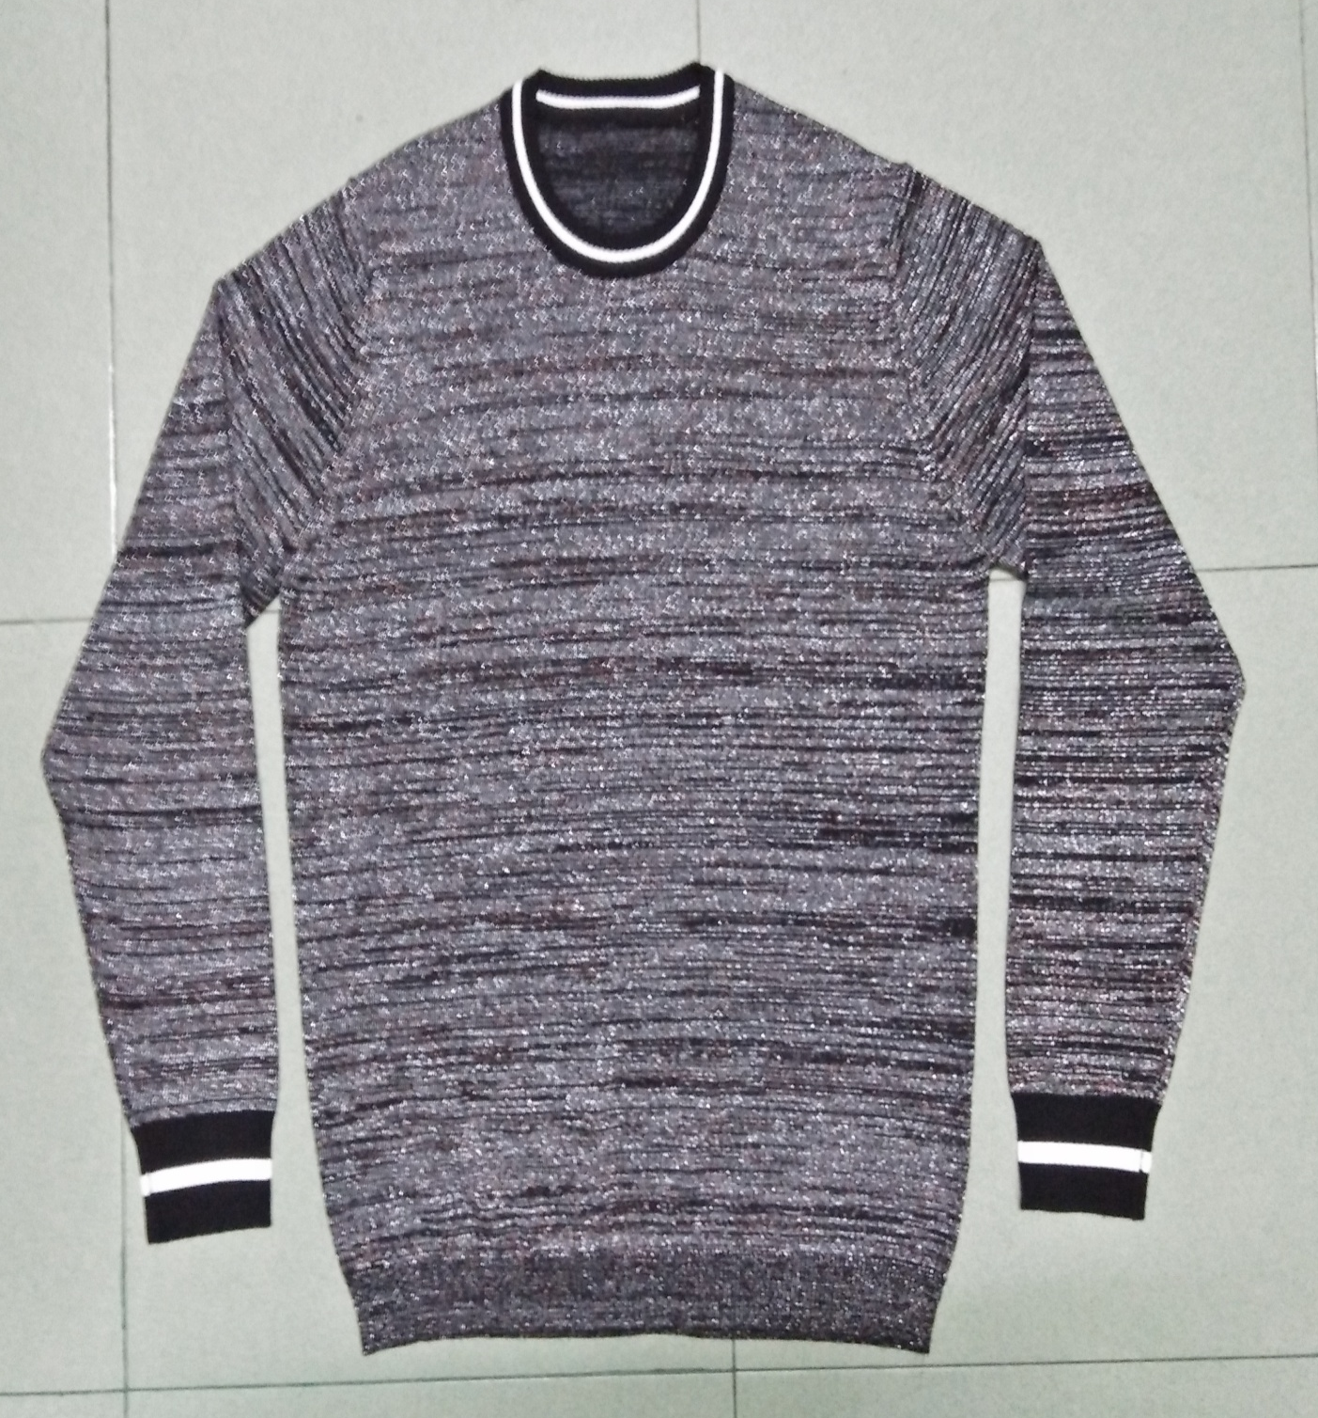
STYLE : HF2018063
YARN : 100% COTTON
GAUGE : 12 GG
DES: MENS PULLOVER

Slide 6
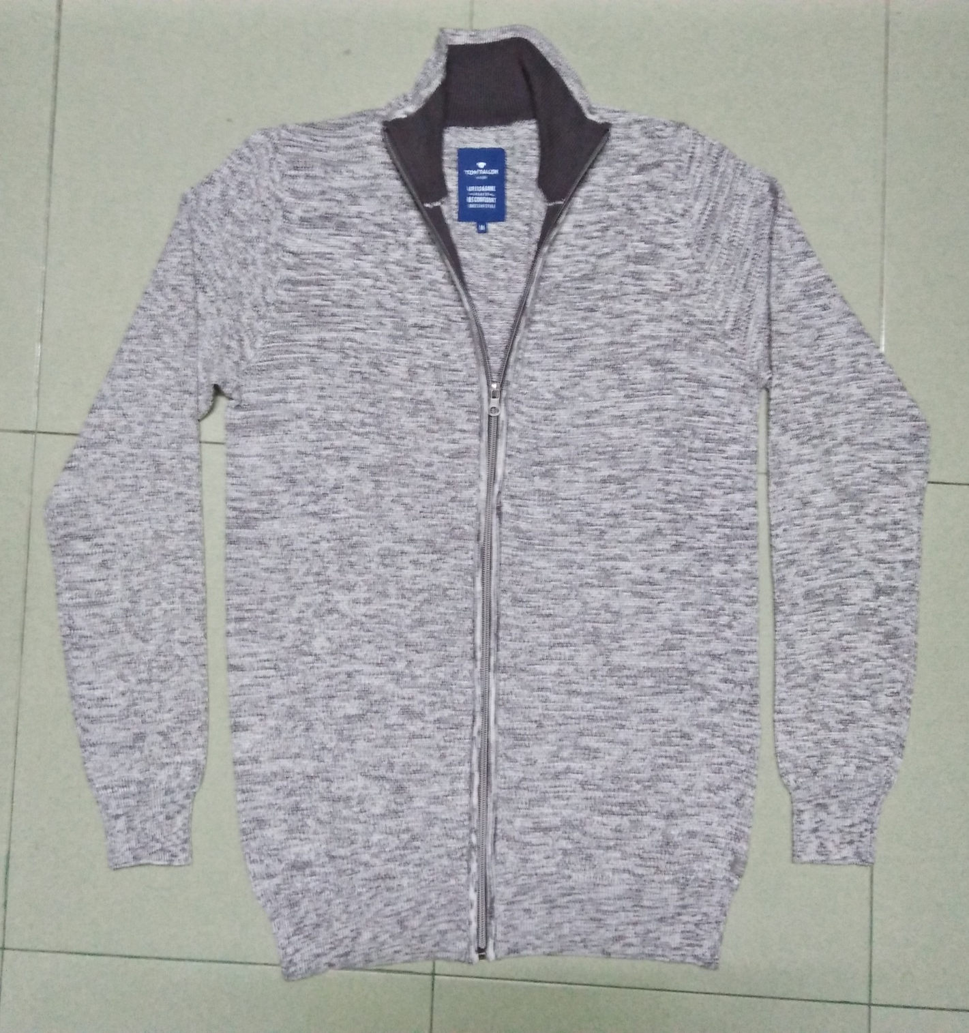
STYLE : HF2018064
YARN : 100% COTTON
GAUGE : 7 GG
DES: MENS PULLOVER

