Slide 1
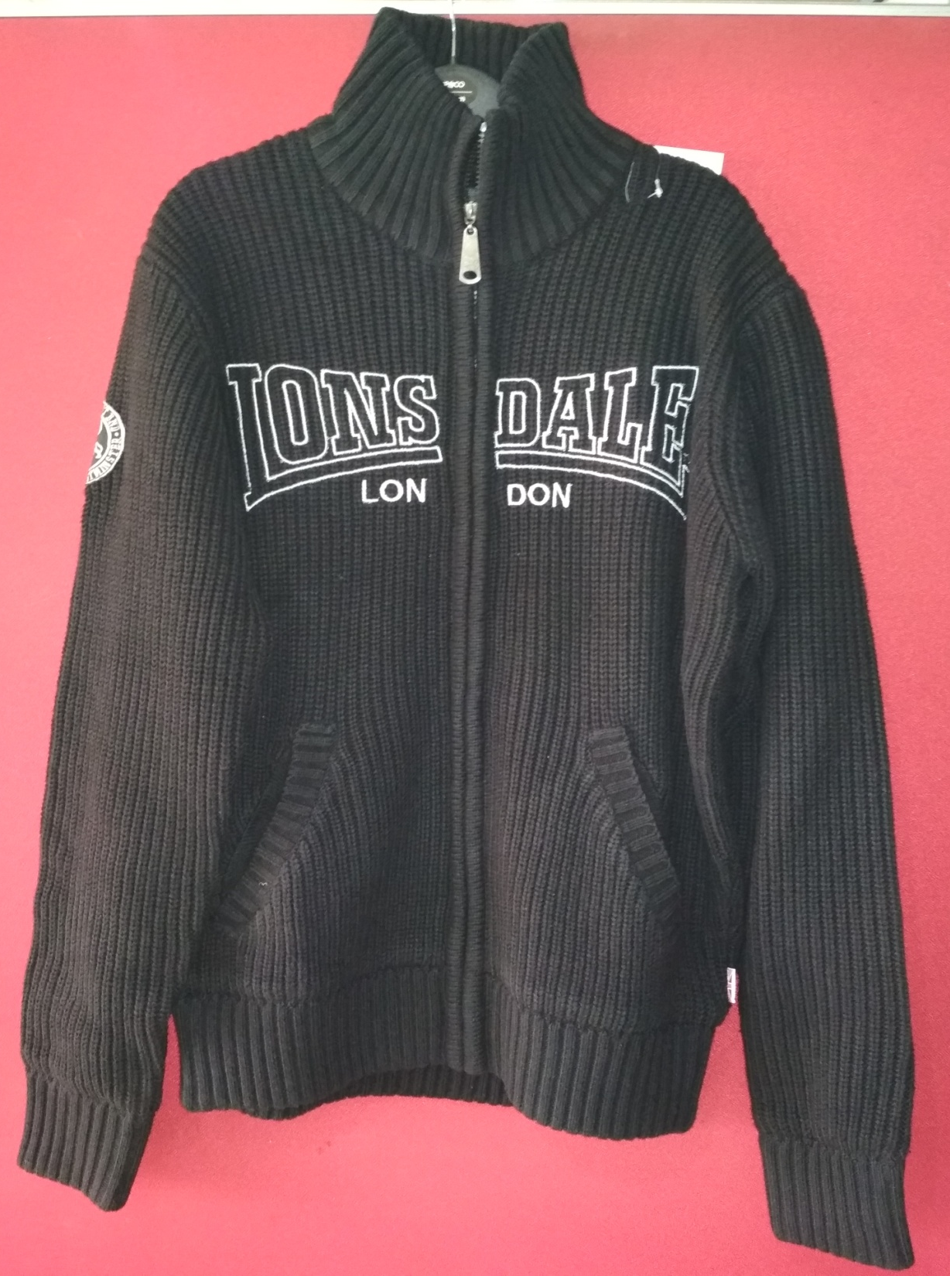
Style # Appel35
Description: Mens l/slv cardigan mock neck with pocket sweater
Yarn: 100% Acrylic
Gauge: 5 gg
Weight : 19.50 lbs/dz
Size Range: S-XL

Slide 2
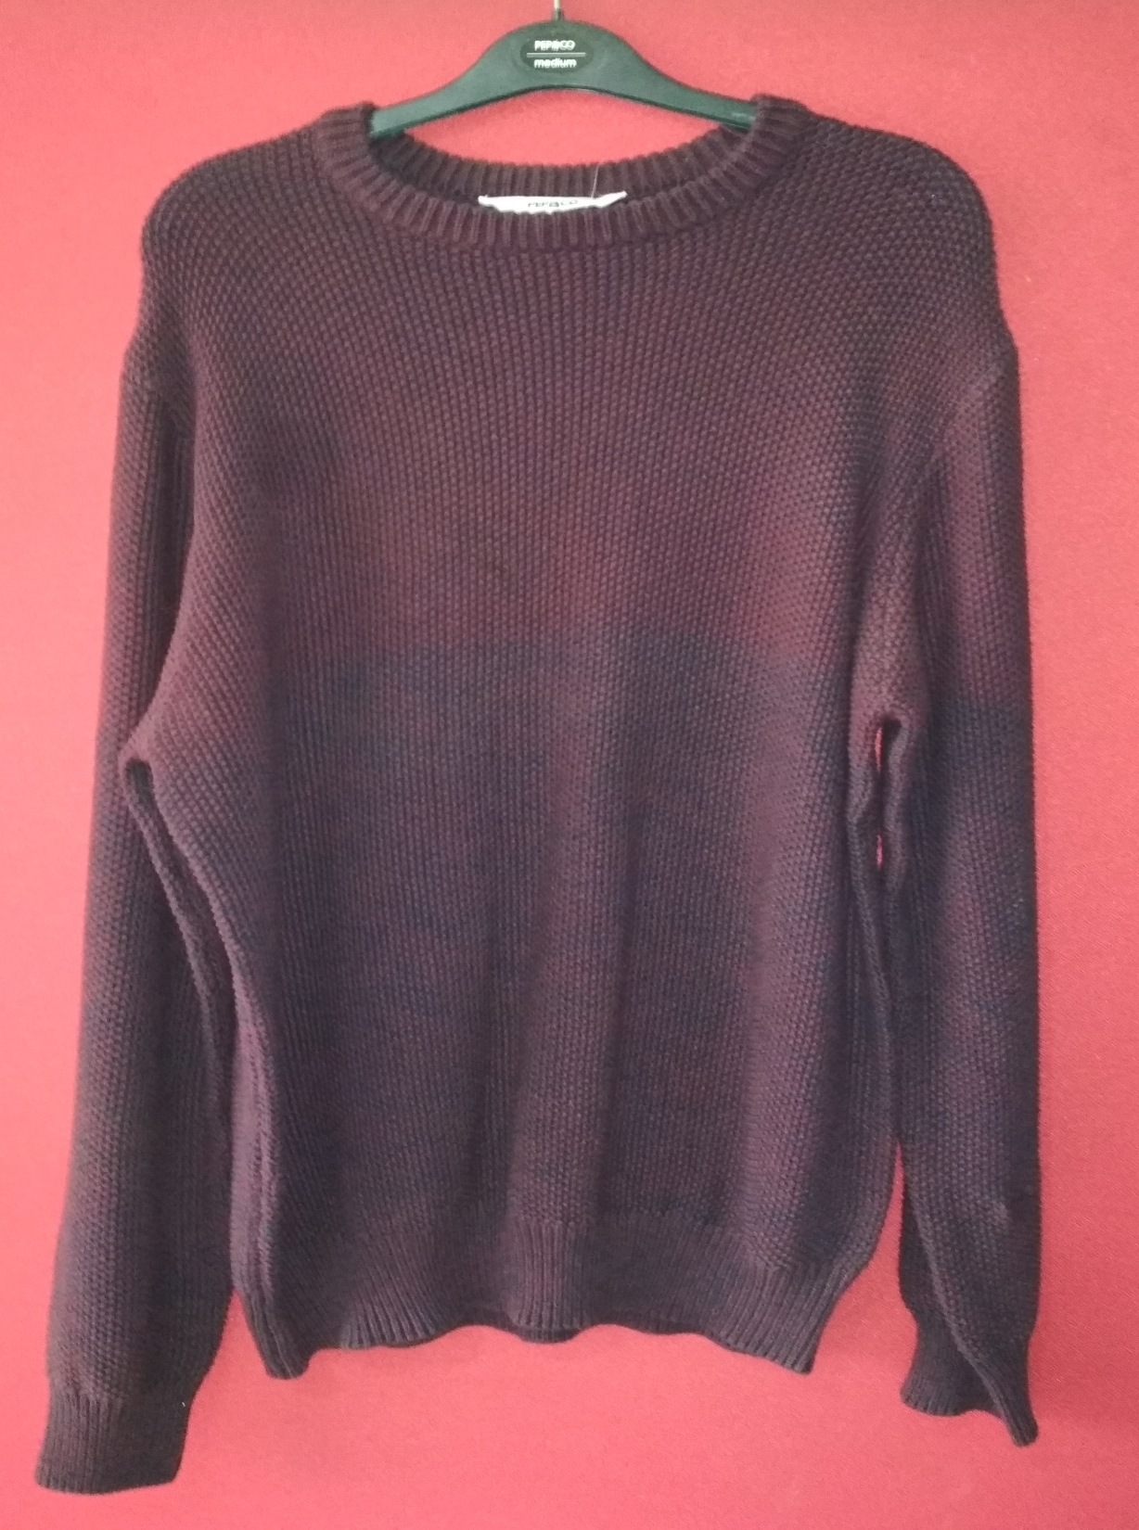
Style # Apel670
Description: Mens l/slv round neck jacquard sweater
Yarn: 100% Cotton
Gauge: 5 gg
Weight : 16.00
Size Range: S-XL

Slide 3
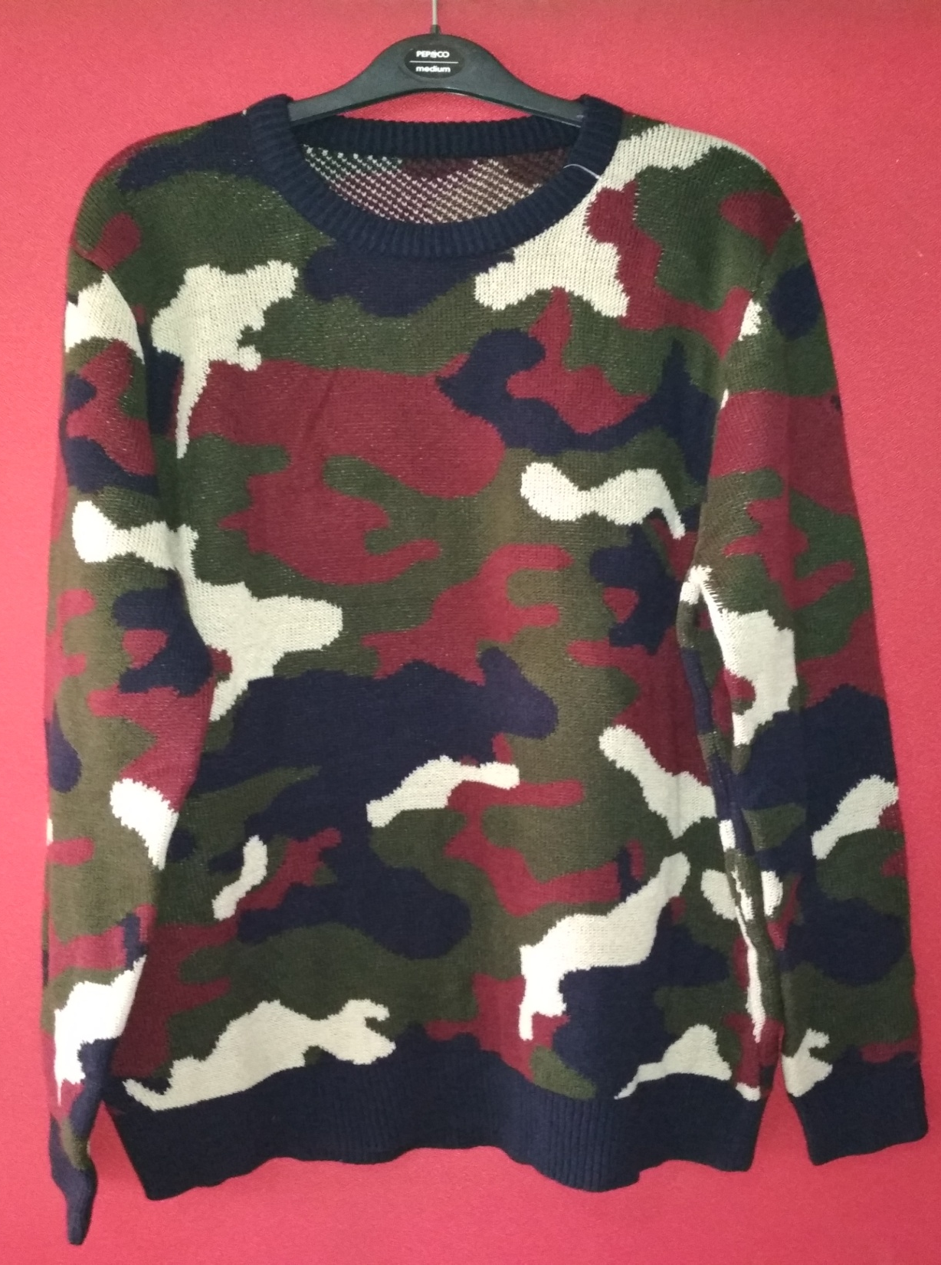
Style # GL1705
Description: Mens l/slv round neck jacquard print sweater.
Yarn: 100% Acrylic
Gauge: 7 gg
Weight : 12.50 lbs/dz
Size Range: S-XL

Slide 4
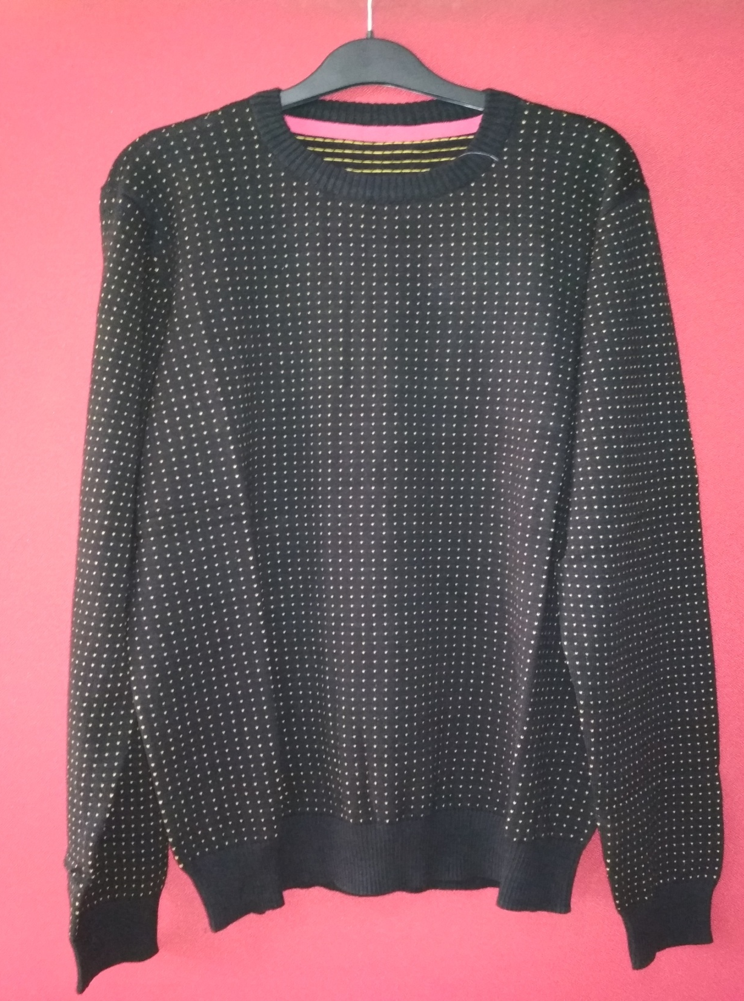
Style # One125
Description: Mens l/slv round neck jacquard print sweater
Yarn: 100% Cotton
Gauge: 12 gg
Weight : 9.00 lbs/dz
Size Range: S-XXL

Slide 5
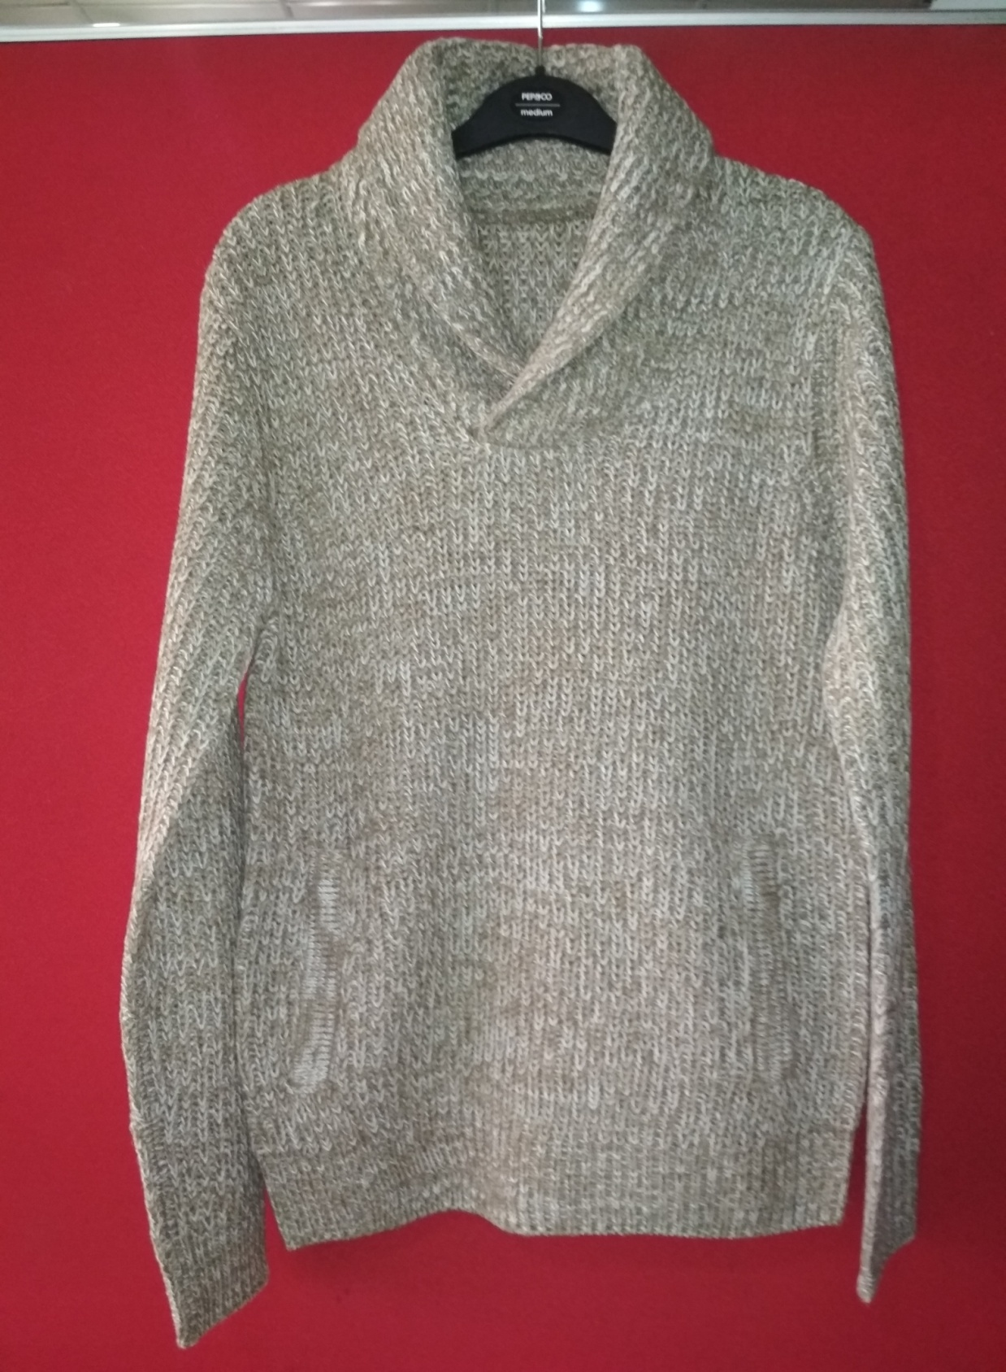
Style # Tuhid08
Description: Mens l/slv shawl neck twist sweater
Yarn: 100% Acrylic
Gauge: 3 gg
Weight : 19.00 lbs/dz
Size Range: S-XXL

Slide 6
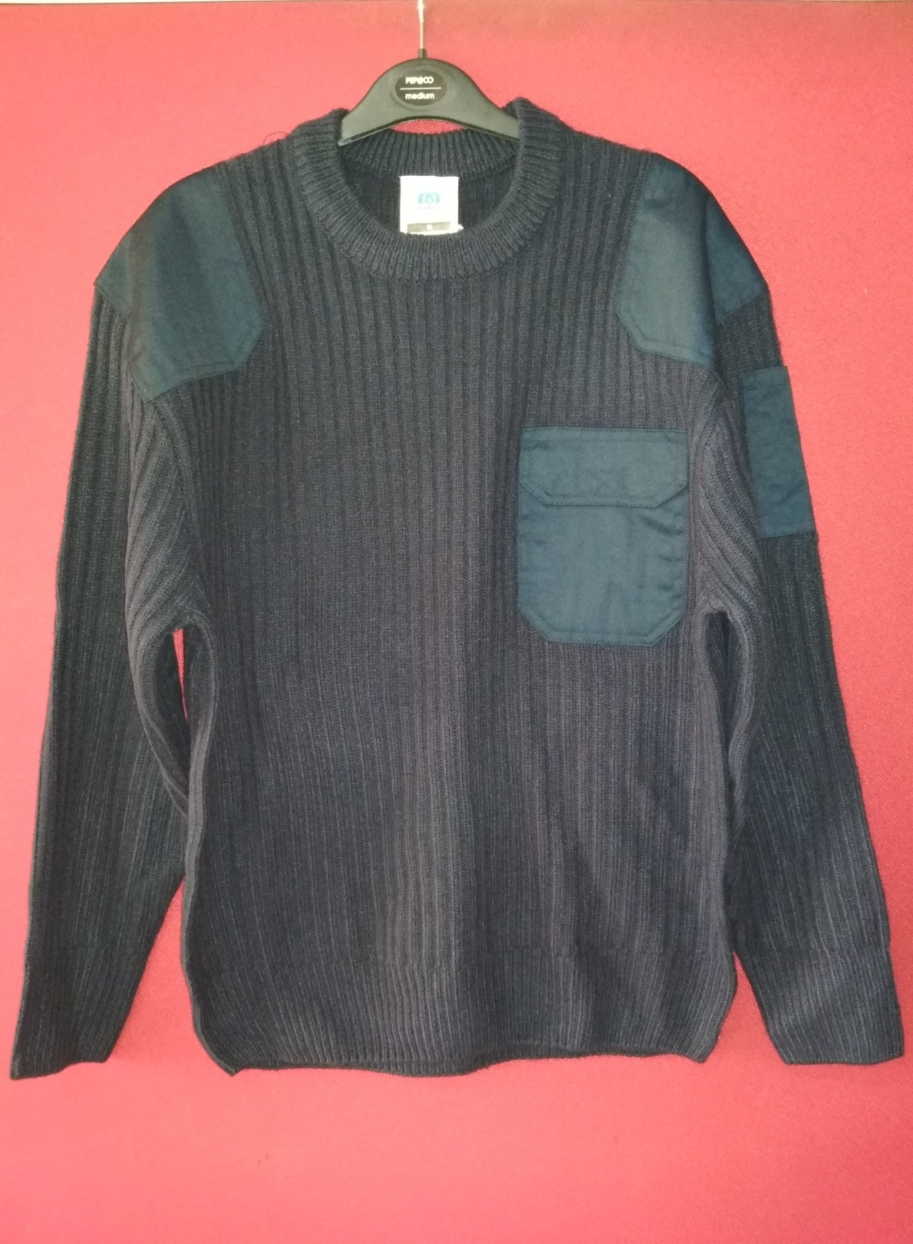
Style # Marca17
Description: Mens l/slv round neck rib sweater
Yarn: 100% Acrylic
Gauge: 5 gg
Weight : 15.00 lbs/dz
Size Range: S-XXL

