Slide 1
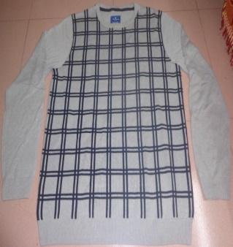
STYLE : HF2018001
YARN : 100% COTTON
GAUGE : 12 GG
DES: MENS PULLOVER

Slide 2
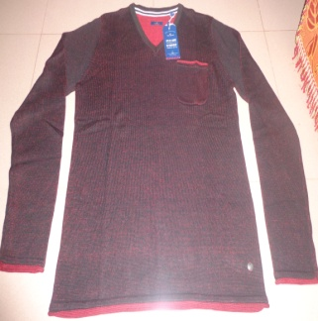
STYLE : HF2018002
YARN : 100% COTTON
GAUGE : 12 GG
DES: MENS PULLOVER

Slide 3
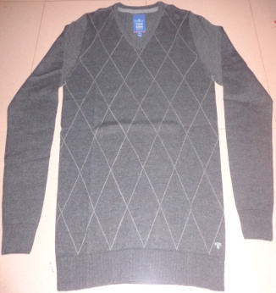
STYLE : HF2018003
YARN : 100% COTTON
GAUGE : 12 GG
DES: MENS PULLOVER

Slide 4
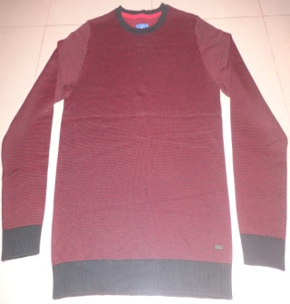
STYLE : HF2018004
YARN : 100% COTTON
GAUGE : 12 GG
DES: MENS PULLOVER

Slide 5
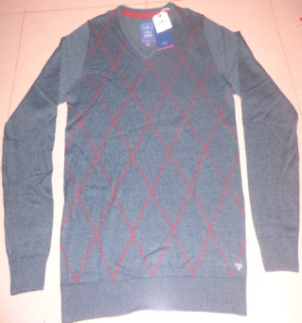
STYLE : HF2018005
YARN : 100% COTTON
GAUGE : 12 GG
DES: MENS PULLOVER

Slide 6
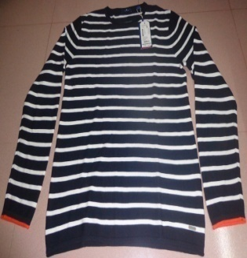
STYLE : HF2018006
YARN : 100% COTTON
GAUGE : 12 GG
DES: MENS PULLOVER

Slide 7
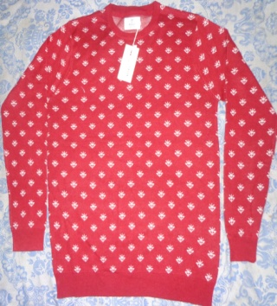
STYLE : HF2018007
YARN : 100% COTTON
GAUGE : 12 GG
DES: MENS PULLOVER

Slide 8
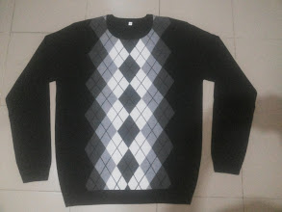
STYLE : HF2018008
YARN : 100% COTTON
GAUGE : 12 GG
DES: MENS PULLOVER

Slide 9
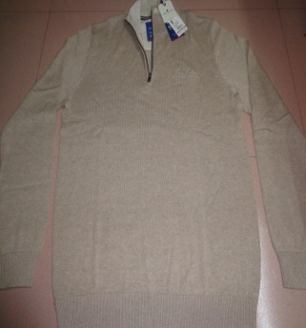
STYLE : HF2018009
YARN : 100% COTTON
GAUGE : 12 GG
DES: MENS PULLOVER

Slide 10
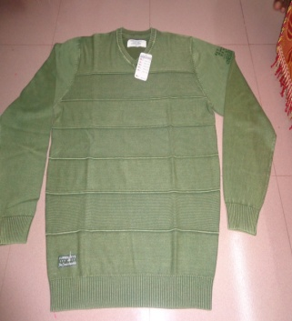
STYLE : HF2018010
YARN : 100% COTTON
GAUGE : 12 GG
DES: MENS PULLOVER

Slide 11
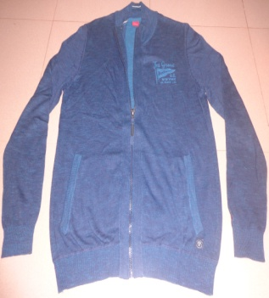
STYLE : HF2018011
YARN : 100% COTTON
GAUGE : 12 GG
DES: MENS CARDIGAN

Slide 12
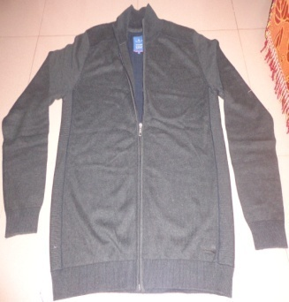
STYLE : HF2018012
YARN : 100% COTTON
GAUGE : 12 GG
WEIGHT : 10.50 LBS
DES: MENS CARDIGAN

Slide 13
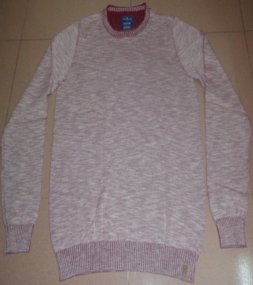
STYLE : HF2018013
YARN : 100% COTTON
GAUGE : 7 GG
DES: MENS PULLOVER

Slide 14
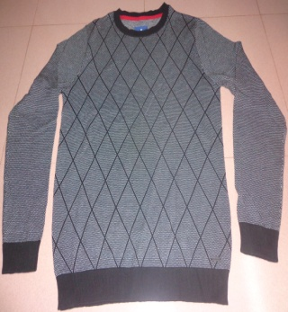
STYLE : HF2018014
YARN : 100% COTTON
GAUGE : 7 GG
DES: MENS PULLOVER

Slide 15
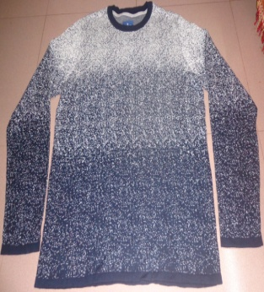
STYLE : HF2018015
YARN : 100% COTTON
GAUGE : 7 GG
DES: MENS PULLOVER

Slide 16
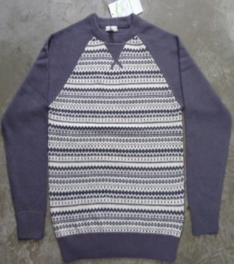
STYLE : HF2018016
YARN : 100% COTTON
GAUGE : 7 GG
DES: MENS PULLOVER

Slide 17
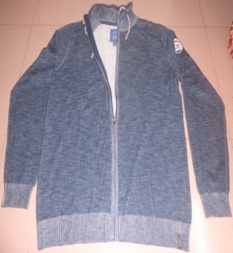
STYLE : HF2018017
YARN : 100% COTTON
GAUGE : 7 GG
DES: MENS PULLOVER

Slide 18
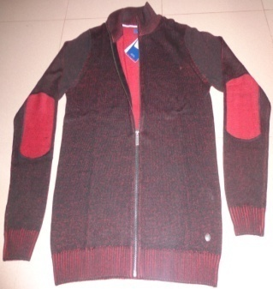
STYLE : HF2018018
YARN : 100% COTTON
GAUGE : 7 GG
DES: MENS PULLOVER

Slide 19
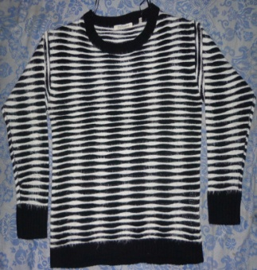
STYLE : HF2018019
YARN : 70% POLYESTER FEATHER 30% ACRYLIC
GAUGE : 5 GG
DES: MENS PULLOVER

